Slide 1

Actions for Marine Protected Areas AMAre
Interreg MED Programme 2014 – 2020
Budget: 2.7 million €
(EU contribution: 2.3 million €)
Duration: 3 years
(November 2016 - October 2019)
Coordinator: prof Simona Fraschetti
CoNISMa
Partners:
CoNISMa, CNR, CMCC, HCMR, IFREMER, CSIC, University of Malta,
Torre Guaceto MPA, Balearic Islands MPA, Sporades MPA, Malta MPA
Bonifacio & Porto Cesareo MPAs
The main objectives of AMAre are to develop:
1- shared methodologies and geospatial tools for multiple stressors assessment, coordinated monitoring/management, multicriteria analyses with stakeholders’ engagements
2- specific pilot actions in selected Marine Protected Areas (MPAs) to solve issues on hot spots of conflicts affecting marine biodiversity and the services it provides
https://amare.interreg-med.eu/

Slide 2

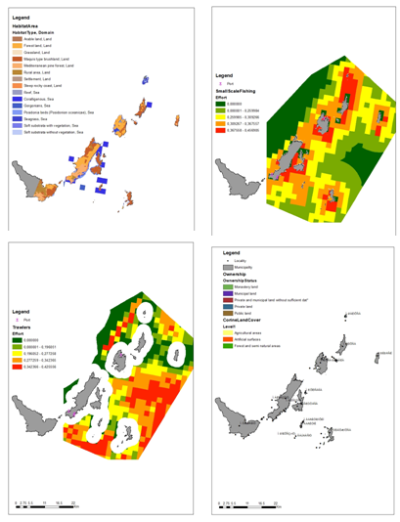
Sporades: 22 layers
Malta: 10 layers
Torre Guaceto: 19 layers
Baleares: 20 layers
spatial geoportal
Monitoring plans with a common set of variables (MSFD – GES)
Monitoring and assessment guidelines
for marine litter
Early warning indicators to alert of an approaching regime shift in marine ecosystem
Collation of spatial information on key ecosystem components & human activities
in the MPAs

Slide 3
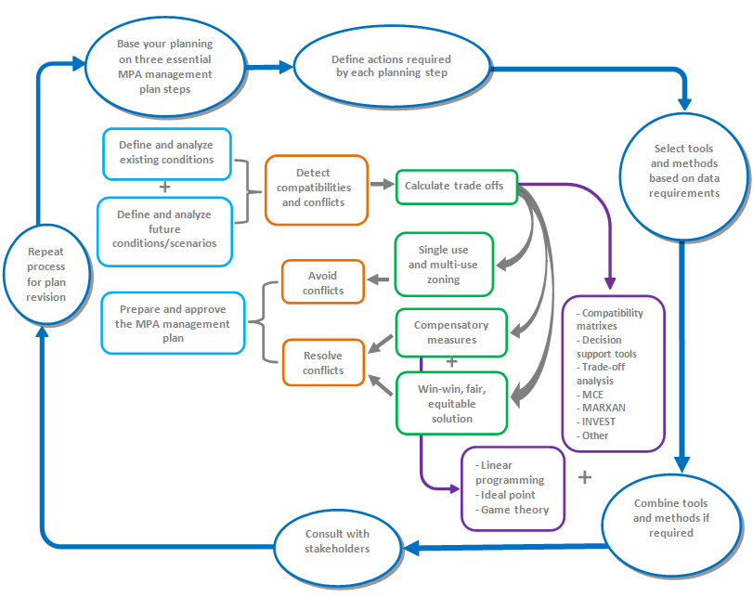
Development of a framework to assess alternative management planning options
Identification of combinations of human uses, limiting present and future conflicts, empowering cost-effective synergies.
Engagement of key stakeholders
Selection of the spatial sea use scenario that will produce results in the most effective (leading toward results), efficient (producing expected results at the least cost), and equitable way (costs and benefits for achieving results are distributed equitably) using trade off analysis balancing between the compatibilities and conflicts by suitable trade-offs between uses.

Slide 4
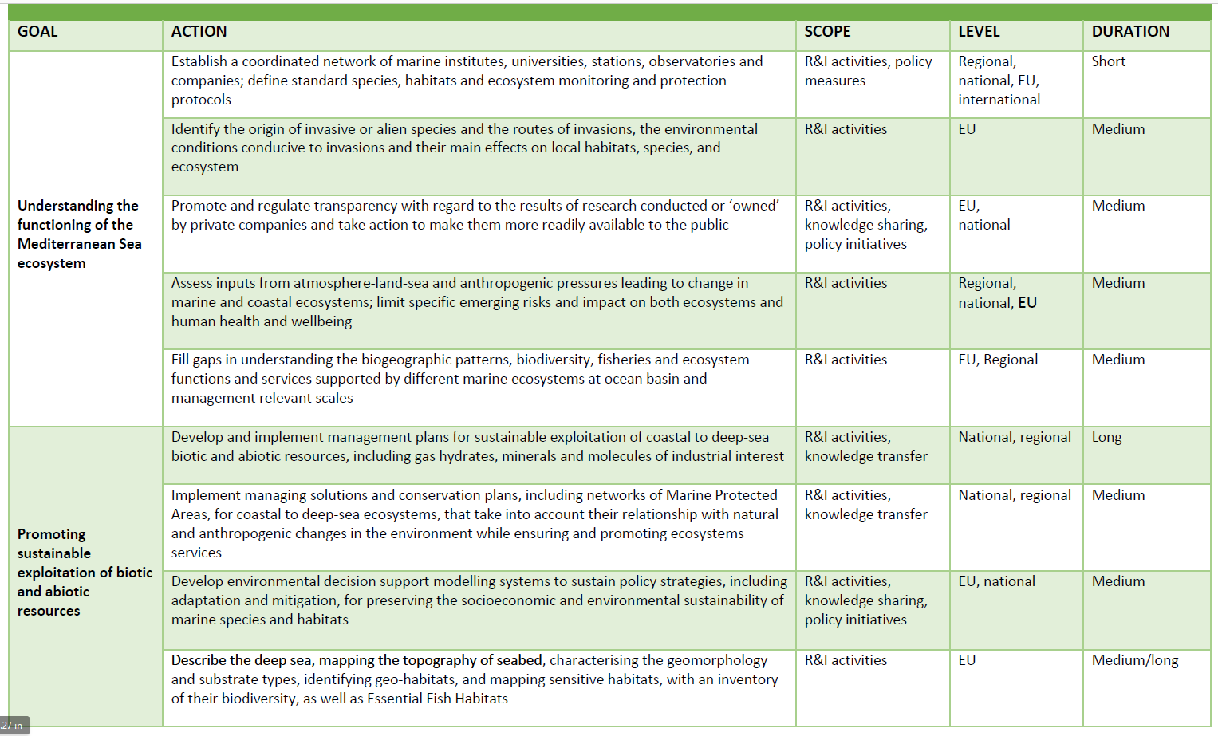

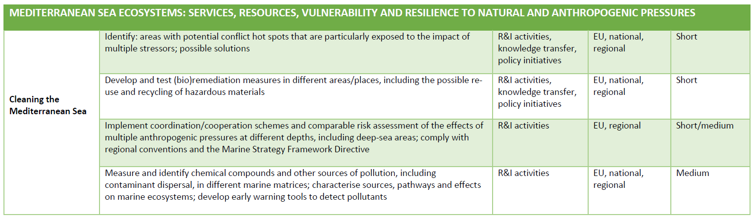
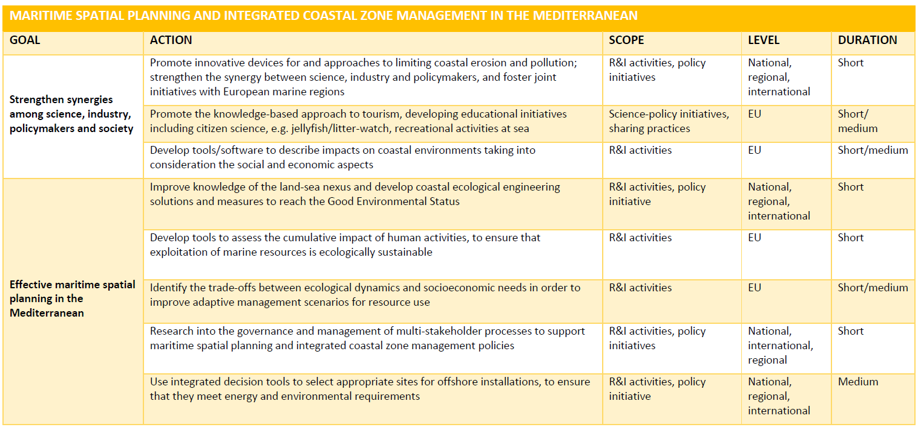

Slide 5






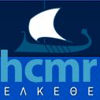



New methodologies for an ecosystem approach to spatial and temporal management of fisheries and aquaculture
in coastal areas - ECOAST
ERA-net COFASP - II Call Coordinator: Dr Fabio Grati
CNR-ISMAR
Duration: 36 months (1st March 2016 – 28 February 2019).
Budget : 2.274.000 Euros
AIM: integrate ecological, social and economic approaches within a unified framework to provide overall information for future development of fisheries and aquaculture in coastal areas, also including spatial conflicts with other users and the stakeholders’ point of view.
http://www.cofasp.eu/node/6080

Slide 6
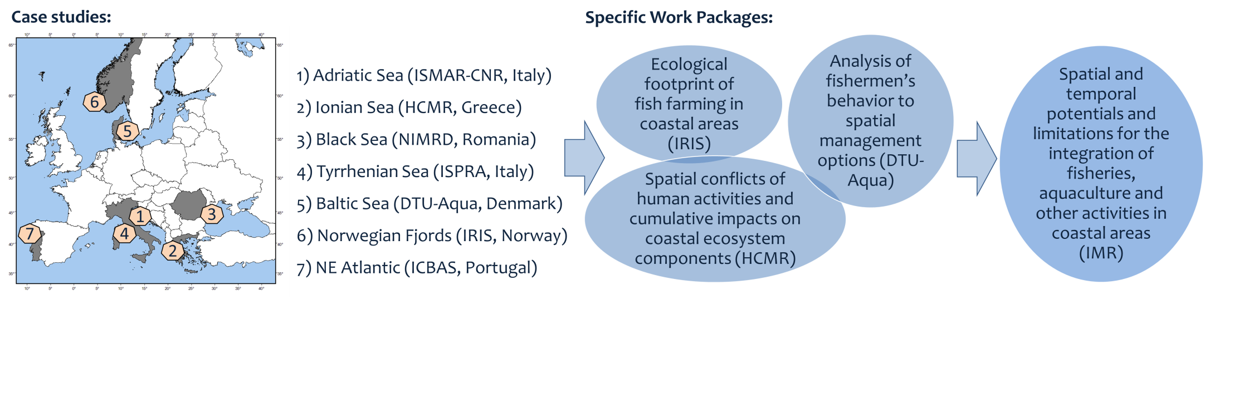

Slide 7

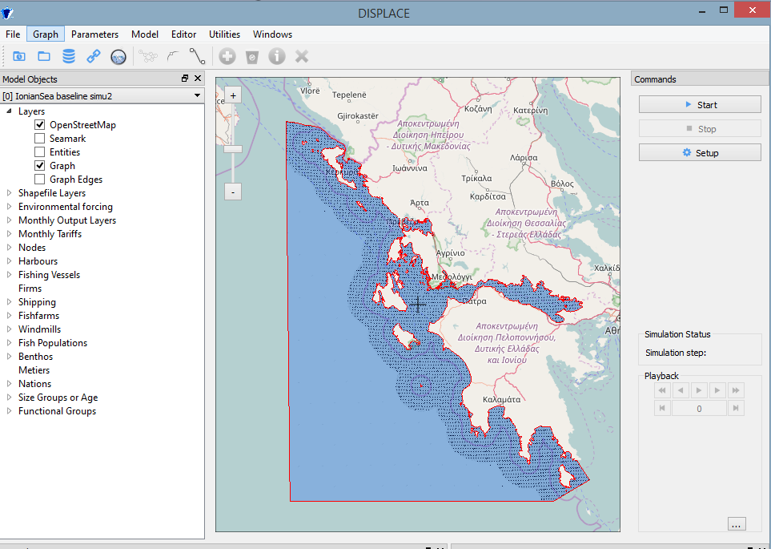
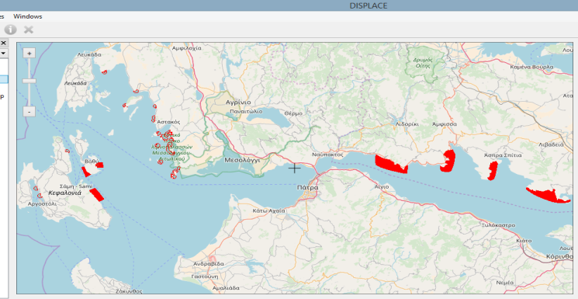
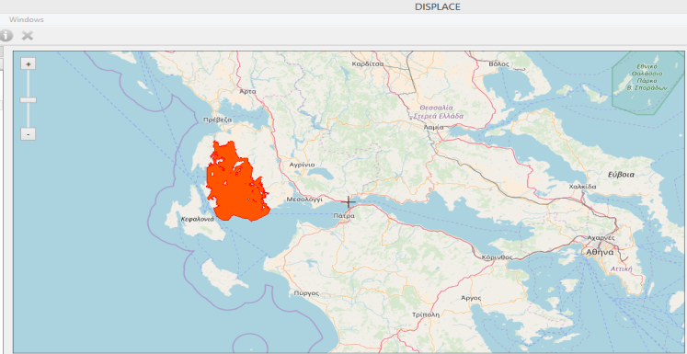
DISPLACE: a dynamic, spatial individual vessel-based modelling approach
Case Study: Eastern Ionian Sea
Data used
Fishing effort
Spatial distribution of species abundance
Vessels specifications per harbor and métier
Stock biological parameters
Stock prices data
Selectivity ogives
Benthic habitats
Scenarios:
Spatial planning scenarios (evaluating against the baseline status quo situation).
Scenario 1: excluding small scale fishing activities from suitable areas for aquaculture development (national management plan)
Scenario 2: excluding trawling activities (April-September) from an area known as hake nursery ground.
Scenario 1:
Scenario 2:
Notes:
What is DISPLACE :
DISPLACE is a fisheries spatial ecosystem impact assessment tool that can be used to look at the consequences of fisheries and the benefits from managing them (including spatial fisheries closures) for a sustainable use and a viable economy of fisheries exploiting marine resources (fish, shellfish). The model simulates the fishing of individual vessels and their capacity to deploy their effort at fishing when constrained by spatial or temporal closures, other managements, and including spatial restriction from other concurrent uses of the sea (fish farms, commercial shipping lanes, wind farm parks). In this context DISPLACE provides a basis for testing scenarios and projects the amount of income generated by national fishing fleets (or the economics of some finer segmentation such as fishing harbor communities) over months, quarters and years.
IONIAN Case study:
Preliminary simulations were first performed to calibrate the model and evaluate whether it was able to mimic the data. The final settings from this calibration process make then the Baseline simulation.
Various spatial plans scenarios will be based against the baseline status quo situation to inform the local policy makers with the predicted outcomes of alternative option in managing the fisheries and the marine space.

Slide 8

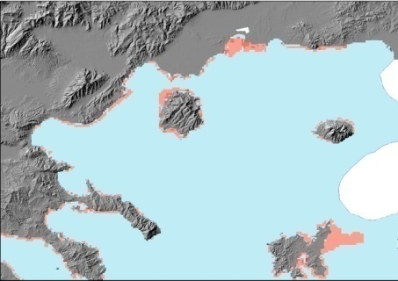
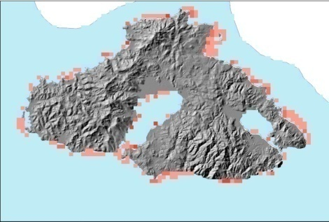
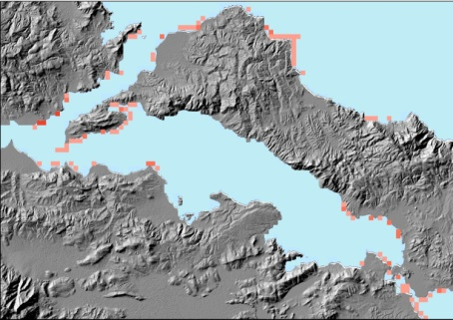
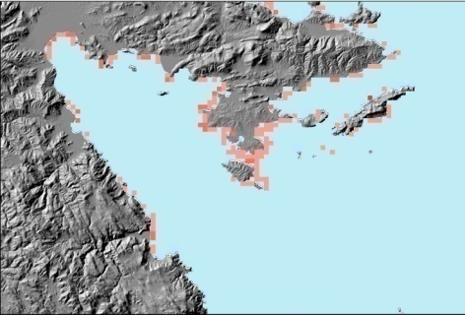
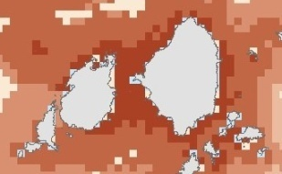
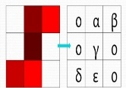
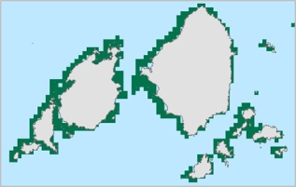



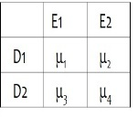
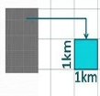
Assess and map the cumulative impact of fisheries and aquaculture on coastal ecosystems
Results
Cumulative impact assessment can be used for the identification of areas where the environmental/ecological components are more exposed to specific anthropogenic pressures.
Aegean Sea
Methodology
D_{i} : human activities (e.g. fishing and aquaculture activities)
E_{j}: ecosystem components
(e.g. seagrass meadows )
μi,j : weight factors (obtained by experts)
According to the impact scores calculated, the total pressure on the ecosystem is in most cases low and medium but there are also areas scoring medium to high
Ι: impact score (Ic) the per-pixel average of each ecosystem component vulnerability-weighted stressor intensities
Notes:
Cumulative impact assessment (CIA) can be used for the identification of areas where the environmental/ecological components are more exposed to specific anthropogenic pressures.
We used CIA as a tool to quantify the spatial conflicts between:
existing human uses and
the key priority seagrass habitat Posidonia oceanica
Combined with other decision making tools CIA can support the Marine Spatial Planning process under an Ecosystem-based Approach as it contributes to the effective management of human activities towards minimizing spatial conflicts and achieving sustainability of the marine resources. Such efforts are of crucial importance as they promote the Blue Growth Strategy concepts.

Slide 9
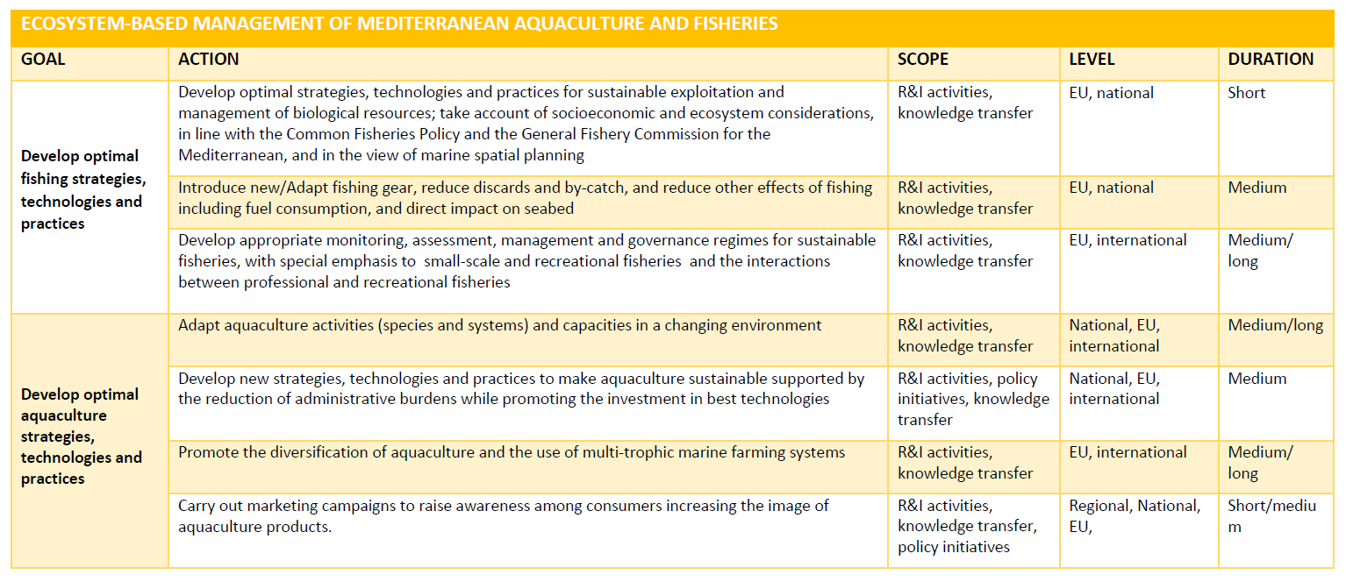

Slide 10

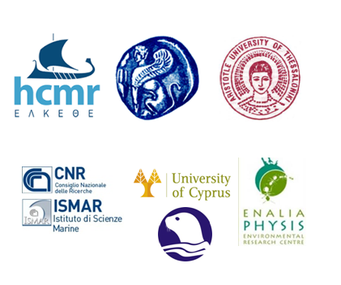
Towards the establishment of Marine Protected Area Networks in the Eastern Mediterranean
Duration: 36 months
December 2016-November 2018
Budget
600 000,00 € EU funding
+ 66886,00 € own resources
Coordinator: Dr Paraskevi Karachle
HCMR
AIM: Propose a Marine Protected Area (MPA) network in Greece & Cyprus, taking into account the protection of ecological characteristics and Essential Fish Habitats (EFH), significant areas for fisheries, as well as their socio-economic impacts through a participatory bottom-up process.
PROTOMEDEA along with MANTIS & SAFENET aim to identify coherent networks of MPAs in the Mediterranean based on sound scientific knowledge to promote sustainable Blue Economy in the region.

Slide 11
EFHs require special protection to improve stock status and long‑term sustainability
sardine
anchovy
Source: Giannoulaki (2017)

Slide 12
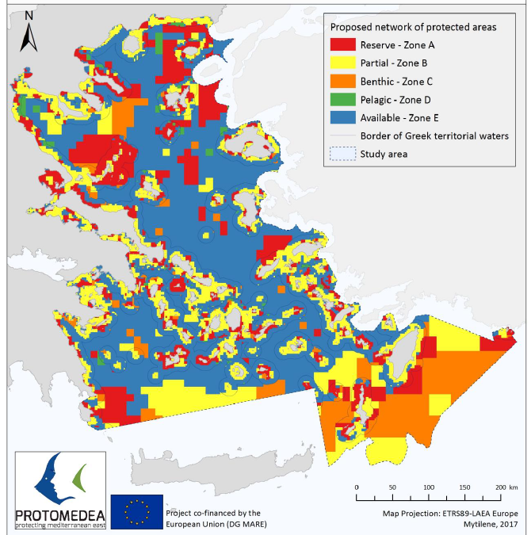
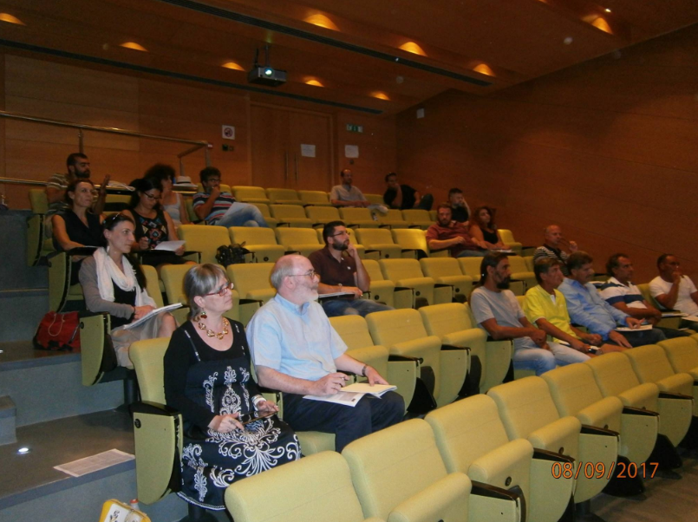
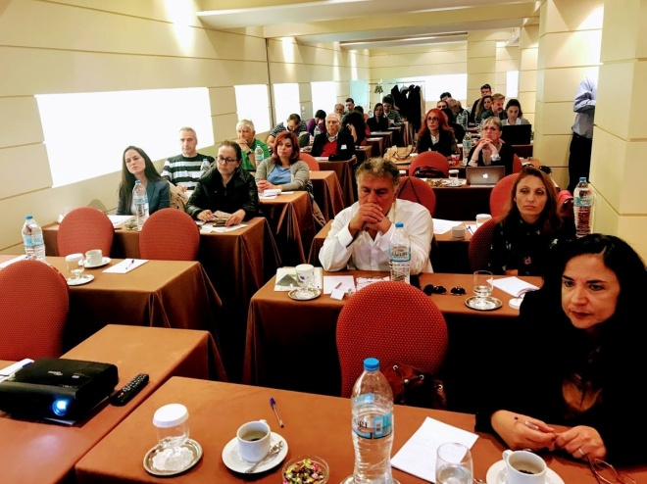
Using MARXAN with zones to design a network of MPAs for fisheries and conservation
Initially proposed plan to be refined using the results from
MSY/ECOPATH modelling
stakeholder perceptions
Source: Markantonatou et al. (2017)

Slide 13



Slide 14

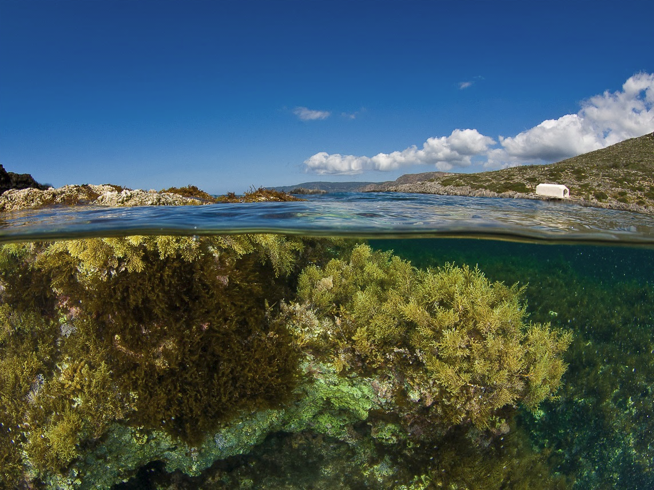
Thank you
for listening!
Photo: Y. Issaris
Celia Vassilopoulou
celia@hcmr.gr

