Slide 1

Villa Bighi, Kalkara, Malta, 11-12.01.2018
BLUEMED Coordinators’ meeting
Including projects in the BLUEMED - Tips for triggering the discussion
Margherita Cappelletto
CNR, BLUEMED Project Manager
bluemed@cnr.it

Slide 2
BACKGROUND INFORMATION/1
BLUEMED shall facilitate the connection of relevant projects and initiatives of the whole Med area, so that results are shared and uptaken while the BLUEMED SRIA is injected and its actions implemented…
  Outcomes of the BLUEMED Conference A Basin of Research and Innovation for Sustainable Growth,
  Sliema, Malta, April 18-19 2017, organized under the Maltese Presidency of the EU Council
  Report available here
Within the Maltese Conference two sessions were dedicated to “Showcasing projects/initiatives which implement the BLUEMED Initiative: how research and innovation can be drivers for sustainable blue growth”
ODYSSEA, Med-Jellyrisk, MedAid Project, COPERNICUS CMEMS, EMSO ERIC, EMBRC ERIC, ProCREW, BIODIVALUE, SUPREME, SIMWESTMED, ARCHEOSUB, BlueNET, FiDaCaMS, BIOVecQ and SecurAqua (projects funded mainly by EC - DG R&I and DG MARE)
www.bluemed-initiative.eu/wp-content/uploads/2017/10/Mediterranean-H2020-projects-final.pdf

Slide 3
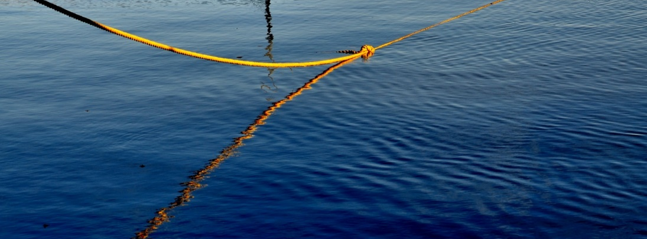
BACKGROUND INFORMATION/2
[…] Concrete actions proposed to create co-ownership
The existing BLUEMED Strategic R&I agenda needs to be updated regularly
[…]
A series of targeted follow up meetings need to be organized to continue the discussions with speakers/partners and share experience, information and tools and interconnect all the different parallel ongoing initiative to:
• better align and go beyond national priorities/jurisdiction;
• learn from each other, e.g. create better interfaces between sectors and actors so as to drive local innovation;
• connect existing initiatives and projects, look at interrelations between sea-land-air;
identify a wide range of existing tools not only from the EU Framework Programme for Research and Innovation, Horizon 2020.
Reccommendation from the BLUEMED session of the technical level meeting on
Strenghtening Euro-Mediterranena Cooperation through Research and Innovation, 3 May 2017, Malta
(www.bluemed-initiative.eu/wp-content/uploads/2017/10/summary-of-BLUEMED-techcnical-meeting-on-3-MAy-BH-150520172.pdf)

Slide 4
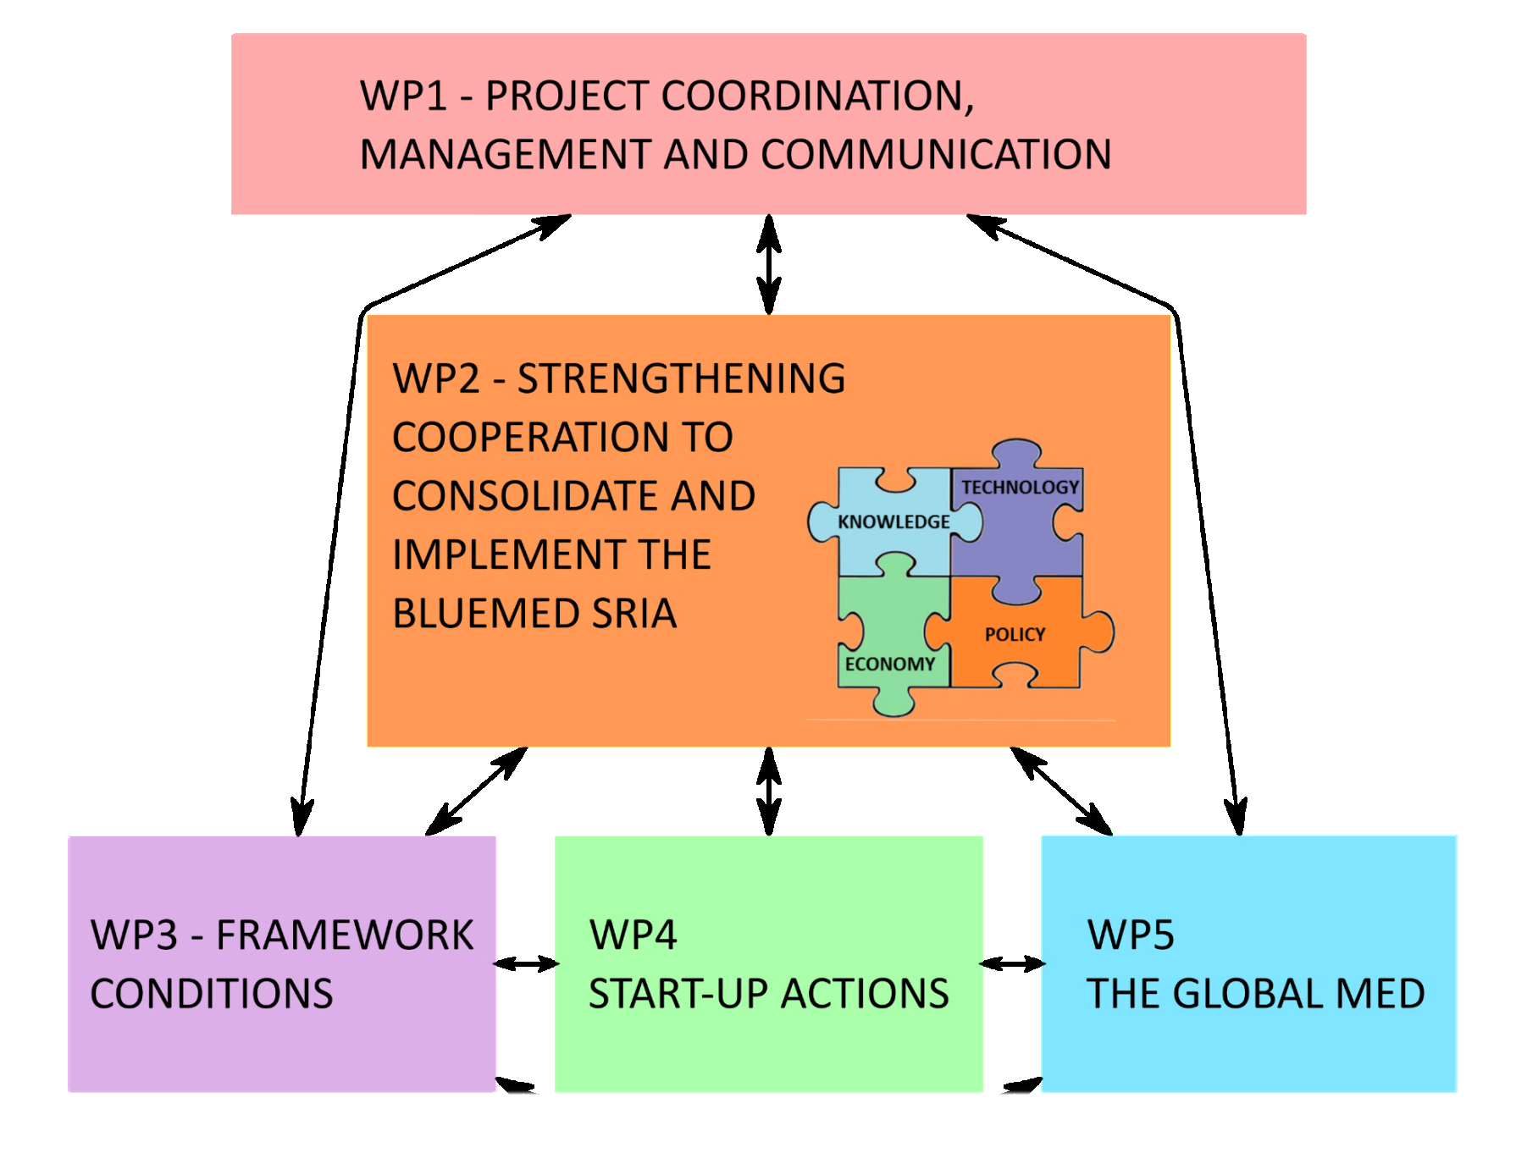
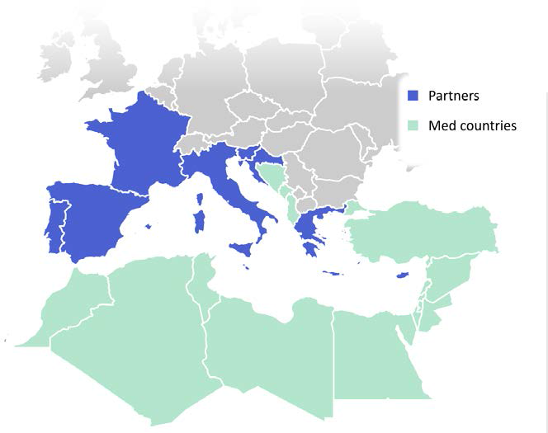
BACKGROUND INFORMATION/3
HERE WE ARE: BLUEMED CSA ACTIVITIES IN SUPPORT TO THE BLUEMED INITIATIVE
T5.1 «CAPITALIZATION OF PROJECTS’ RESULTS WITHIN THE BLUEMED CONCEPT»

Slide 5
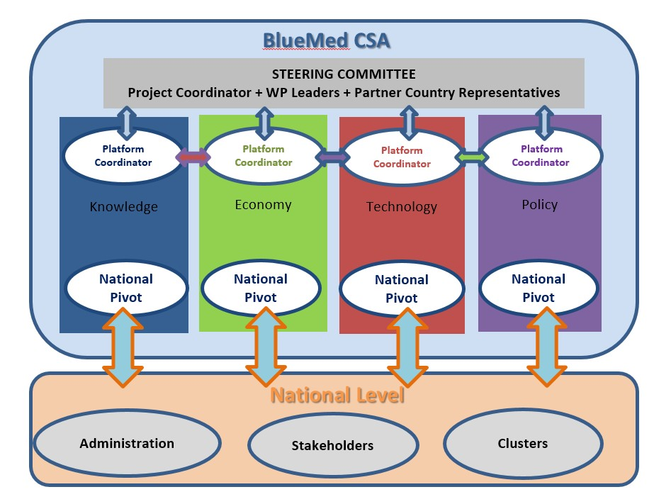
BACKGROUND INFORMATION/4
THE FOUR BLUEMED PLATFORMS ARE WORKING ON THE CONSOLIDATION AND PRIORITIZATION OF THE SRIA AND WILL MEET IN ATHENS ON 1-2 FEBRUARY 2018 TO SHARE THE FINDINGS OF NATIONAL COMMUNITIES

Slide 6

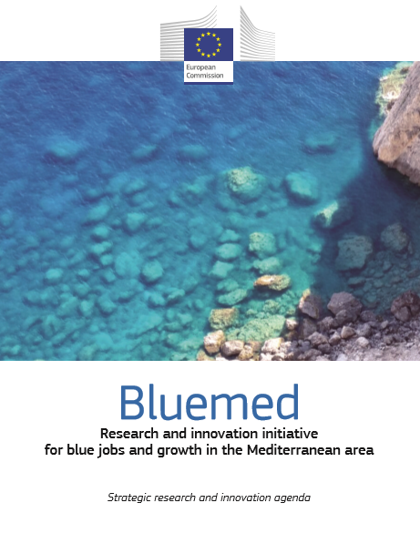
STEP FOWARD/1: HERE YOU ARE >> FROM SHOWCASING TO COOPERATING
ECOPOTENTIAL | H2020 – SC5
MERCES | H2020 – SC5
LEANSHIPS | H2020 – SC3
ODYSSEA | H2020 – SC2
PerformFISH | H2020 – SC2
Sea Litter Critters (and CLAIM) | H2020 – SC2
Muses | H2020 – SC2
LINCOLN | H2020 – SC2
MARIBE | H2020 – SC2
EONAV | H2020 – IND. LEADERSHIP
JERICO-NEXT* | H2020 – INFRAIA
MONGOOS/EuroGOOS* | Network
PANACEA | INTERREG-MED
BLEUTOURMED | INTERREG-MED
AMARe and ECOAST | INTERREG-MED
PERSEUS | FP7
Solaqua | Locally funded
12 key challenges, actions and goals
Key enabling knowledge for the Med (ecosystems, dynamics, coastal areas…)
Key sectoral enablers in the Med (tourism, clusters, MSP, bioresources …)
Enabling technology and capacity creation for the Med (transport, observing systems, off-shore platforms, cultural heritage)
* BLUEMED CSA Deliverable D3.3 «Research Infrastructures Assessment» (www.bluemed-initiative.eu/wp-content/uploads/2017/10/BLUEMED-CSA_Final_D3.3_30.10.2017.pdf)

Slide 7
STEP FORWARD/2: THE MUTUAL BENEFIT
INTERCONNECTING
SHARE ACHIEVEMENTS/METHODOLOGIES AND IDENTIFY GAPS/BOTTLENECKS FOR UPDATING THE BLUEMED SRIA
STIMULATE INTERACTIONS, DIALOGUE AND DISCUSSION, UNDER THE BLUEMED UMBRELLA TO STRUCTURE THE COMPLEXITY AVOIDING FRAGMENTATION
INTEGRATING
COMPARE COLLABORATION INSTRUMENTS AND IMPLEMENTATION DIMENSION (LOCAL, REGIONAL, TRANSNATIONAL)
FAVOUR INTERSECTORAL AND MULTIDISCIPLINARY
APPROACH AMONG DIFFERENT STAKEHOLDERS FOR JOINT PLANNING
DESIGNING INNOVATIVE BLUEGROWTH TRAJECTORIES
ENSURE THE UPTAKE AT POLICY LEVEL (PROVIDE SOLUTIONS AND SUPPORT TO DECISIONS)
PROMOTE COOPERATION AND FUTURE COLLABORATIONS/SYNERGIES

Slide 8
STEP FORWARD/3: TRIGGERING MED SPECIFIC SYNERGIES AND INTEGRATED THEMES
Blue tourism value chains
BLUEMED entrepreneurship hubs
Skills for BLUEMED Jobs
KNOWLEDGE
ECONOMY
TECHNOLOGY
Blue off-shore platforms
Connected secure transport
Turning data into blue services
Response on land-sea interaction
Whealthy BLUEMED ecosystems
A culture of healthy seafood

Slide 9
Thanks for your attention and have a fruitful working time!
Do not forget to sign up to our newsletter (www.bluemed-initiative.eu/newsletter/),
link to our Twitter account @BlueMedEU
and register your project on the Virtual Knowledge Center by the Union for Mediterranean at www.med-vkc-blueconomy.org/vkc-network/register/

