Slide 1

Villa Bighi, Kalkara, Malta, 11-12.01.2018
BLUEMED CSA Coordinators’ meeting
The BLUEMED Initiative
Fabio Trincardi
CNR, BLUEMED CSA Coordinator
fabio.trincardi@cnr.it

Slide 2
BLUEMED is the Research and Innovation Initiative for promoting the blue economy in the Mediterranean Basin through cooperation and alignment of programmes.
It is the strategy of reference to work together for a better known, healthy, safe and productive Mediterranean Sea
Unique biodiversity
2nd largest market for cruise ships
30% of global sea-borne trade by volume and ¼ oil traffic
450 ports and terminals
Geopolitical complexity
Coastal pressure
Safety and security issues
400 UNESCO sites
Culture of environmental healthy life
Resources over-exploitation
236 Marine Protected Areas
Choke points in the Mediterranean

Slide 3
THE PROCESS SO FAR…
Oct 2015 >> Venice Declaration endorsed by 10 EU Member States and launch of the BLUEMED Strategic R&I Agenda
Oct 2016 >> BLUEMED CSA begins
April-May 2017 >> BLUEMED Conference under Malta Presidency of EU Council, SRIA 1st update, and Valletta Declaration signed by the Union for Mediterranean and EU Member States
Dec 2014 >> Priority of the Programme of the Italian Presidency of the EU Council
Nov 2017 >> Launch of the process to establish a BLUEMED WG within EU-Med GSOs on R&I*
* Evolution of the governance: the BLUEMED Initiative has being coordinated by a Strategic Board chaired by Italy, together with EC DG RTD and DG MARE, and composed by state representatives of Cyprus, Croatia, France, Greece, Malta, Slovenia, Spain, Portugal, and Belgium. Recently, Montenegro joined it. The Strategic Board counts on the CSA BLUEMED for the implementation of some strategic actions as well as on experts, including from JPI Oceans and some of the other R&I initiatives in place in the Mediterranean area.

Slide 4
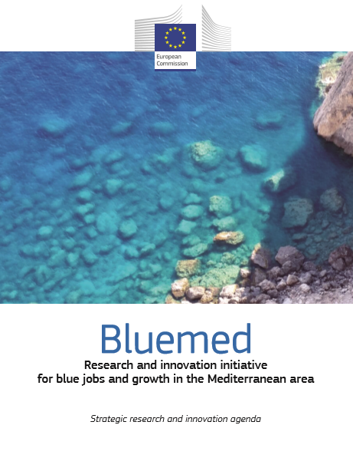
BLUEMED ‘mantra’ – The Strategic Research and Innovation Agenda
Sharing, update, implement
The BLUEMED Initiative will contribute to the creation of new ‘blue’ jobs, social wellbeing and a sustainable growth in the marine and maritime sectors through the implementation of the Strategic Research and Innovation Agenda, the BLUEMED SRIA
12 key challenges, actions and goals
Key enabling knowledge for the Med (ecosystems, dynamics, coastal areas…)
Key sectoral enablers in the Med (tourism, clusters, MSP, bioresources, …)
Enabling technology and capacity creation for the Med (transport, observing systems, off-shore platforms, cultural heritage)

Slide 5
Priorities
Facilitate BLUEMED SRIA adoption by each BLUEMED country in their national plans for Research&Innovation, Bioeconomy strategies, Regional Smart Specialization Strategies.
Engage non-EU MED Countries in the process, i.e. for consolidating the SRIA
Promote cooperation among initiatives/actors active in the area, e.g.:
- EU Strategy for the Adriatic Ionian Region (EUSAIR) - Western Mediterranean initiative (WEST MED);
- CIESM, CIHEAM, CPMR, GFCM, INTERREG MED, UNEP-MAP, Bologna Charter;
- major on going EU/international projects (R&I, training, education), technology clusters and platforms
Impacts
BLUEMED SRIA priorities were adopted by the EC, and included in R&I Programmes
DG RTD – H2020 SC2 Work Programme 2016-2017, six BLUEMED R&I priorities included
EC DG-MARE Call for proposals:
> Blue Labs - innovative solutions for maritime challenges & Blue Careers in Europe (May, 2016)
> Blue Technology - transfer of innovative solutions to sea basin economies (Sept 2016)
> Blue networks for the Mediterranean (Feb 2018)
> Joint Actions for a sustainable Blue economy in the Mediterranean (Feb 2018)
Create the conditions for commitment and investments/develop new market opportunities
Improve coordination between regional-national-EU-international stakeholders and policies
DG RTD – H2020 SC2 Work Programme 2018-2020, to BLUEMED Initiative as one reference strategy in 3 Blue Growth calls
About € 50 M allocated to the Area

Slide 6
DG RTD – H2020 SC2 Work Programme 2016-2017, six BLUEMED R&I priorities included
BG-07-2017: Blue green innovation for clean coasts/seas (IA,12M, 2017) CLAIM and GoJelly
BG-12-2016: Towards an integrated Med Sea Observing System (IA, 8M, 2016) ODYSSEA
BG-13-2016: Support to the BLUEMED Initiative: Coordination of marine and maritime research and innovation activities in the Mediterranean (CSA, 3M, 2016) BLUEMED
SFS-20-2017: Towards a science-based regionalisation of the Common Fisheries Policy (RIA, 6M, 2017)
SFS-21-2016/2017: Advancing basic biological knowledge and improving management tools for commercially important fish and other seafood species (RIA, 5M) FAR FISH(2016)
SFS-23-2016: Improving the technical performance of the Mediterranean aquaculture (RIA, 6M, 2016) MedAID and PerformFISH
Other H2020 R&I projects addressed to boost blue growth the Mediterranean area are on-going (www.bluemed-initiative.eu/mediterranean-h2020-projects/)

Slide 7
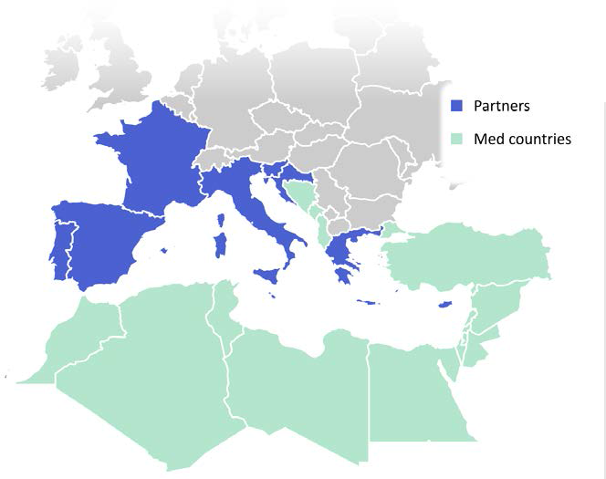
BLUEMED Coordination and Support Action
11 PARTNERS, COORDINATED BY CNR (IT)
9 COUNTRIES
4 YEARS (from 1st Oct 2016)
2,998 K€ EC FUNDS
What is «special» in this Coordination and Support Action?
  It directly supports a political initiative
  It has specific objectives and activities that are major tools and steps towards a wider and more ambitious goal

Slide 8
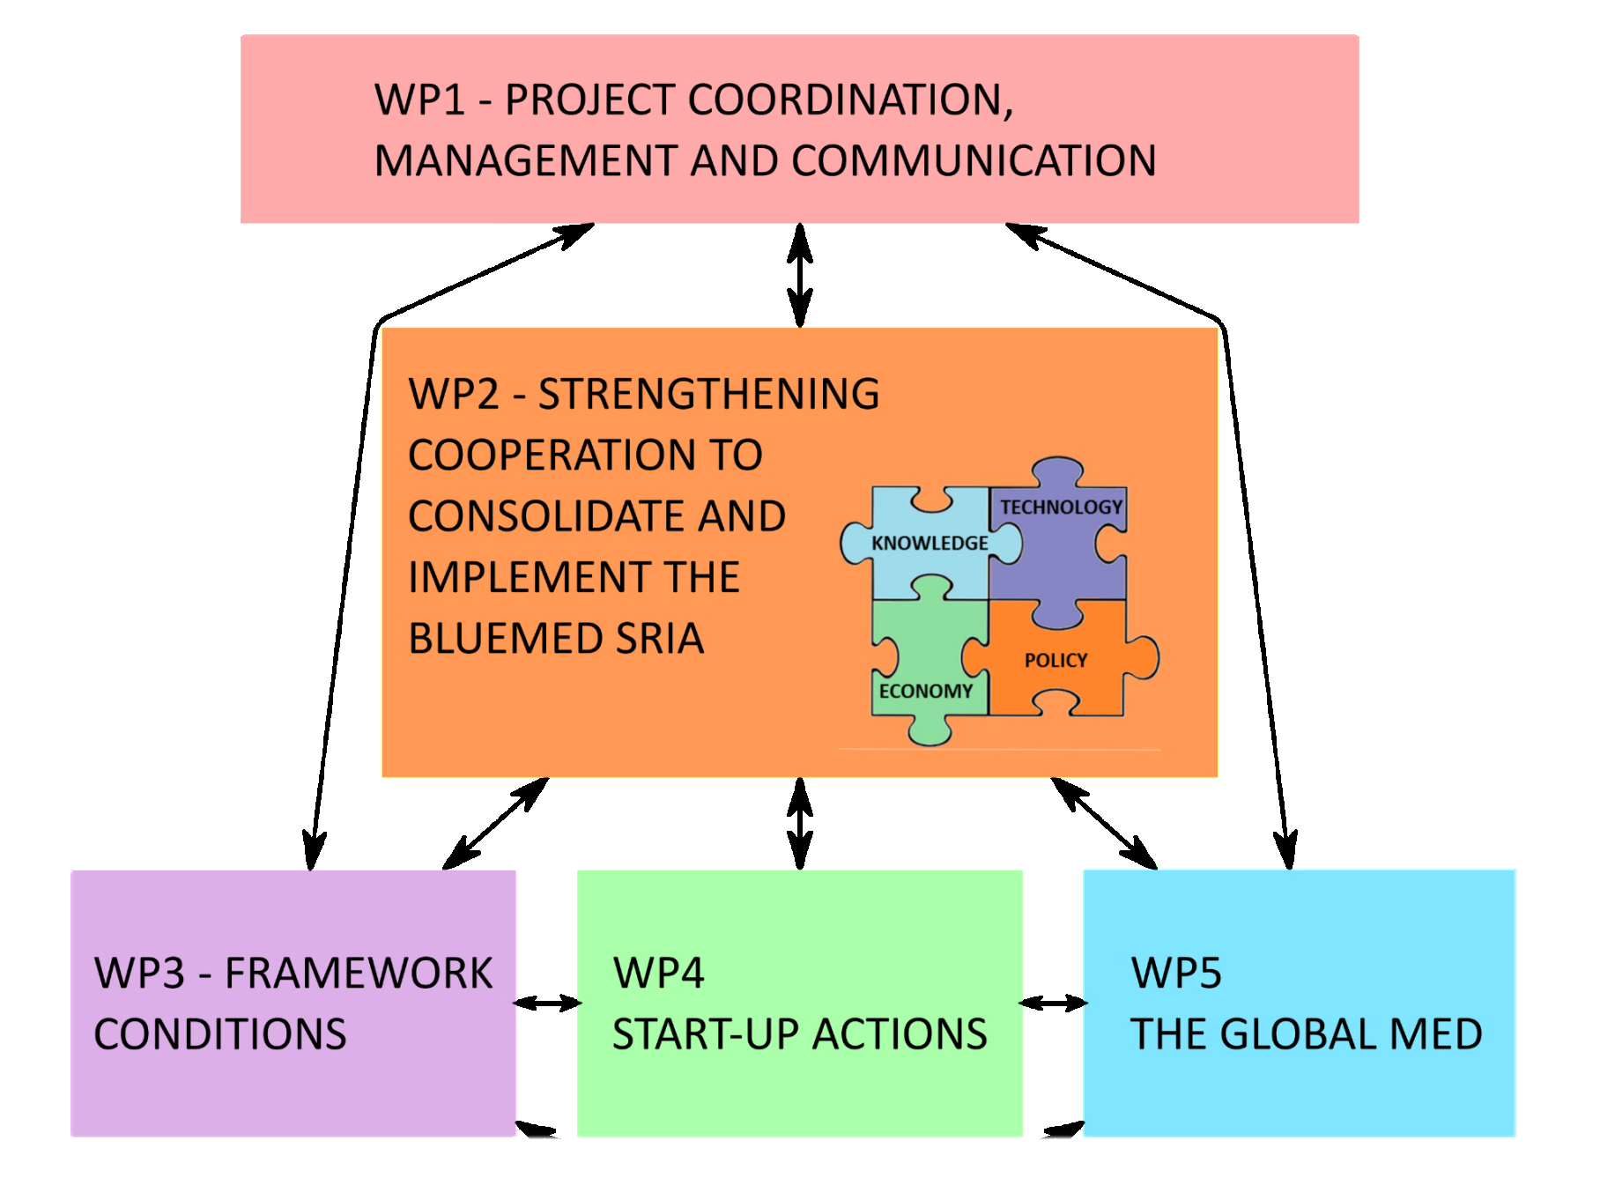
BLUEMED CSA ACTIVITIES AND STRUCTURE
bluemed-initiative.eu
@BlueMedEU
Newsletter
Research Infrastructures
Data
Human Resources
Indicators

Slide 9
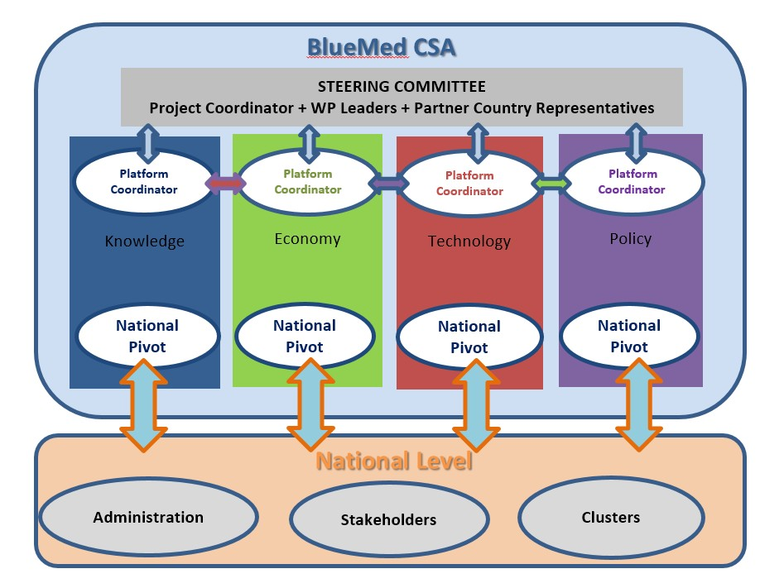
BLUEMED Platforms
A long lasting tool for stakeholders’ consultation and engagement
Setting the frame for the effective coordination of research and innovation activities at transnational level, consolidating networks and establishing mechanisms that will remain and be further developed after the conclusion of the project
thematic, transnational, interconnected, open, flexible

Slide 10

BLUEMED Platforms, design and objectives
Operative environments where national representatives interact to convey the messages form their sectors
Fora to address the needs of both the BlueMed CSA partner countries and the Mediterranean as a whole by promoting and supporting integrated efforts in the fields of science, technology, economy and policy
  Allow cross-national communication & interplay among research, private sector, public administration & civil society via participation of stakeholders from different levels, regions, initiatives, etc
Working place for consolidating and updating the SRIA, support prioritization of topics and actions, support discussion on joint implementation & network of research funders, address & provide inputs to the SRIA Implementation Plan
Have a significant effect on the development of a consistent, and coherent national policy of coastal and maritime activities
Provide suggestions for the relevant EU policies for the Mediterranean area

Slide 11
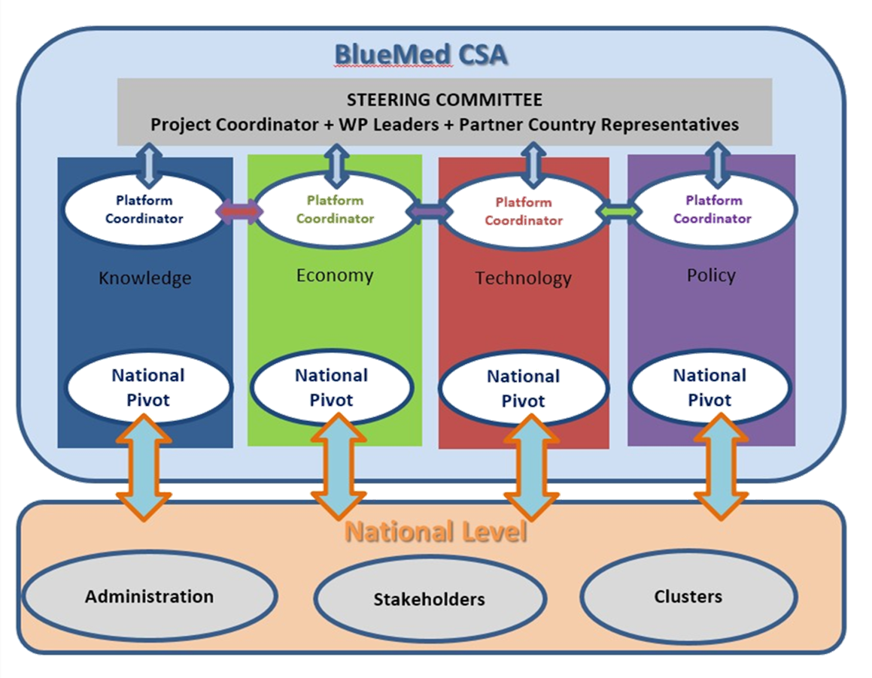
BLUEMED Platforms, composition
Permanent members
Platform Coordinator
National representatives (one per platform): Pivots
BLUEMED CSA partners’ representatives
Non-permanent members / observers
WP - Task Leaders / Interested CSA Partners, Invited Experts/ Stakeholders, Members of the BLUEMED Advisory Board
BLUEMED Pivots
Key contributors to Platform operation appointed at national level as representatives of different partner countries on the four specific platform themes
Acting as main interface between the Consortium and the stakeholders at national level, contribute to increasingly mobilize other relevant national stakeholders by collecting and conveying their messages and bringing back feedbacks for SRIA updates
OPEN AND FLEXIBLE
Representatives in the MED Platforms maintain and promote a constant dialogue with national communities (through mirror mechanisms or fora), existing networks, international organizations, etc.

Slide 12
BLUEMED CSA Expected Achievements
Change the mindset for growing blue in the Med Area envisioning the Med Basin as a spot for innovation
BLUEMED SRIA consolidated and updated through cooperation across the Med
1 BLUEMED Implementation Plan
4 BLUEMED Platforms
1 Network of funders and key players
3 to 5 Start-up Actions
n+1 people in the BLUEMED Community
5 BLUEMED Ambassadors
in support to
- overcoming key innovation bottlenecks
- creation>improvement>valorisation of national and local experiences in line with the BLUEMED Vision
- implementation of effective participatory mechanisms
- increased innovation capacity and competitiveness
- alignment of programmes and maximization of fund streamlines
- development of research/industry/policy /society virtuous relationship…and the environment
- enhanced mechanisms for knowledge based policy decisions

Slide 13
BLUEMED CSA – Key actions in support to the BLUEMED Initiative
Support to the organization of high level event BLUEMED Conference A Basin of Research and Sustainable Growth under the Maltese Presidency of the EU Council, 18-19 April 2017
Set-up of 4 BLUEMED Platforms at Med and national level to consolidate and update the SRIA towards the definition of the Implementation Plan (next meeting in Athens on 1-2 February 2018)
Support to the engagement of non-EU countries via the BLUEMED policy dialogue workshop on Building a shared research and innovation agenda for blue jobs and growth across the Mediterranean organized in the framework of the Union for Mediterranean Regional Stakeholders’ Conference, Naples, 30 November 2017
Meeting with coordinators of relevant projects/initiatives to capitalize on results, Villa Bighi, Kalkara, Malta, 11-12 January 2018

Slide 14
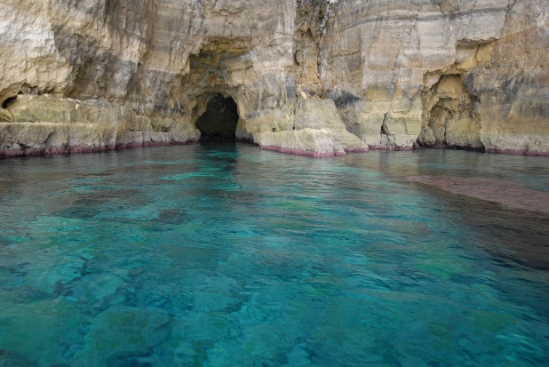
Thanks for your attention!

