Slide 1






The Community of Sustainable Tourism in the Mediterranean Region
BleuTourMed Interreg Med project
Nelly Bourlion, program officer, UNEP- MAP- Plan Bleu
11 January 2018
BlueMed Coordinators’ meeting , Malta

Slide 2
THE INTERREG MED PROGRAMME : AN INNOVATIVE APPROACH
Notes:
The BleutourMed C3 project is co-financed by the INTERREG MED program.
European territorial cohesion project.
13 countries- northern rim
Modular Projects (MP) - thematic
Module-based approach with different phases: Studying, Testing, Capitalizing
- Phase of study and development of strategies and policies
- Phase of testing, to validate the hypothesis developed
- Phase of transferability and capitalization of results at the transnational level
Horizontal Project (HP)
unifying element of a thematic community of modular projects
HP are in charge of community building, joint communication and joint capitalization
BleuTourMed – HP corresponding to the sustainable tourism community

Slide 3







BleuTourMed Project : Who we are
Associated Partners
CPMR, Medcities, Università di Catania Università degli Studi di Bari "Aldo Moro”, University of Girona; Greek Tourism, Agency for tourism promotion “inLiguria”; Metropolitan Cty of Florence, Valencia Provincial Council; Provincial Government of Málga; Province of Livorno; Region of Thessaly; Hellenic Development City Network DEPAN; South Aegean Region; Europarc Italy; PAP-RAC; Genoa Municipality University of the Aegean – Research Unit, University Mediterranean Podgorica, Faculty of Tourism, Metropolitan City of Turin; UICN-Med; Euromed réseau des Villes; CAT-MED;
Notes:
6 Partners of BleuTourMed :
PLAN BLEU: Francia
Diputación de Barcelona
UNIMED – Red de Universidades en el área mediterránea, que tiene su sede en Roma
Universidad de PANTEION, Grecia
Adriatic Ionian Euroregion (Croacia)
Arco Latino
Budget of 1.4 M€
3 years – Oct 2016 – Oct 2019.

Slide 4
BleuTourMed : OBJECTIVES
To facilitate the knowledge sharing and the capitalization of results of 14 Modular Projects of MED Community on Sustainable Tourism
Community building (CB) keeping the community active, synthesizing and harmonizing the results of the MPs, identifying possible common thematic objectives, synergies on methods and tools and common spatial context.
Communication (COM) driving external flow of information on results of the community to the Med Programme, other horizontal projects and the main EU and MED target groups.
Capitalisation (CAP) transferring results delivered by MPs to a variety of target groups and stakeholders at EU and MED level, in order to mainstream project results and policy messages.
Notes:
The BleutourMed C_3 project manages
the coordination of communication, the exchange of experiences and the capitalization of 14 European projects focused on sustainable tourism, which seek to find common solutions to problems related to coastal and maritime tourism in the Mediterranean.
Created a network of 200 public and private entities that act and speak with a single voice.

Slide 5
BleuTourMed : A NETWORK AND A COMMUNITY
MEDFEST
MITOMED+
TOURISMED
BLUEISLANDS
SIROCCO
EMbleMatiC
CO-EVOLVE
ALTER ECO
DestiMED
CONSUME-LESS
SΗΑPETOURISM
CASTWATER
MEDCYCLETOUR
BLUEMED
To enhance a more efficient valorisation of natural resources and cultural heritage in coastal and adjacent maritime areas for a sustainable and responsible coastal and maritime tourism development in the MED area
Notes:
This image is very significant because it explains what we are trying to do:
That the 14 projects exchange experiences, instruments, problems and solutions, and that the impact of their findings is larger
To create a community of projects and actors in the Mediterranean area that want to improve the quality of tourism in their territories through actions that improve the social, economic and environmental sustainability of tourism.

Slide 6
BLEUTOURMED : EXPECTED RESULTS
Integrate tourism development into wider strategies
(ICZM, MSP, tourism in regional development policies)
Enhance sustainable and responsible tourism management through:
  Improving planning management of costal tourist destinations
  Preventing negative impacts on natural and cultural heritage
  Promoting an innovative sustainable and high quality offer
Types of expected results:
17 instruments will enhance the development of sustainable and responsible tourism
108 tourist destinations will be covered by a sustainable tourism evaluation tool
11 strategies will be applying sustainable tourism management criteria
144 regions and sub-regions will be engaged in implementing sustainable tourism plans
Notes:
improvement and adaptation of cooperation strategies, public policies, economic activities and joint planning tools; coordinated actions between public authorities of different MED territories; action plans and transfer of practices

Slide 7
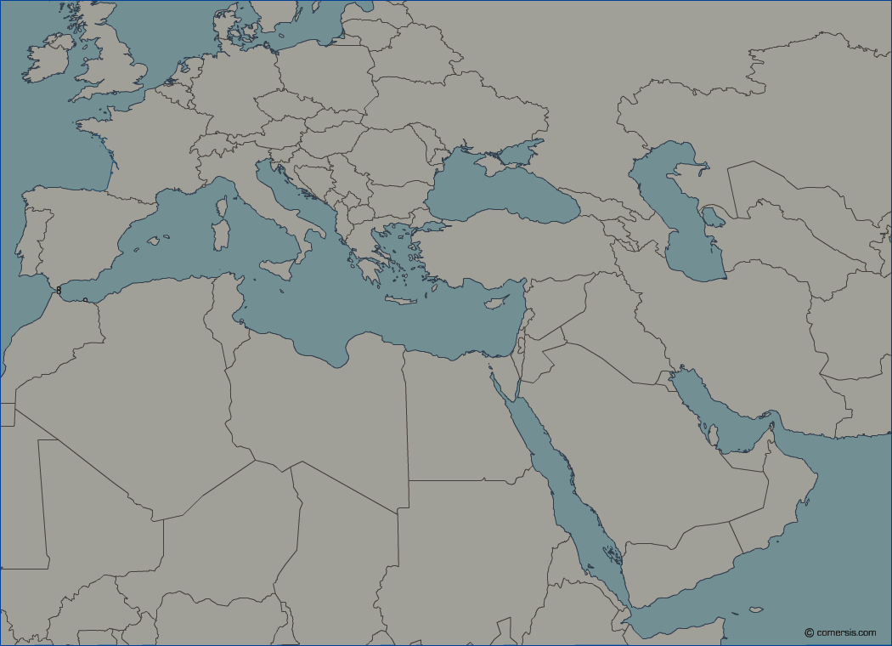
The Sustainable Tourism Community : WHERE WE ARE
(SL)
MEDCYCLETOUR
EMBLEMATIC (Languedoc-Roussillon, PACA)
CO-EVOLVE (Occitanie)
DESTIMED
TOURISMED
MEDCYCLETOUR
ALTERECO-CO-EVOLVE-BLUEMED-SIROCCO (Jadranska Hrvatska)
BLUEISLANDS
DESTIMED
MITOMED+ (Istria)
MEDCYCLETOUR
(FR)
EMBLEMATIC (Abruzzo, Sicily)
BLUEISLANDS (Sicily, Sardegna)
ALTERECO (Liguria, Veneto)
CO-EVOLVE (Emilia-Romagna, Veneto)
BLUEMED (Campania, Calabria)
CONSUME-LESS (Sicily)
DESTIMED
SIROCCO (Lazio)
TOURISMED
MITOMED+ (Tuscany)
MEDCYCLETOUR
(HR)
SIROCCO (Lisbon)
EMBLEMATIC
CONSUME-LESS (Saranda)
DESTIMED
TOURISMED
(PT)
EMBLEMATIC (Catalonia, Balearic islands)
BLUEISLANDS (Balearic islands)
ALTERECO (Andalusia, Valencian Community)
CO-EVOLVE Valencian Community)
CONSUME-LESS (Andalusia)
DESTIMED
TOURISMED
MITOMED+ (Catalonia, Andalusia)
MEDCYCLETOUR
(AL)
EMBLEMATIC (Central Macedonia)
ALTERECO-BLUEISLANDS-CONSUME-LESS-SIROCCO (South Aegean)
BLUEMED (Thessaly)
CO-EVOLVE (Eastern Macedonia-Thrace)
CASTWATER-BLUEISLANDS- EMBLEMATIC (Crete)
TOURISMED
MEDCYCLETOUR
(IT)
(GR)
BLUEISLANDS
SIROCCO (Limassol & Larnaca)
TOURISMED
MITOMED+
MEDCYCLETOUR
(ES)
(MT)
BLUEISLANDS
CONSUME-LESS (Gozo)
(CY)
Notes:
In this map you can see the geographical distribution of the projects involved:
The partners of the MP are from Portugal, Spain, France, Italy, Malta, Slovenia, Croatia, Albania, Greece, Cyprus.
+ Pilot Activities
As you can see, the projects include the entire Mediterranean basin.
Here are some of the main points of our community: to include most of the territories of the Mediterranean basin means to create a significantly strong community.

Slide 8
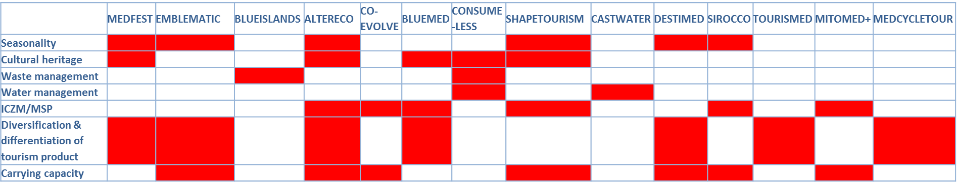
The Sustainable Tourism Community : THEMATIC OBJECTIVES

Slide 9
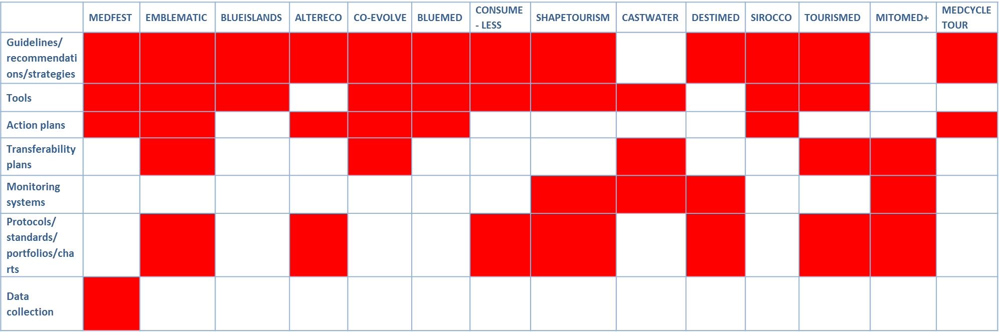
The Sustainable Tourism Community : KEY DELIVERABLES

Slide 10
POTENTIAL LINKS WITH BLUEMED INITIATIVE
Sustainable innovations in the tourism sector
  A focus on sustainable tourism innovations in one of the MED ST Community's deliverables (e.g. within the knowledge database, or in a factsheet)
  Athens Declaration of the MED Sustainable Tourism Community already published on BlueMed’s website
Notes:
This meeting to find some more………

Slide 11

FOR More information
THANK YOU
Nelly Bourlion, program officer, UNEP-MAP-Plan Bleu
nbourlion@planbleu.org
Notes:
Very brief overview of the project
Much more information on our dedicated website
Some factsheets and documents available

