Slide 1
Project presentation – 11th Jan’18
Presenter: Kris Lemmens (ONL)

Slide 2
Project description
“Earth Observation for Maritime Navigation”
Problem statement
From ship company standpoint
Increasing fuel costs, increasing environmental regulatory pressure, safety issues, maintenance costs
From environmental standpoint
Increasing air pollution (GHG, SOx, PM), increasing water pollution
Goal statement
Increase a ship’s energy efficiency
Lower fuel consumption
Lower emissions
Increase navigational safety of maritime transport

Slide 3
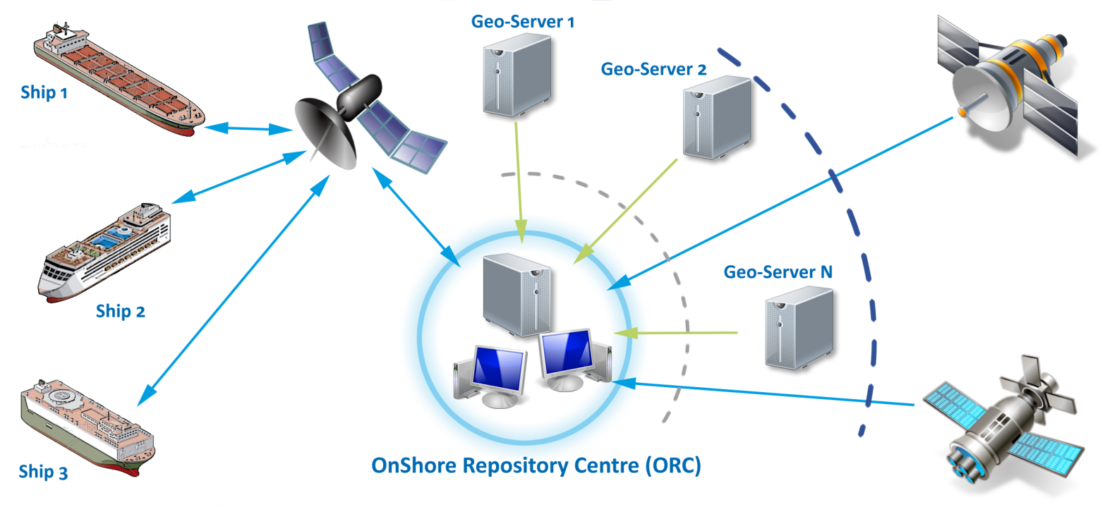
Project description
Approach
Weather routing
To avoid hazardous and unfavourable weather
Route optimization
To take advantage of favourable atmospheric and oceanic conditions
Implementation
Advanced route planning system
Combines remote sensing (satellite) earth observations (EO) with in-situ and local ship observations to correct and improve weather predictions from multiple forecast providers
Uses smart algorithms to learn over time strengths and weaknesses of predictions and observations
Includes advanced ship performance models to simulate route outcome
Combines multiple optimization algorithms to arrive at best possible solution

Slide 4
Project description
Expected result
Reduced fuel consumption up to 7% and more due to sailing with currents and winds
Reduced emissions up to 7% and more due to reduced fuel consumption
Increased service life of ships up to 15% due to reduced exposure to heavy weather
Increased crew/passenger safety due to avoidance of heavy/stormy weather
Increased structural safety due to weather related hull stress and hull wear and tear monitoring
Reduced ‘accidental’ pollution due to better timed maintenance and inspection
“Just as you use a car navigation software to optimally navigate a static network of streets, shipping companies can use EONav to optimally navigate a dynamic network of currents, winds and waves.”

Slide 5
Relation to Bluemed SRIA
SMART, GREENER MARITIME TRANSPORT AND FACILITIES IN THE MEDITERRANEAN
Develop innovative design and management solutions for (eco-friendly vessels and) fuel saving
R&I activities, knowledge sharing and transfer, policy initiatives
EU & International level
Short to medium duration

Slide 6
Offshore Navigation Ltd
A Small Medium Enterprise (SME) technology company developing navigation solutions and services for the maritime transport industries
Tel: +44 20 3287 3300
+44 20 3608 2870
Website: offshorenavigation.com
E-mail: info@offshorenavigation.com
kris.lemmens@Offshorenavigation.com

