Slide 1


















Slide 2


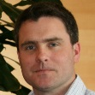
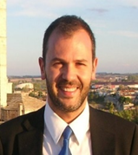

EuroGOOS Office
Erik Buch
EuroGOOS Chair
Senior consultant on EU projects
Dina Eparkhina
Policy and Communications Officer
EuroGOOS, EOOS, EU projects, EP
Glenn Nolan
Secretary General
Oversight and Office
Vicente Fernandez
Science Officer
AtlantOS, Data integration
Patrick Gorringe
Senior Operations Officer
Task Teams, Data projects, DATAMEQ
Orla Colligan
Administrator
Office support, financial monitoring
4 full-time staff members based in Brussels
3 offices provided by BELSPO at Avenue Louise

Slide 3
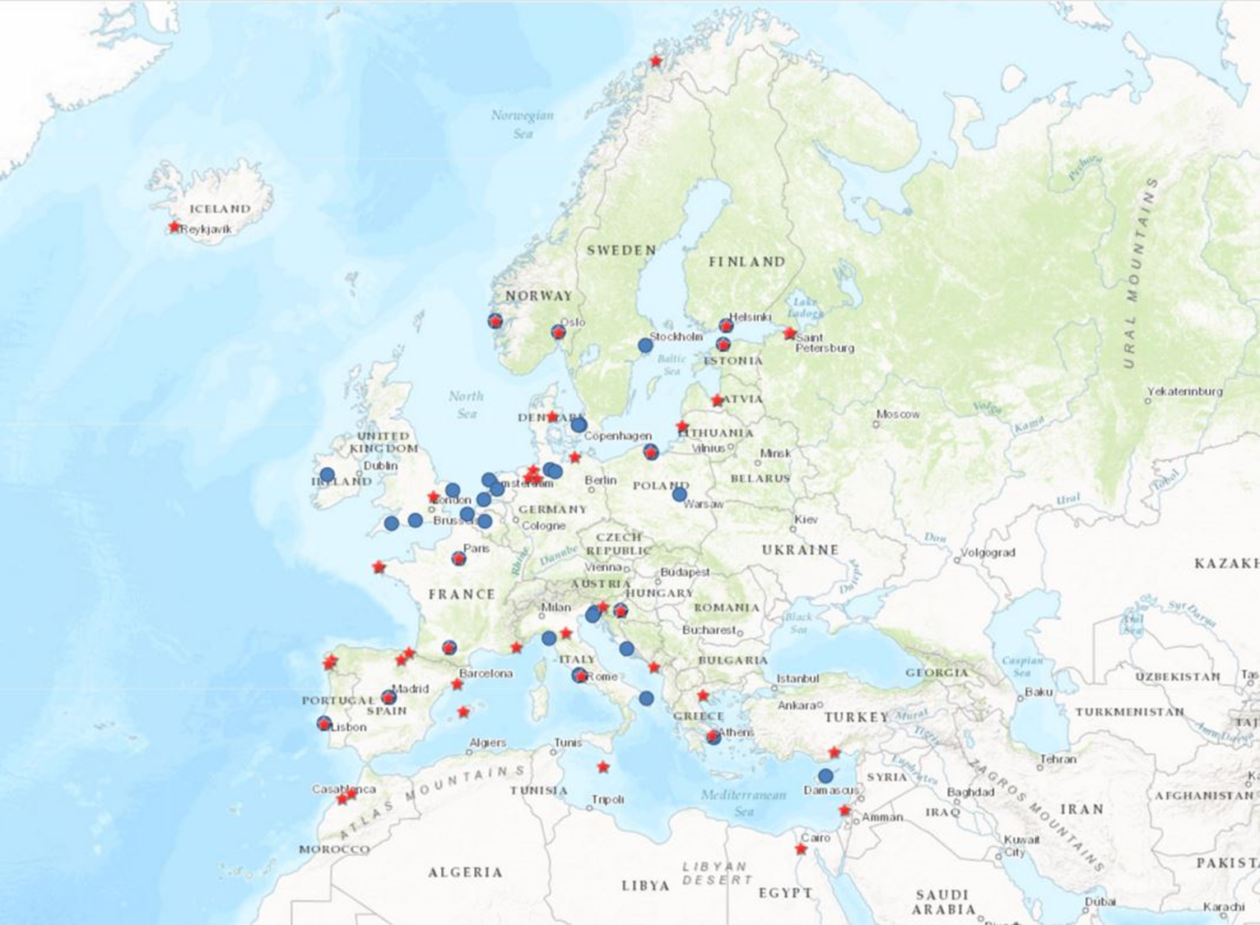
EuroGOOS is an association promoting and implementing Operational Oceanography. Ensure sustained observations and models are made in European seas underpinning a suite of fit-for-purpose products and services for marine and maritime end-users.
41 EuroGOOS members, mainly marine institutes and organisations
48 additional ROOS members
Secretariat Office in Brussels
Established in 1994 (legal entity (AISBL) since 2013)
5 regional systems, ROOSes
7 European operational networks, Task Teams
EU projects
eurogoos.eu | twitter.com/EuroGOOS
Notes:
An association of 41 full members plus….in a nutshell is a network promoting OO and to ensure obserbaions and model .
They are 41 members distributed in 18 countries and the secretariat is in Brussels
So, the range of activities span from …

Slide 4







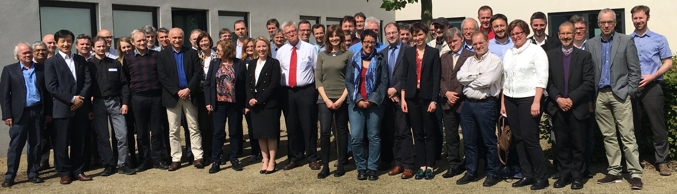

































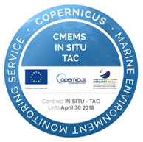

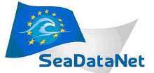











Leading pan-European ocean observing network

Slide 5
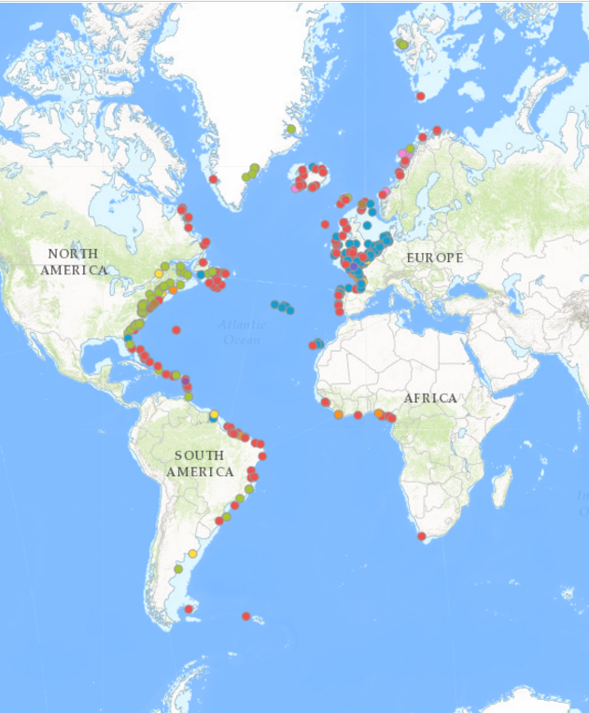
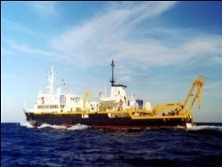
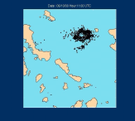
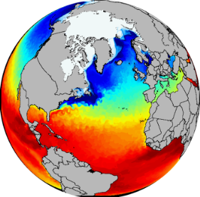
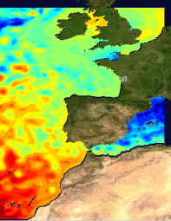
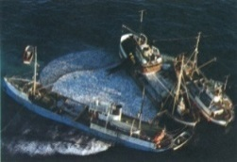
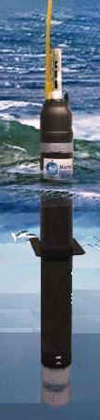
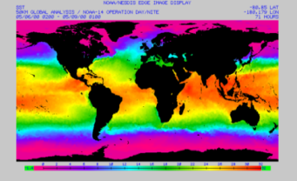

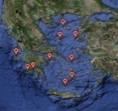
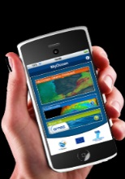
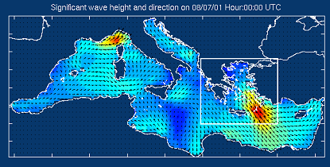
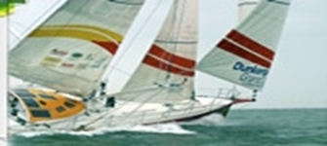
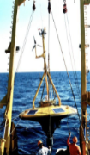
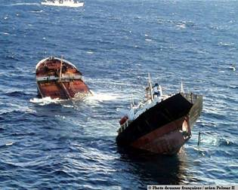
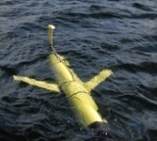
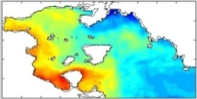
Through our members we cover the full value chain from observations to societal applications
Observations
Processing & Modeling
Services
EOOS
GOOS
G7
CMEMS
+ Other
Downstream Services
Local/national Forecasts and analysis
End Users

Slide 6

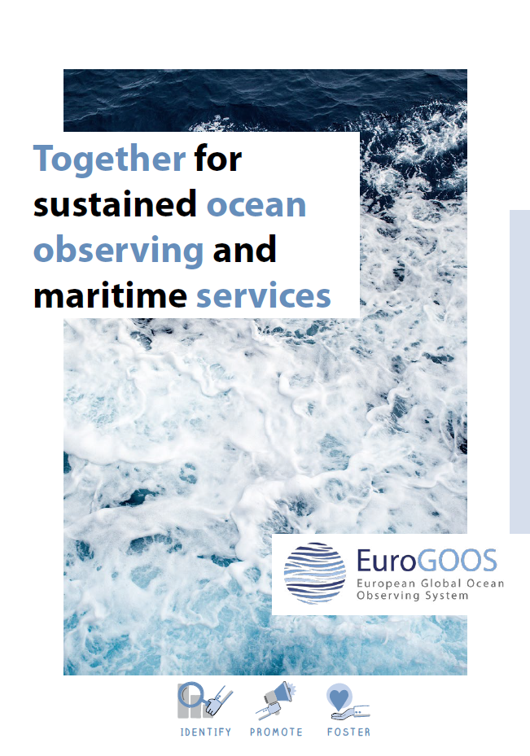

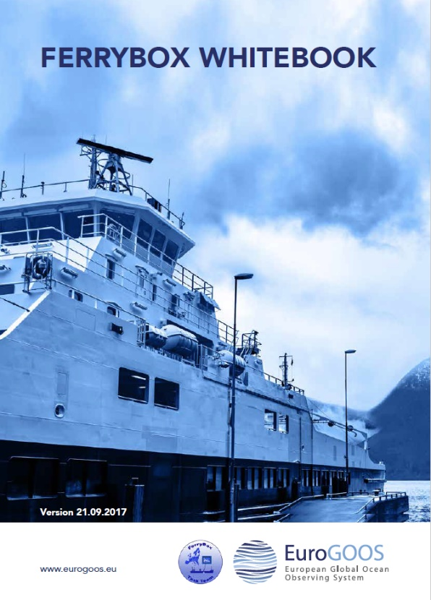
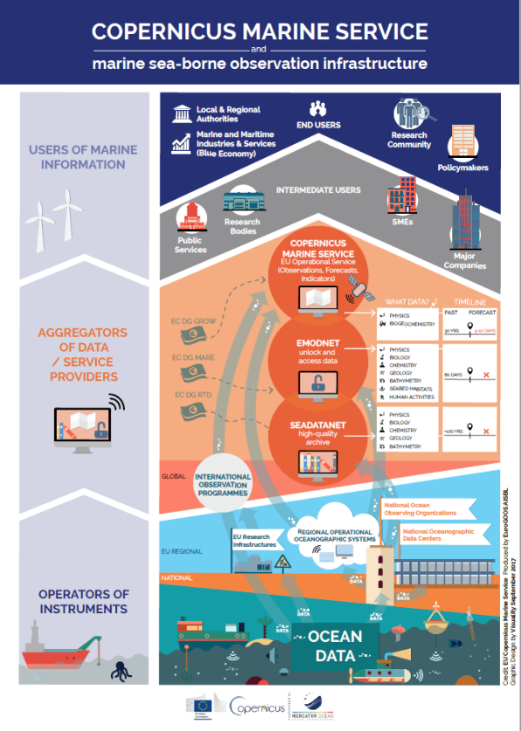
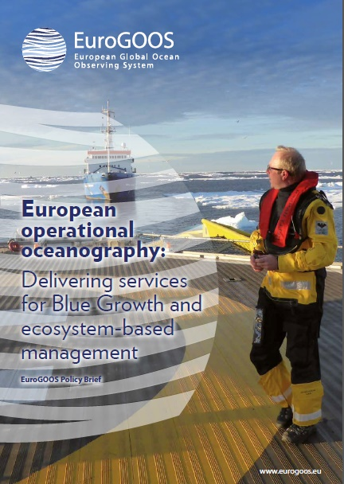
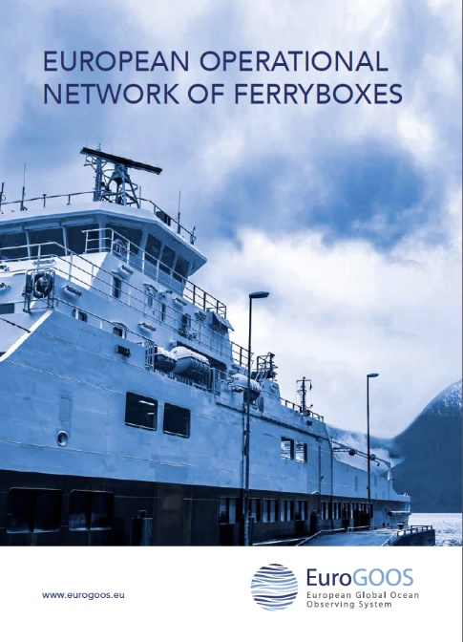

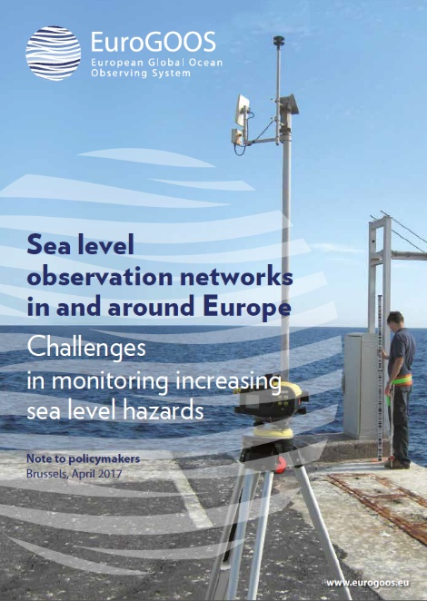
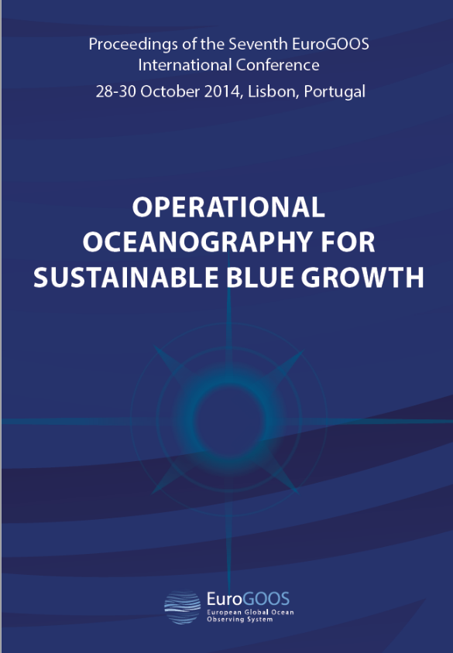
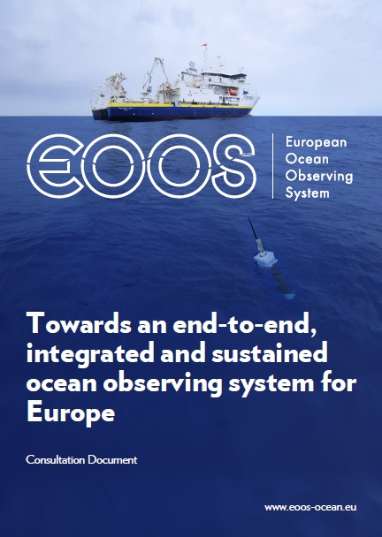
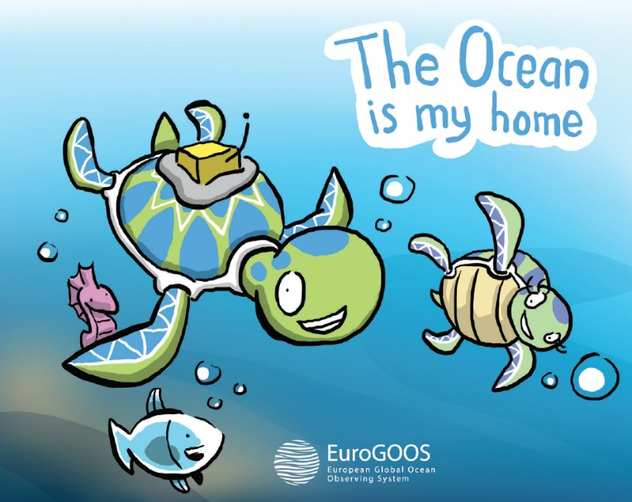
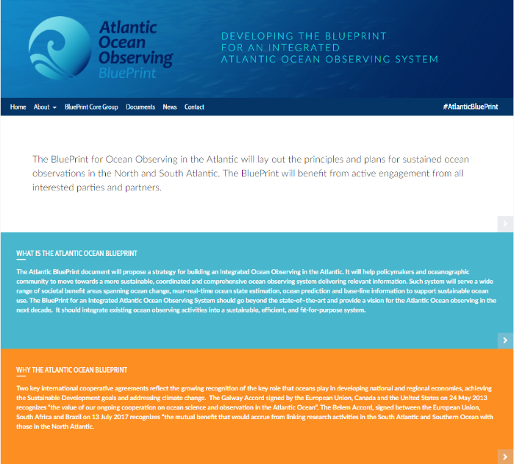
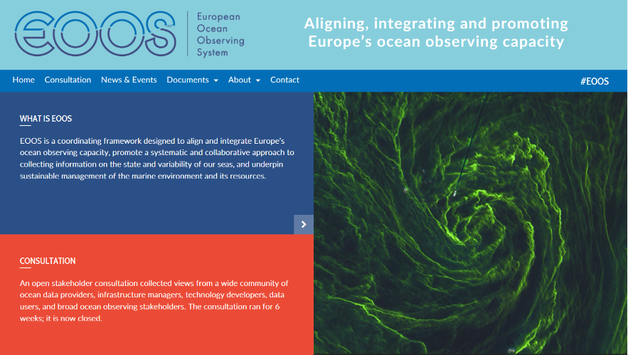
EuroGOOS 2017 | eurogoos.eu | twitter.com/EuroGOOS
Notes:
Concretely, EuroGOOS serves its members, ROOSes and community delivering strategic advice and promoting sustained systems

Slide 7
EuroGOOS Structure
BOOS
(Baltic)
ARCTIC
ROOS
MONGOOS
(Mediterranean)
NOOS
(Northwest shelf)
IBI-ROOS
(Iberia-Biscay-Ireland)
Working Groups
Data-MEQ Technology Planning Products Science Advisory Coastal
C-
Production
Task Teams
Tide Gauge Ferrybox Glider HF radar Euro-ARGO EMSO Fixed Platform Animal-Borne
Sustained Observations
EuroGOOS 2017 | eurogoos.eu | twitter.com/EuroGOOS

Slide 8

EuroGOOS ROOSs
The ROOSs - Regional Operational Oceanographic Systems are the operational arm(s) of EuroGOOS
About 50 additional partners in ROOSs
The ROOSs cooperation focus on improved national and regional services and products
ROOSs coordinate the observations and the data transfer for internal use and to other users
Regional data portals in every ROOS simplifying the data transfer and enable interoperability and act as “data translators”
EuroGOOS 2017 | eurogoos.eu | twitter.com/EuroGOOS

Slide 9
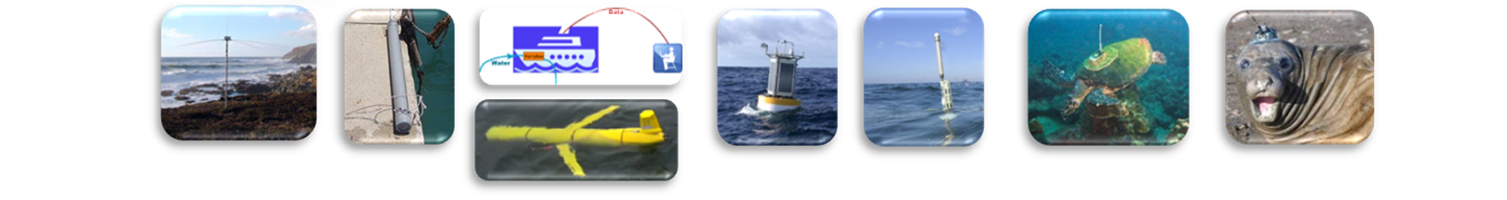
Task Teams
Tide Gauge Ferrybox Glider HF radar Euro-ARGO EMSO Fixed Platforms Animal-Borne
EuroGOOS Task Teams are operational networks of observing platforms ;
They promote scientific synergy and technological collaboration among European observing infrastructures;
Task Team members exchange open source tools, collaborate in areas of common interest, and jointly make European marine data available to the EuroGOOS ROOS regional data portals and hence to major EU data initiatives i.e. EMODnet, SeaDataNet and Copernicus Marine Service (CMEMS);
Coordinate the existing efforts of the individual observation communities;
Provide an up to date picture of the reporting platforms in Europe;
Provides recommendations of common operational data procedures and services (incl. data quality control, data formats and data management);
Promotion (webpage) and representation (Global);
Co-production of data products;
Brings people and communities together, avoiding duplication of efforts
www.emodnet.eu
www.seadatanet.org
www.copernicus.eu

Slide 10

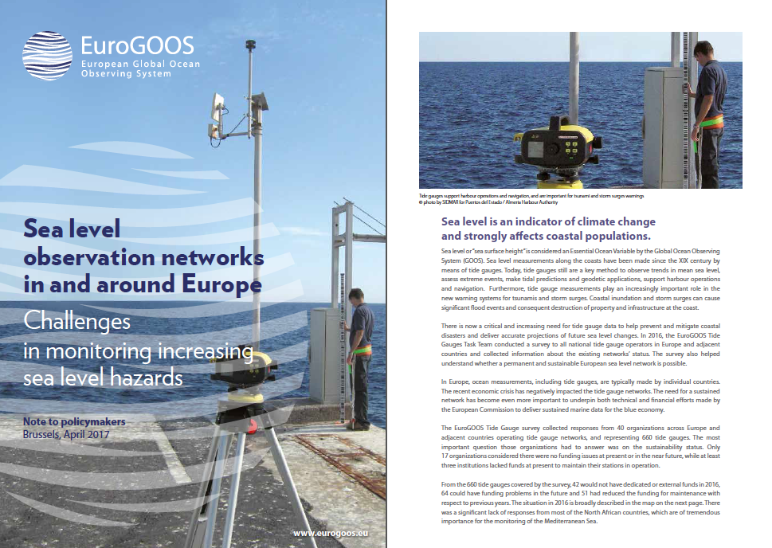
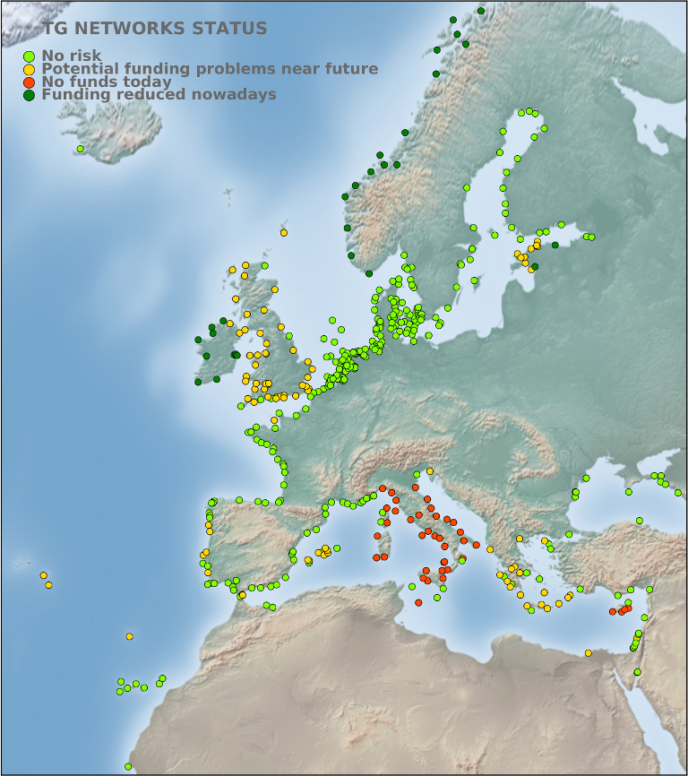
Tide Gauge TT - Note to policy makers
Nearly 25% of the stations facing problems in some way !
eurogoos.eu | twitter.com/EuroGOOS

Slide 11



RTD PRIORITIES
EuroGOOS working groups
COPERNICUS MARINE SERVICE
Data assessment, quality control, products
EMODnet
Data discovery, download, interoperability
National Data Centres
Archiving, standards, services
GEO, WMO, GOOS, EMSA, EEA
European data package to global initiatives
EuroGOOS data
Regional systems collect and process data in
all European basins

Slide 12

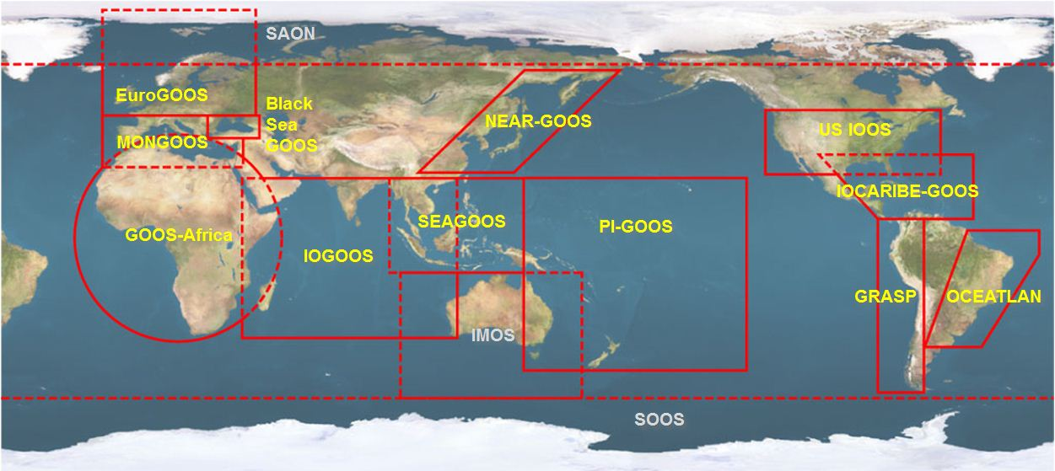

Part of the global effort
EuroGOOS is one of the thirteen GOOS Regional Alliances (GRAs) that develop the system in different parts of the World Ocean.
GOOS establishes a permanent global system for observations, modelling and analysis of marine and ocean variables to support operational ocean services worldwide
GOOS is a programme executed by the Intergovernmental Oceanographic Commission (IOC) of the UNESCO to:
Foster international cooperation for sustained observations of the oceans
Generation of oceanographic products and services
Interaction between research, operational, and user communities

Slide 13

EOOS is a coordinating framework designed to:
align and integrate Europe’s ocean observing capacity;
promote a systematic and collaborative approach to collecting information on the state and variability of our seas;
underpin sustainable management of the marine environment and its resources

Slide 14

Both bottom up: community push
Top down: policy pull and support
Not an infrastructure or a system with a central governance BUT a common conceptual framework and a brand, endorsed and promoted, representing a consolidated vision of the EU Observing as a whole
EOOS will help:
local/national/regional prioritization and funding
pan-EU cooperation (communal synergies and projects targeted at filling the gaps)
EU leadership at the global level

Slide 15

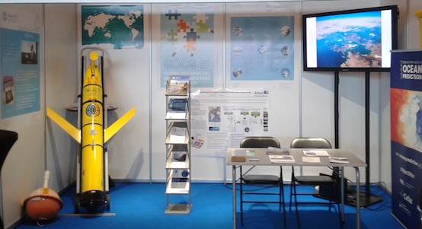
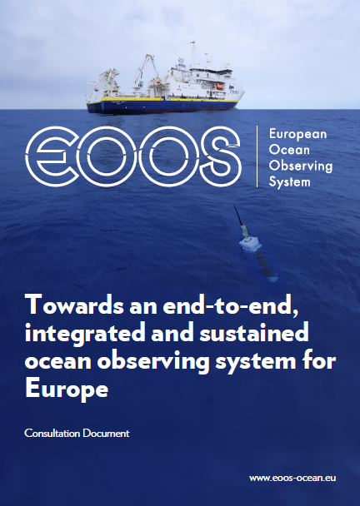
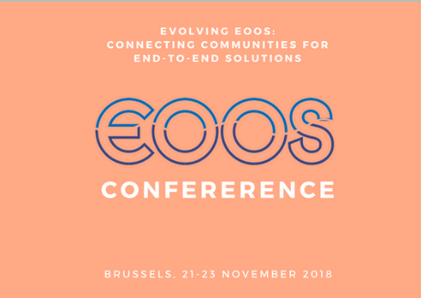


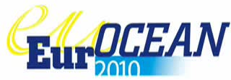
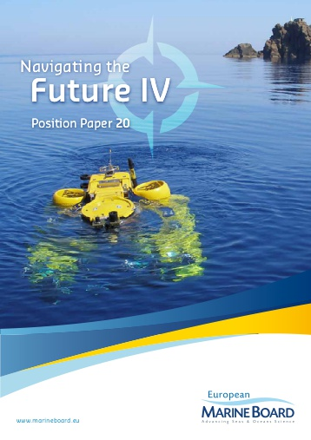



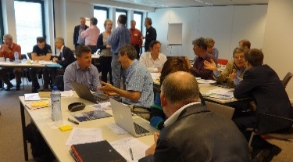
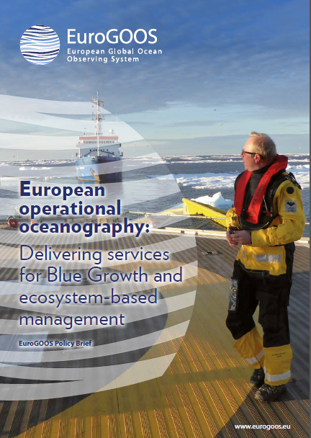
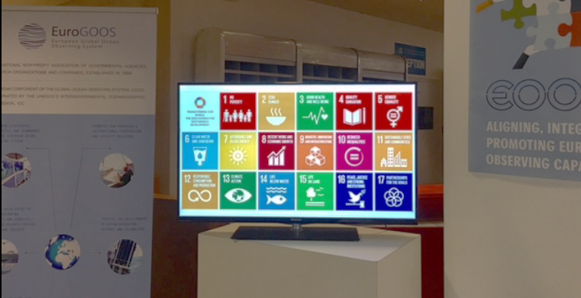
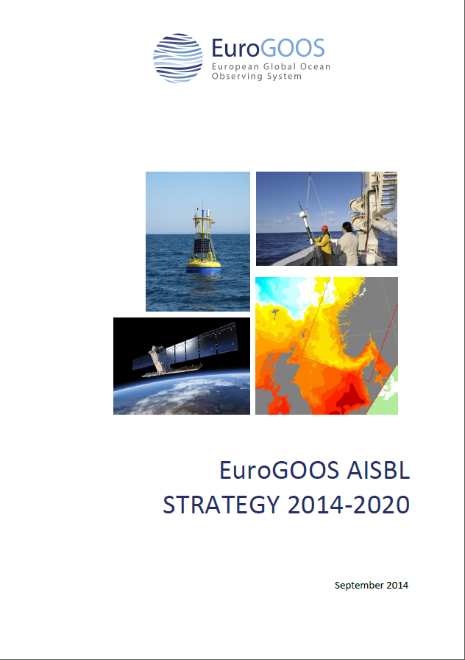

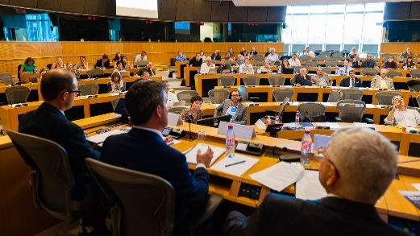
May 2015, expert brainstorming workshop: recommendation to set up a steering group; steering group convened in March 2016, EuroGOOS and EMB co-chairs
EOOS steering group meetings: 18 April 2016, 15 Sept. 2016, 9 Feb. 2017, 20 Sept. 2017, 19 Dec. 2017
Summer 2016: drafting of Consultation Document for an open stakeholder survey; Cons. Doc. presented at European Parliament EOOS event on 8 September
May 2017: EOOS consultation report released
Winter 2018: EOOS long-term strategy and short-term implementation
8 March 2018: EOOS forum in Brussels, and Conference 21-23 Nov., Brussels
2018
2017
2007
2015
2016
www.eoos-ocean.eu
www.eoos-ocean.eu
Dina Eparkhina, EuroGOOS

Slide 16
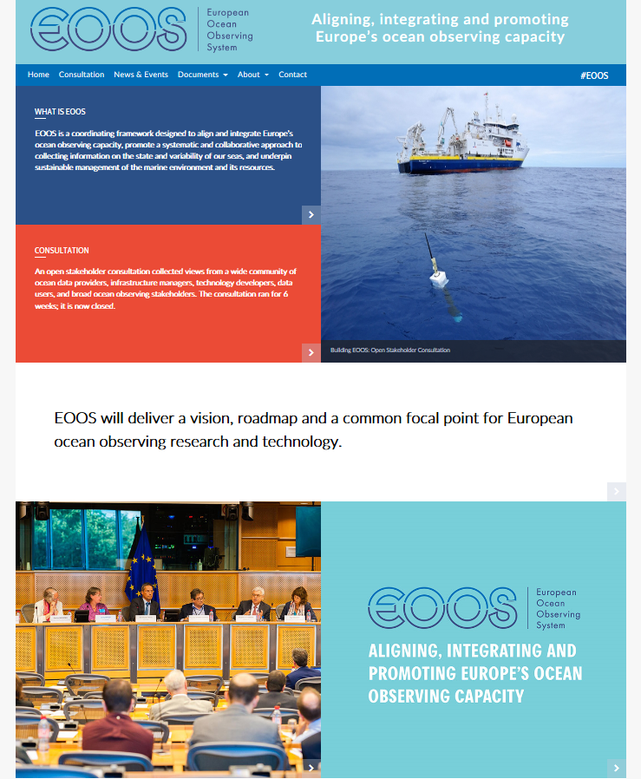
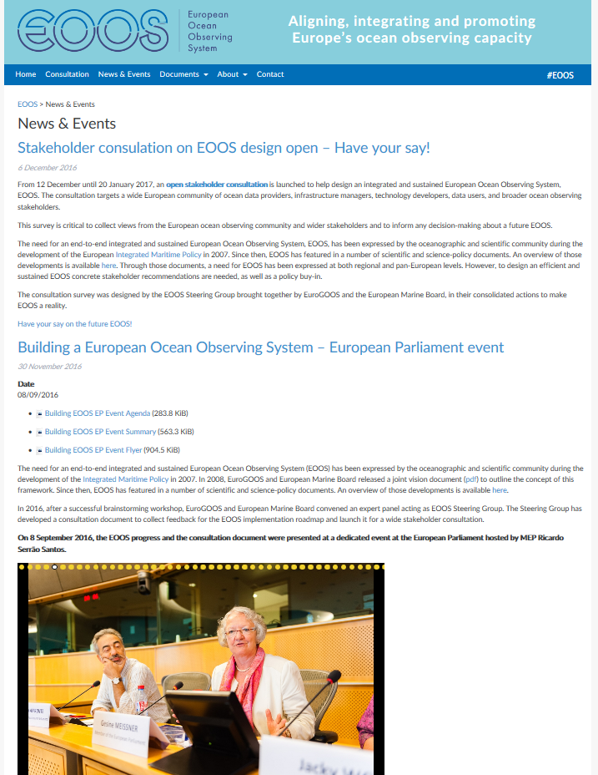
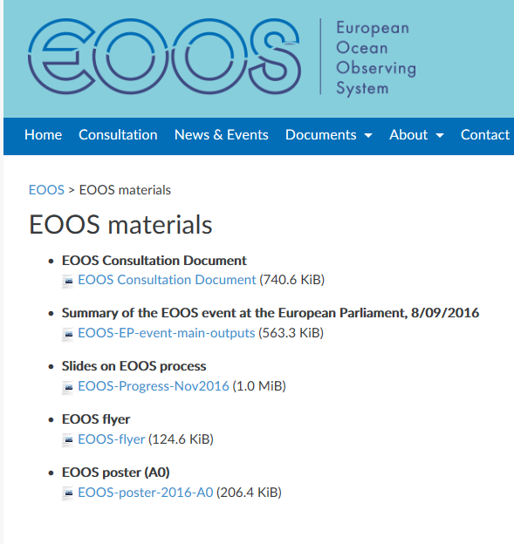


+
Relevant Materials
About: What is EOOS, Why, EOOS Progress
EOOS
www.eoos-ocean.eu

Slide 17
EOOS Forum, 8 March 2018, Area 42, Brussels
Integrated and sustained ocean observing: a European strategy
Objectives:
Present and discuss the EOOS strategy delivered by the EOOS Steering Group further to the stakeholder survey on the EOOS consultation document;
Highlight the main opportunities and threats to the delivery of EOOS and the downstream services linked to the funding sustainability;
Demonstrate examples of national or EU funding commitments to EOOS-related infrastructures and services;
Discuss sensitivities and bottlenecks to sustainable and integrated EOOS;
Promote the value of communications in achieving the EOOS objectives.
Targets: National funders – need to be explained why EOOS is needed (reqs for obs, policy response, sustainability); implementers – need to be brought in to align and share; users – need to be asked for their feedback.
Outputs: strategy and implementation discussed; forum report published; forum conclusions feed into the conference in Nov. 2018
Principle objective: The EOOS Forum 2018 will bring together the main ocean observing funders, implementers and users in Europe. It will examine the extent to which the current observing systems are sustainable today, and what opportunities and threats there are.
Initiated by the EOOS Steering Group as the main forum for an integrated European Ocean Observing System, the event will discuss the EOOS strategy, developed further to the stakeholder consultation Dec. 2016- Jan. 2017, and seek feedback from the funders, implementers and users on the way forward.
www.eoos-ocean.eu

Slide 18


patrick.gorringe@eurogoos.eu
Website
www.eurogoose.eu
Twitter
twitter.com/EuroGOOS
E-mail
eurogoos@eurogoos.eu

