Slide 1

JERICO-RI: the European coastal observing system of systems, component of EOOS
Patrick Farcy, Simon Keeble, Aldo Drago
BlueMed– Malta

Slide 2







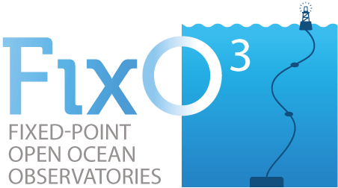
  Toward a sustained Pan European JERICO-RI
  Some components of the European Context
EOOS
Marine Core Services (CMEMS)
SEADATANET
EMODNET (DG MARE)

Slide 3
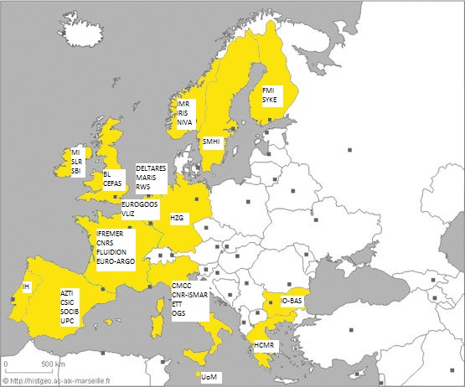
JERICO-NEXT in a nutshell
Duration: Sept. 2015- Aug. 2019
EU funding: 10M€
Consortium: 34 partners, 910 MM
Organisation:
  9 WPs
  STAC
  External User panel
Coordination: Ifremer: jerico@ifremer.fr
66 deliverables, 63 milestones

Slide 4
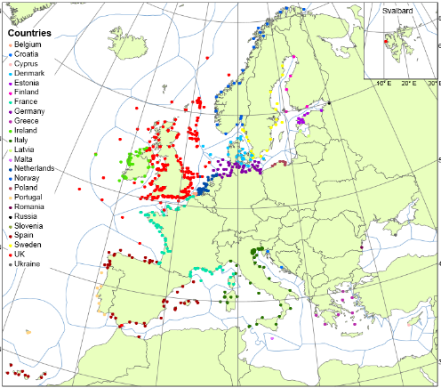
Status and Challenges of present European coastal observatories
Sustainability
More biogeochemical and biological
observatories

Slide 5
…The JERICO mind…
The JERICO-NEXT community
  “ We cannot understand the complexity of the coastal ocean if we do not understand the coupling between physics, biogeochemistry and biology.”
new technological developments for continuous monitoring of a larger set of parameters
→ a priori definition of the optimal deployment strategy
JERICO-NEXT focus
  Multidisciplinary: interactions between physics, biogeochemistry and biology
  Not restricted to pure technological aspects : include fundamental scientific considerations
  Integration: Multiplatform
  From coast to open ocean
  Modelling

Slide 6
… Objectives and needs…
Delivery of an harmonized research infrastructure for coastal observations, compliant with EMODNET and Copernicus
To ensure the sustainable provision of high-quality coastal multidisciplinary observations that can support:
To produce a long-term strategy for further development, integration, sustainability and relevance of coastal observatories in Europe
Progress and breakthrough in marine science
European policies and national duties
The development of business activities (e.g. marine services)

Slide 7
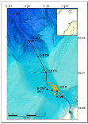
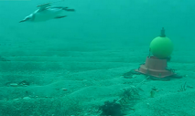
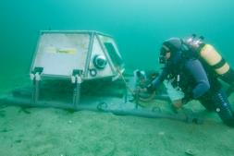
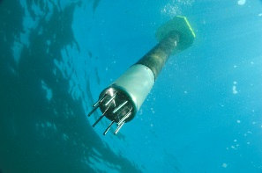
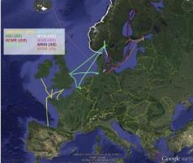
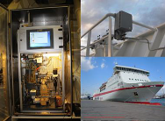
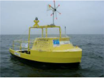
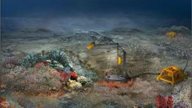
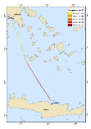

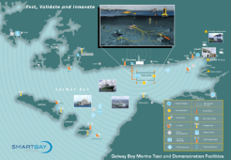
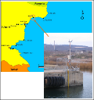
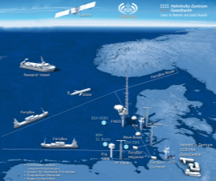
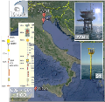
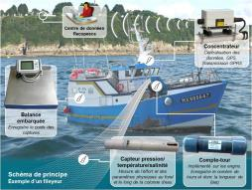
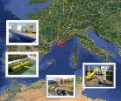
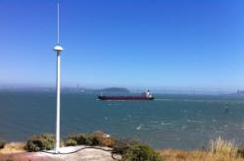

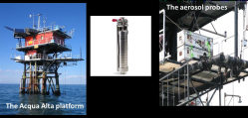
Coastal
Profilers
Cable-based
Multidisciplinary OS
UAV
Ferrybox
JERICO-RI:
European Coastal Observing System of Systems
Calibration
lab
Fixed platforms
Fishing
vessel
Buoys
Gliders
HF radar

Slide 8
New technological developments
Observing pelagic biodiversity
  Automated quantification of organisms
  Flow cytometry, metabarcoding, pigment determination
Observing benthic communities
  Integrated multi-sensors video array
  Organic matter mineralisation
Coastal profiling technologies
  Condition monitoring
Microbial and molecular sensors
  Quantification of hydrocarbon, algae toxins, microbially driven biogeochemistry
Combined carbonate sensors
  pH, CO3, alkalinity

Slide 9
Services to the Research Community
Providing a flow of harmonised multi-disciplinary data
  Competitive research
  Emodnet, Copernicus
Structuring the coastal research community by addressing joint multidisciplinary challenges
Improving capability to increase policy-relevant knowledge
Development and integration of new sensors for investigating the biological and chemical compartment
  Nutrients, optical sensors, carbonate system
Integrating platforms and technologies
  Ferrybox, gliders, fixed platforms, HF-radars, cabled-coastal observatories, coastal profilers

Slide 10
Services to stakeholders
European monitoring programs
  Support harmonising observations between national monitoring programs
  Provide continuous and often quasi-realtime marine observations of key parameters
  Provide physical, chemical and biological observations
  Provide observations across borders
    Gradient – source/accumulation
    transport
JERICO-NEXT best practices freely available
http://www.jerico-ri.eu/

Slide 11
Services to Technology Providers
Test of technologies
  Sensors
  Integration of sensors
  Smart solutions (P&P, energy, logger, communication)
Comparaison and intercalibration of technologies
Proof-of-concept and marketing argument
Use of Research Infrastructure through TNA
Window for European know-how
The role of Trans-National Access

