Slide 2
LINCOLN – Lean Innovative Connected Vessels
BLUEMED Meeting
Kalkara, Malta 11th – 12th January 2018
Lucia Ramundo, Politecnico di Milano

Slide 3
LINCOLN in Numbers
16 Partners from 6 Countries
6.343.600,00 € Budget
36 months duration
Started on 1st October 2016
Ending on 30th September 2019
GA number 727982

Slide 4
LINCOLN Vision
Developing three new added value vessels with innovative on board equipment, using lean design methodology and IoT solutions, able to be used in diverse maritime coastal activities and sectors in an efficient and sustainable way.

Slide 5
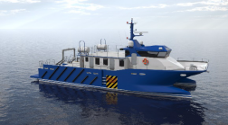
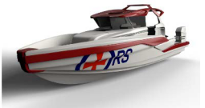
LINCOLN Objectives (1/2)
A multi-platform catamaran to serve as:
- Service crew vessel
- Multipurpose survey vessel
With Hybrid engine and innovative people transfer system
A module based high-speed patrol boat platform
To enhance the modular design solution
An Emergency Response and Recovery Vessels (EERV)
With a low cost dynamic positioning system

Slide 6
LINCOLN Objectives (2/2)
Improve vessel design and manufacturing through the LEAN Product Development methodology, fostering EU SME maritime competitiveness
Develop and deliver IoT based solutions for the maritime professional market, enhancing EU SME technological capabilities
Adopt Lifecycle environmental and economic assessment to provide sustainable vessels solutions

Slide 7
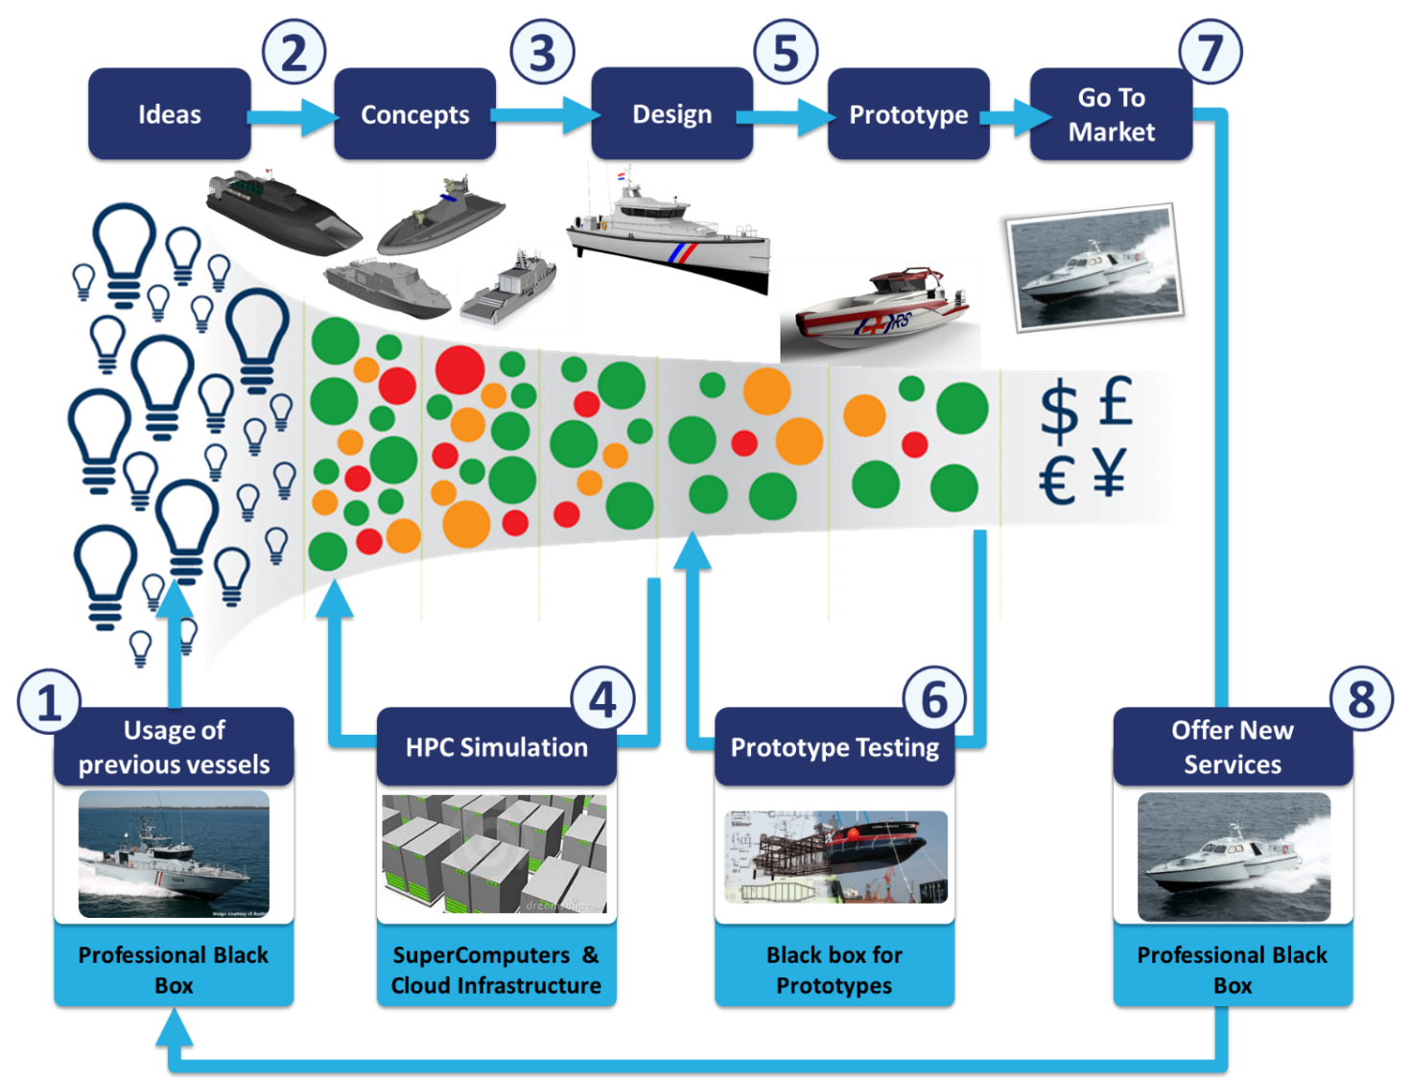
Lean fact based approach
Vessel Design and Manufacturing life
Vessel operative life
iCaptain
Maritime cloud
Claims
Weather
forecast
Fleet Management
Advanced
Maintenance
Vessels Lifecycle sustainability assessment

Slide 8
Contribution to BLUEMED objectives
• Developing innovative marine-based technologies, methodologies and approaches with a view to boosting the sustainable economic growth of the European maritime sectors and the conservation and upgrading of the marine environment, resources and cultural heritage;
• Fostering innovative multidisciplinary research and cooperation activities addressing the relevant Mediterranean challenges;
• Providing knowledge-based support for the implementation of EU policies and directives on marine and maritime issues in the Mediterranean;

Slide 9
LINCOLN Technological Exploitable Results

Slide 10
The Lean design methodology

Slide 11
IoT for the maritime sector

Slide 12
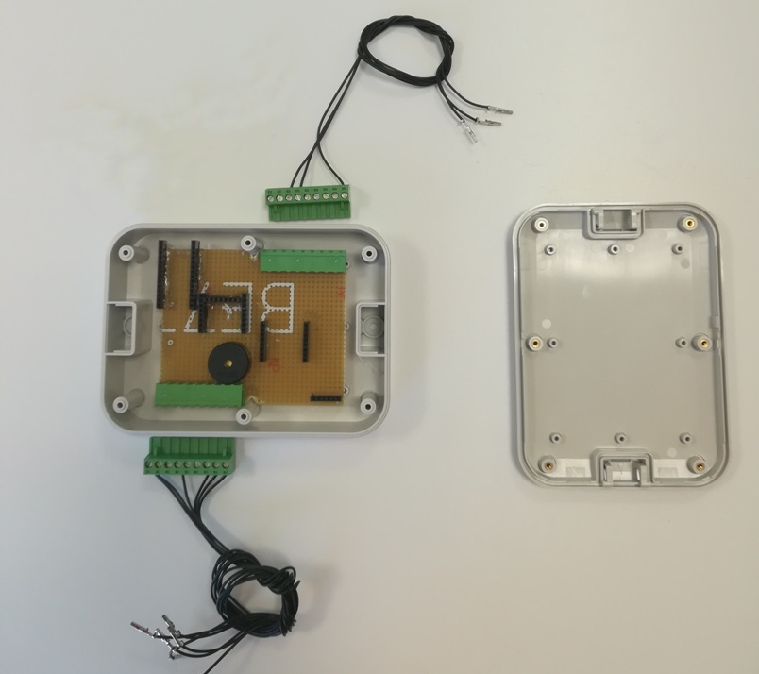
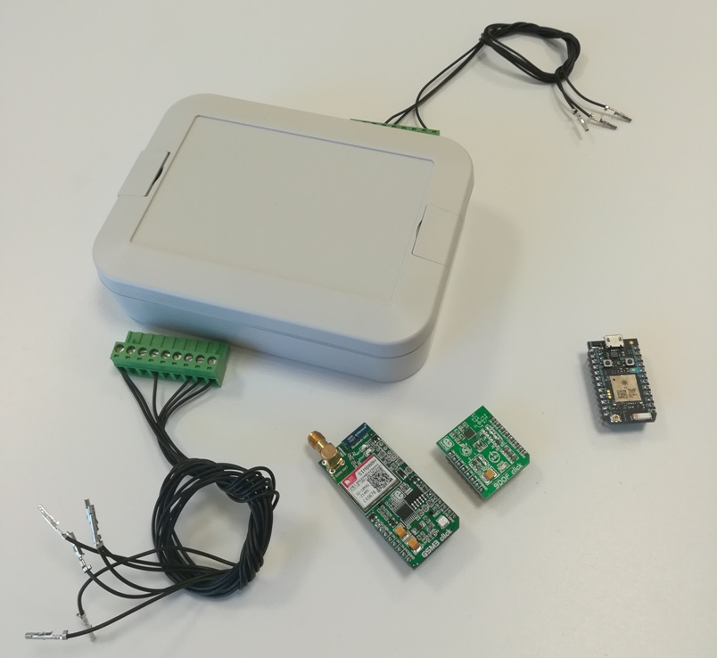
The new iCaptain Black Box
Developed according to lean design principles:
Modular and easy programmable HW to allow fast upgrade and new components inclusion
Easy Maintenance

Slide 13
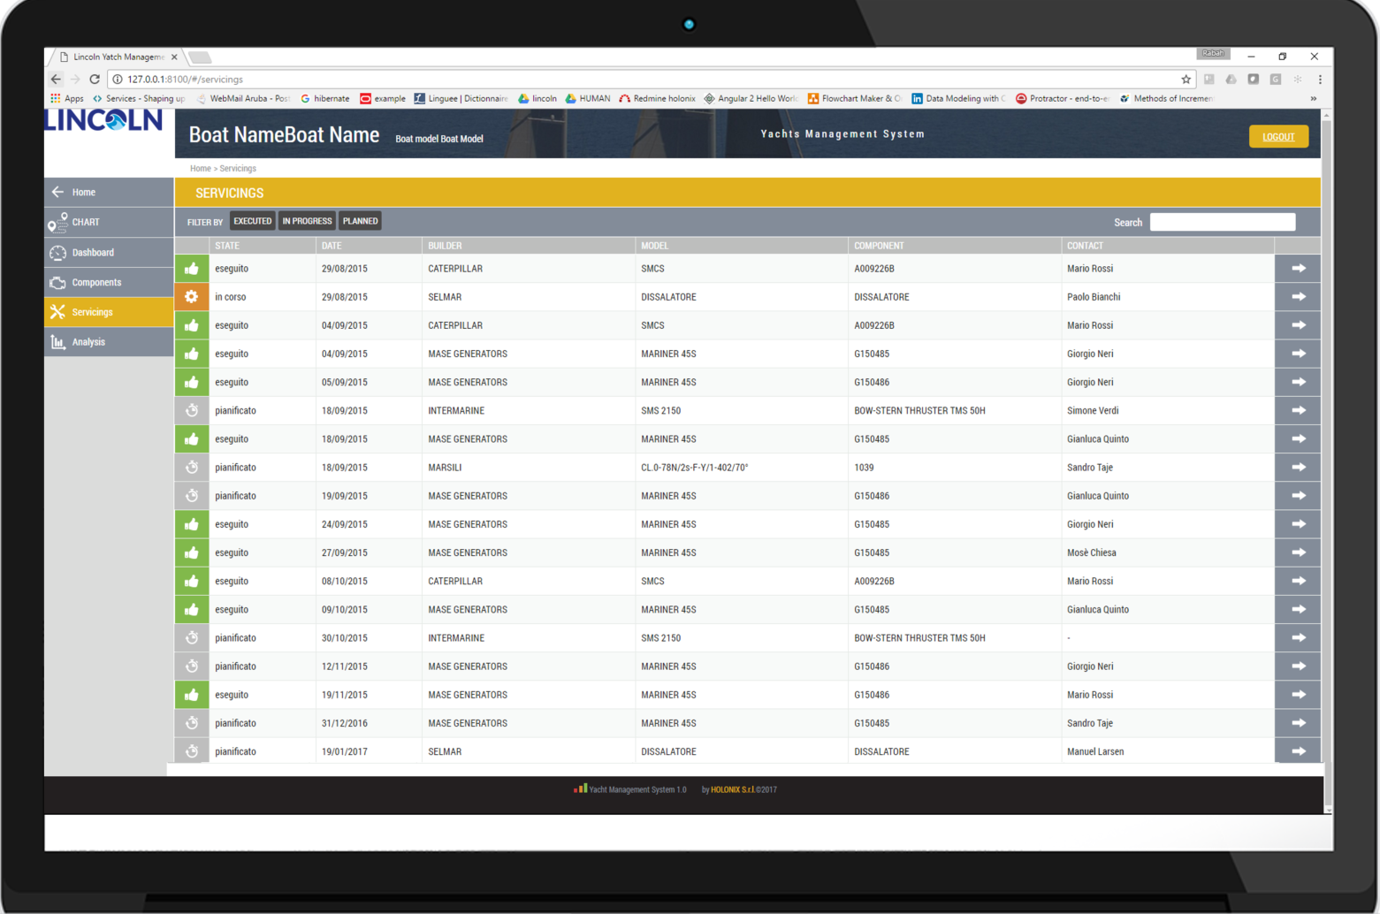
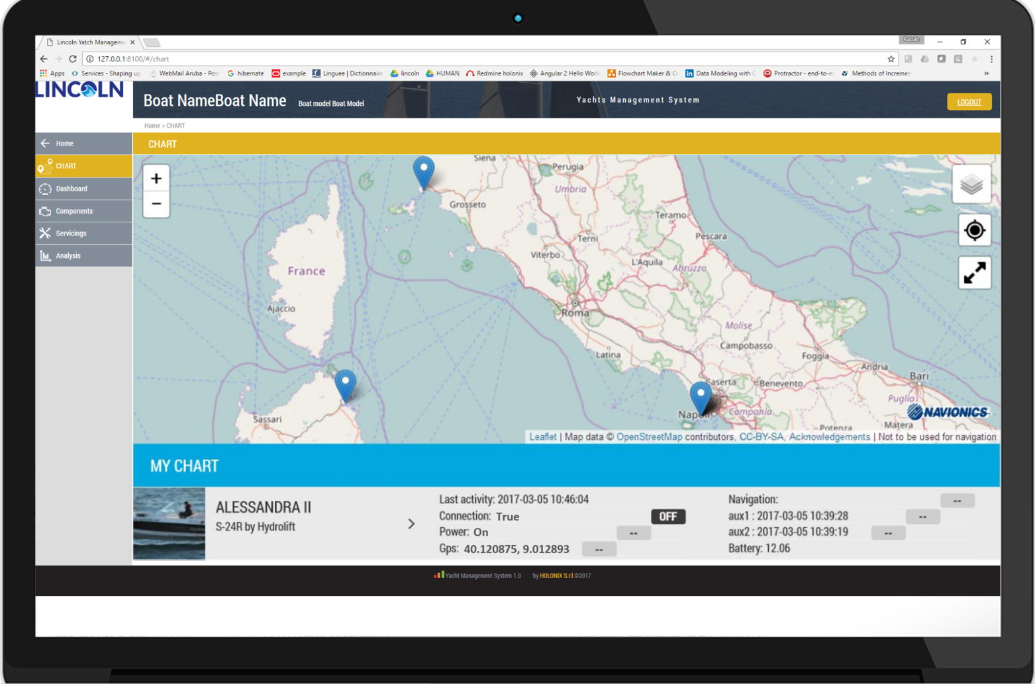
Service oriented SW
Modular SW aproach based on microservices:
Vessels data management
Maintenance
Data analitics
Weather forecasts
Vessel simulation
Dedicated user interfaces for
different stakeholders

Slide 14
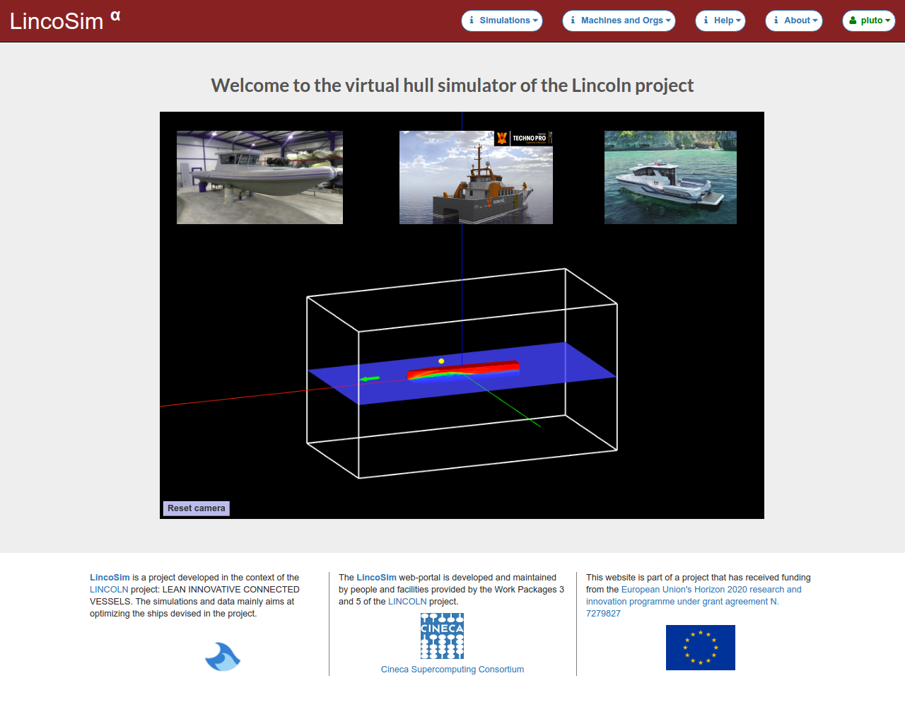
LincoSim: the virtual towing tank
LincoSim will provide an automated, user friendly and OPEN ACCESS simulation environment to designers.
It allows to define main hull parameter since early design stage, fastening the design:
Hull final attitude
Resistance plot
Pressure distribution along the hull
Waterline on the hull
Hull rigid body dynamics
Hull forces dynamics
Other derived KPIs

Slide 15
Development of a Life Cycle Performance Assessment SW for optimal definition of the environmental and economic sustainability of the vessels
Eco-friendly Vessels
SW characterisitcs
Design costs
Production costs
Maintenance costs
Repair costs
Standard user profile
Replacement/maintenance schedule
Replacement/maintenance costs
Fuel consumption
Operation costs
What?
Methotology to analyze and compare several vessel design from different perpectives:
- Different operative profiles
- Different costs scenarios
- Different design alternatives

Slide 16
Contacts
www.lincolnproject.eu
Coordinator: Sergio Terzi sergio.terzi@polimi.it
Project Manager: Lucia Ramundo lucia.ramundo@polimi.it

