Slide 1
Multi-Use in European Seas Project
Bruce Buchanan, Project Coordinator (Marine Scotland)

Slide 2
What is MUSES?
EU Horizon 2020 funded project
24 Month project – started 1 November 2016
Multi-Use in European Seas – 5 Sea Basins
Baltic Sea
Black Sea
Eastern Atlantic
Mediterranean Sea
North Sea
Notes:
Brief introduction on the MUSES project as outlined in slide

Slide 3
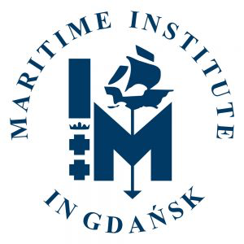
10 Consortium Partners
7 Countries
Scotland
Poland
Germany
Italy
Netherlands
Greece
Azores - Portugal
Notes:
A total of 10 partners from 7 different countries, some partners also have links to satellite offices within their organisations that cover other countries of interest to the project. Marine Scotland is the co-ordinating partner.
A mix of consultancies, academia and Government bodies providing a strong team with complementary skills from the different types of organisations.
Excellent geographical coverage, understanding and relevant links to key stakeholders in the five sea basins that this project will report (Baltic Sea, North Sea, Mediterranean Sea, Black Sea and Eastern Atlantic).
The breadth of the consortium will therefore strengthen MUSES ability to fully understand the barriers, how best to reduce risks, improve efficiencies and enhance social acceptance of combining marine activities.

Slide 4
Why Multi-Use?
Need for space efficiency (eminent driver in small EEZs)
Drive for offshore aquaculture to expand and move offshore
→ easier in combination with existing offshore infrastructures
Environmental synergies (i.e. IMTA)
Economic and societal benefits
→ synergies in operations, licensing, job creation, etc.
Notes:
Integrated multi-trophic aquaculture (IMTA) provides the byproducts, including waste, from one aquatic species as inputs (fertilizers, food) for another.
Good alignment with the BlueMed Objectives:
developing innovative marine-based technologies, methodologies and approaches with a view to boosting the sustainable economic growth of the European maritime sectors and the conservation and upgrading of the marine environment, resources and cultural heritage;
fostering innovative multidisciplinary research and cooperation activities addressing the relevant Mediterranean challenges;
providing knowledge-based support for the implementation of EU policies and directives on marine and maritime issues in the Mediterranean;
creating an interoperable, fully integrated observing and forecasting system to promote continuous long-term observation based on open data structures to guarantee easy access;
promoting public awareness and understanding of how important sustainably prosperous resources of the Mediterranean Sea for the surrounding countries and for Europe as a whole;
training a new generation of scientists, professionals, technicians and entrepreneurs able to tackle complex ecological, economic and societal challenges in a holistic way, thus creating new and qualified ‘sea-based’ jobs.

Slide 5
MUSES Objectives/Focus
MUSES aim:
Contribute to policy, legal and administrative harmonization and improvement to overcome barriers to multi-use.
Objectives:
Provide a comprehensive understanding of environmental, spatial, economic and societal benefits of Multi-Use,
Highlight inappropriate regulatory, operational, environmental, h&s, societal and legal barrier to Multi-Use → distinguishing between real and perceived barriers;
Propose solutions and actions to be taken.
3 main steps
I Sea Basin Overview of Multi-Uses
II Case Studies
III Action Plan
Notes:
Good synergies with the BlueMed objectives:
MUSES project is based on desk study work and engagement with relevant stakeholders.
These are the main objectives for the MUSES project. The analysis for the project will in the main come from analysis of existing MU literature and engagement with a wide range of stakeholders with expertise in MU, similar to those of you attending today. Stakeholder participation is vital for this project and we appreciate and value your time coming to the event today and we would also very much like to continue engaging with you for the duration of the project.

Slide 6
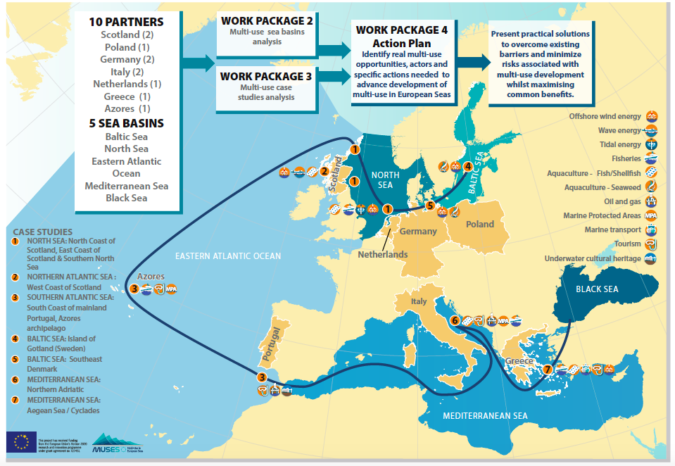
Notes:
Marine Scotland as co-ordinator of the project are responsible for the Project management of the project as well as the communication/ dissemination of information.
There are three main work packages
Sea Basin Overview of Multi-Uses (WP2): Regional overviews of multi-use which take into account EU sea basins (Baltic Sea, North Sea, Mediterranean Sea, Black Sea and Eastern Atlantic) will be based on an analytical framework to facilitate adoption of a common approach across the sea basins. The progress in implementation of the concept of Multi-Uses in European Sea Basins will be assessed and key obstacles and drivers identified.
Case Studies (WP3): MUSES will assess potential synergies for multi-use as well as the challenges encountered through a series of case studies with different thematic, geographic and focus area dimensions, and engage local stakeholders to identify barriers, opportunities, limitations and needs.
Action Plan (WP4): MUSES will develop an action plan to ascertain the real opportunities for multi-use in European Seas, including the scope for innovation and Blue Growth potential. The action plan will be developed actively with stakeholders. It will show the potentiality of ocean space, highlight where benefits can be realized, draw attention to barriers that can be overcome and provide recommendations on what actions are needed in order to enable this.
The action plan will be one of the main deliverables of the MUSES project. Substantial effort will therefore be made to produce a well-designed, easy-to-read, comprehensive printed document, which shall be promoted extensively beyond the lifetime of the project itself.

Slide 7
Notes:
Methodology for evaluating MU - desk analysis, followed by a stakeholder engagement phase. (both in WP2 and WP3)
DRIVERS = factors promoting MU
They are defined as those factors supporting / facilitating / strengthening MU development.
BARRIERS = factors hindering MU
They are defined as those factors preventing /negatively affecting MU.
ADDED VALUES = positive effects/impacts of establishing or strengthening MU
They are defined as the pros or the benefits or the positive effects of implementing / strengthening MU.
IMPACTS (NEGATIVE IMPACTS) = negative effects/impacts of establishing or strengthening MU. They are defined as the cons or the negative effects of implementing / strengthening MU).
MU POTENTIAL is defined as the degree of opportunity the study area has to develop or strengthen MU.
MU EFFECT is defined as the overall result or balance of pros and cons of developing MU in the study area.

Slide 8
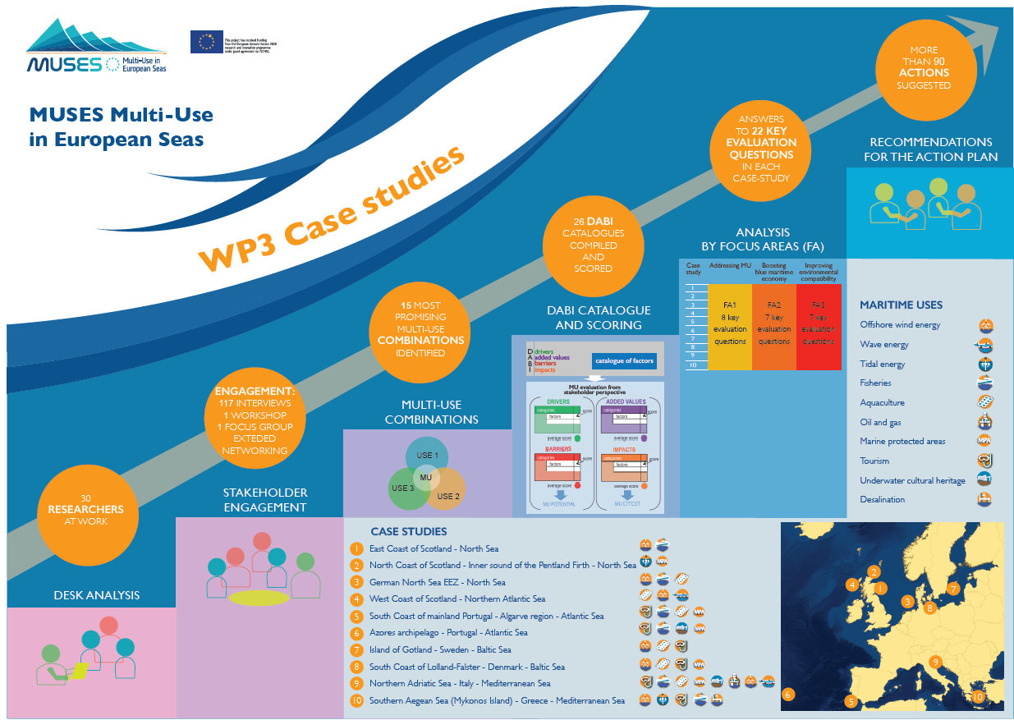
Notes:
Two Med cases studies :
9. Northern Adriatic Sea – Italy
10. Sothern Aegean Sea (Mykonos Island) - Greece

Slide 9
MUSES Output – The Action Plan
Show real opportunities of MU in European Seas
benefits– which / for whom / where?
incl. scope for innovation, Blue Growth potential
Environmental, economic, societal benefits and spatial efficiency
barriers for MU
Real vs Perceived barriers
solutions to overcome identified barriers
who / at which level a solution? easy to achieve ?
recommendations for actions
showing relevant level (local, regional, national, EU)
actors / beneficiaries as well as barriers (private, public)
processes (cooperation, legal, funding, private)
Notes:
The main output from the MUSES project will be the Action Plan. The Action plan will cover – go through points on slide.

Slide 10
MUSES –BlueMed alignment
developing innovative marine-based technologies, methodologies and approaches with a view to boosting the sustainable economic growth of the European maritime sectors and the conservation and upgrading of the marine environment, resources and cultural heritage;
fostering innovative multidisciplinary research and cooperation activities addressing the relevant Mediterranean challenges;
providing knowledge-based support for the implementation of EU policies and directives on marine and maritime issues in the Mediterranean;
promoting public awareness and understanding of how important sustainably prosperous resources of the Mediterranean Sea for the surrounding countries and for Europe as a whole;
Notes:
Good synergies between our projects. I believe particular synergies with these four BlueMed objectives

Slide 11
MUSES –BlueMed alignment
MU Sea Basin Reports
MU Case Studies
Action Plan
Notes:
Main outputs from the MUSES project – especially the Med focused reports.

Slide 12
Keep in Touch!
www.muses-project.eu – sign up to our mailing list
Twitter @H2020MUSES
LinkedIn
I have project leaflets
Notes:
Encourage stakeholders to sign up to newsletter if they have not already done so.

