Slide 1
ODYSSEA - Operating a network of integrateD observatorY SystemS in thE mediterraneAn sea
BlueMed CSA Coordinators’ Meeting
Simon Keeble (Blue Lobster – UK) on behalf of…
Georgios Sylaios (DUTH – Greece - Coordinator)
simon@bluelobster.co.uk - gsylaios@env.duth.gr

Slide 2
ODYSSEA in Numbers
30 partners from 14 countries (6 non-EU)
8.398 M Euros budget
54 months duration
Started 1st June 2017
Ending date 30th November 2021
932 PMs in total

Slide 3
Objective
ODYSSEA is a user-centred project aiming to make Mediterranean marine data easily accessible and operational to multiple end-users,
harmonizing existing Earth Observing systems,
upgrading operational oceanographic capacities,
supporting EU policy implementation,
improving interoperability in monitoring,
fostering blue growth jobs creation, and
opening participation to non-EU member states.

Slide 4
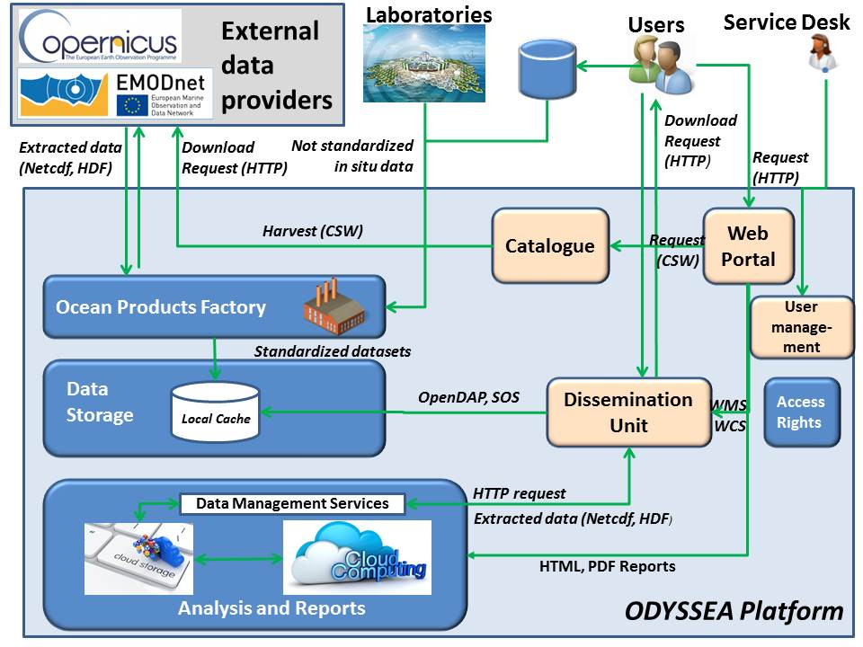
The ODYSSEA Platform
To achieve this, a modular and highly versatile software platform will be designed and developed to search, collect, retrieve and integrate datasets obtained from an expanded range of existing observational platforms, forecasting systems and networks, covering both the open sea and the coastal zone.
ODYSSEA Platform Architecture

Slide 5
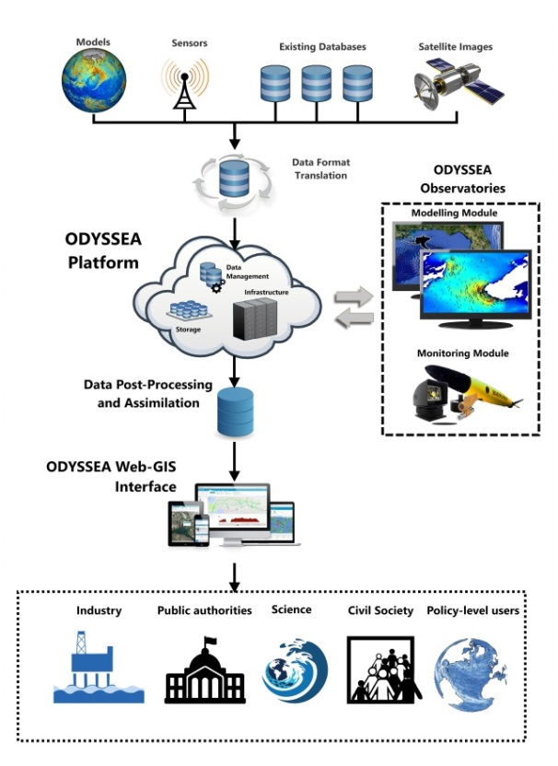
Key element 1
The ODYSSEA Platform
This will integrate data from existing Earth Observation facilities (Copernicus, GEOSS, GOOS, EMODNet, ESFRI, and others), allowing the end-user to access and download archived and forecasted data for any region of the Mediterranean Sea.
On-demand data services will be made available and accessible via a single public portal.
ODYSSEA Data Flow and Integration

Slide 6
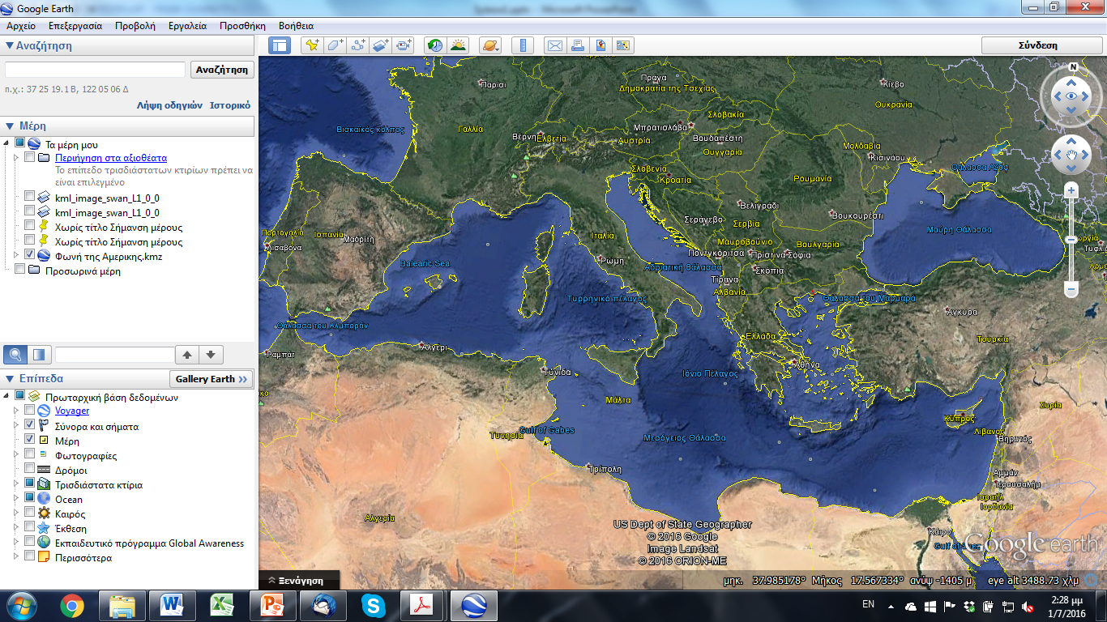
Key element 2
Nine Regional ODYSSEA Observatories
They will be established to fill-in existing data gaps and increase the temporal and spatial resolution of observational and marine forecasting data in the Mediterranean Sea.
In each Observatory, moored and mobile monitoring and high resolution operational modelling will take place.
ODYSSEA Observatories

Slide 7
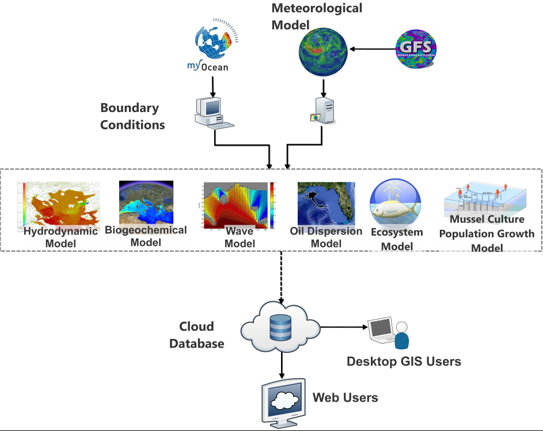
Key element 3
The Modeling Module
A novel prototype ‘chain’ of models linking existing databases, and remote sensing data to provide short- and long-term prognostic results will be developed.
ODYSSEA Models Chain

Slide 8
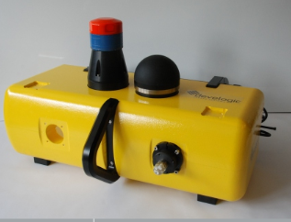
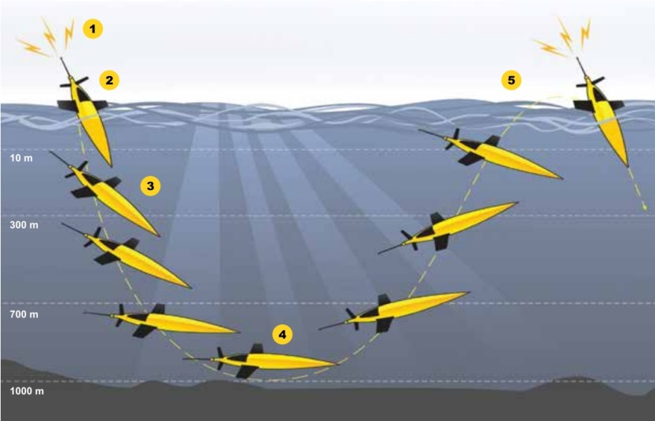
Key element 4
The Monitoring Module
Moored and Mobile systems will collect data from the surface, the water column and the benthos of ODYSSEA Observatories.
To reduce costs and to ensure active participation of end-users on ODYSSEA platform, existing facilities (onshore and offshore), such as oil and gas terminals and rigs, mariculture installations, ports and harbours, will be used to deploy static sensors.
Static Sensors
ODYSSEA Monitoring Systems
Mobile Sensors

Slide 9
Key Element 5
Observational Systems Expansion
In ODYSSEA Observational Systems are expected to expand their operational capacity testing the integration of other existing sensors, such as fluorometer, laser-optical plankton counters, novel sensors for emerging pollutants, such as micro-plastics, submarine cameras (for benthic organisms and fish species recognition, classification and tracking) and acoustic sensors for mammals and marine noise monitoring.
Microplastics sensor by LEITAT

Slide 10
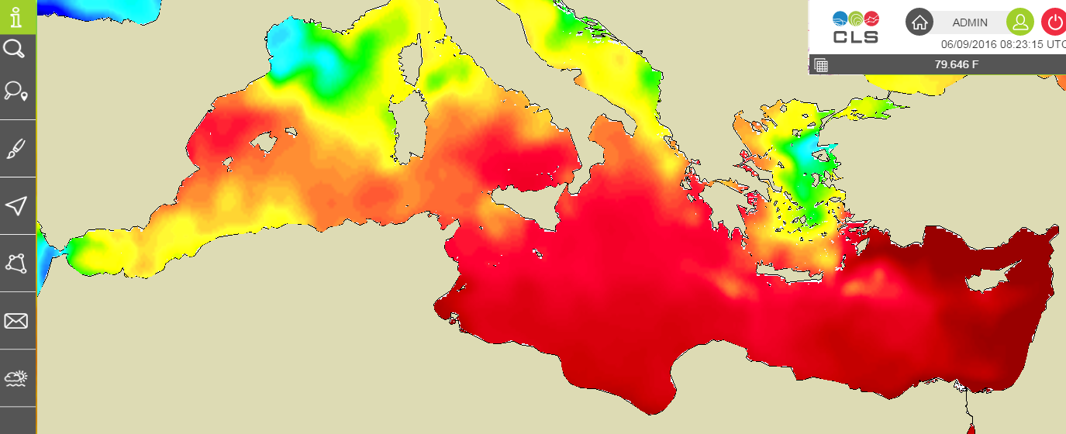
Key element 6
Services Generation
Secondary data (i.e., data packaged in ready-for-use information products) derived from measurements and model results will be disseminated serving the needs of a wide range of end-users, such as industry, policy makers, public authorities and civil societies.
ODYSSEA platform visualisation tool

Slide 11
Key element 7
Networking, Training and Capacity Building in N. African countries
Organize workshops to train future managers and operators of ODYSSEA Observatories;
Organize personnel exchanges;
Improve the professional skills and competences of those working and being trained to work in the blue economy.

Slide 12
ODYSSEA Components
Data Collection
Tools
Products & Services
WP4 : Operational modelling
Impact Generation
Preparatory Actions
WP5 : In-situ monitoring
WP1 : Marine data and availability and integration
WP12 Management
WP2 : Setting up the ODYSSEA observations
WP9 : End user & policy maker involvement
Generating Services
WP3 : Designing the ODYSSEA platform
WP6 : Platform Development, Operation and Maintenance
WP10 : Capacity building in North African countries
WP7 : Big Data Management and Tools Development
WP8 : ODYSSEA End-user Services
WP11 : Dissemination and communication

Slide 13
The ODYSSEA Consortium
Knowledge developers
DUTH (GR), FORTH (GR), Technion (IS), Sapienza (IT), Deltares (NL), IU (TR), HCMR (GR), UNIBO (IT), AUTH (GR)
Technology providers
Alseamar (FR), Leitat (SP), Hidromod (PT), Develogic (GER), GTD (SP), CLS (FR), Thales (FR), Edisoft (PT), Blue Lobster (UK)
Policy makers
UNEP-WCMC (UK), UNEP RAC-SPA (TUN)
Service Providers
VPF (SP), AGIR (MOR), NSV (ALG), ANDDCVS (TUN), RAED (EG), EcoOcean (IS), SPNI (IS), Agora (IS)

Slide 14
THANK-YOU
BlueMed CSA Coordinators’ Meeting
Simon Keeble (Blue Lobster – UK) on behalf of…
Georgios Sylaios (DUTH – Greece - Coordinator)
simon@bluelobster.co.uk - gsylaios@env.duth.gr

