Slide 1

Consumer Driven Production: Integrating Innovative Approaches for Competitive
and Sustainable Performance across the Mediterranean Aquaculture Value Chain
Katerina Moutou
Coordinator
University of Thessaly, Greece
BlueMED CSA Coordinators’ Meeting
Malta 11-12 January 2018
This project has received funding from the European Union’s Horizon 2020 research and innovation programme under grant agreement No 727610. This output reflects the views only of the author(s), and the European Union cannot be held responsible for any use which may be made of the information contained therein.

Slide 2
At a Glance
TITLE: PerformFISH – Consumer Driven Production: Integrating Innovative Approaches for Competitive and Sustainable Performance across the Mediterranean Aquaculture Value Chain
Funding: H2020 (7M€ budget)
Call topic: SFS-23-2016: Improving the technical performance of the Mediterranean aquaculture
Consortium: 28 partners, 12 linked Third Parties, 10 countries
Duration: May 2017 – April 2022 (5 years)
BlueMED CSA Coordinators’ Meeting, Malta 11-12 January 2018

Slide 3

Objective
PerformFISH will increase the competitiveness of the Mediterranean aquaculture sector by tackling biological, technical and operational weaknesses that underlie the stagnation of marine fish production in the last decade, while addressing social and environmental responsibility and contributing to “Blue Growth”.
Target species:
Gilthead sea bream (Sparus aurata) and European sea bass (Dicentrarchus labrax), representing 92.8% of the EU Mediterranean marine fish production volume.
User-centric approach
BlueMED CSA Coordinators’ Meeting, Malta 11-12 January 2018

Slide 4
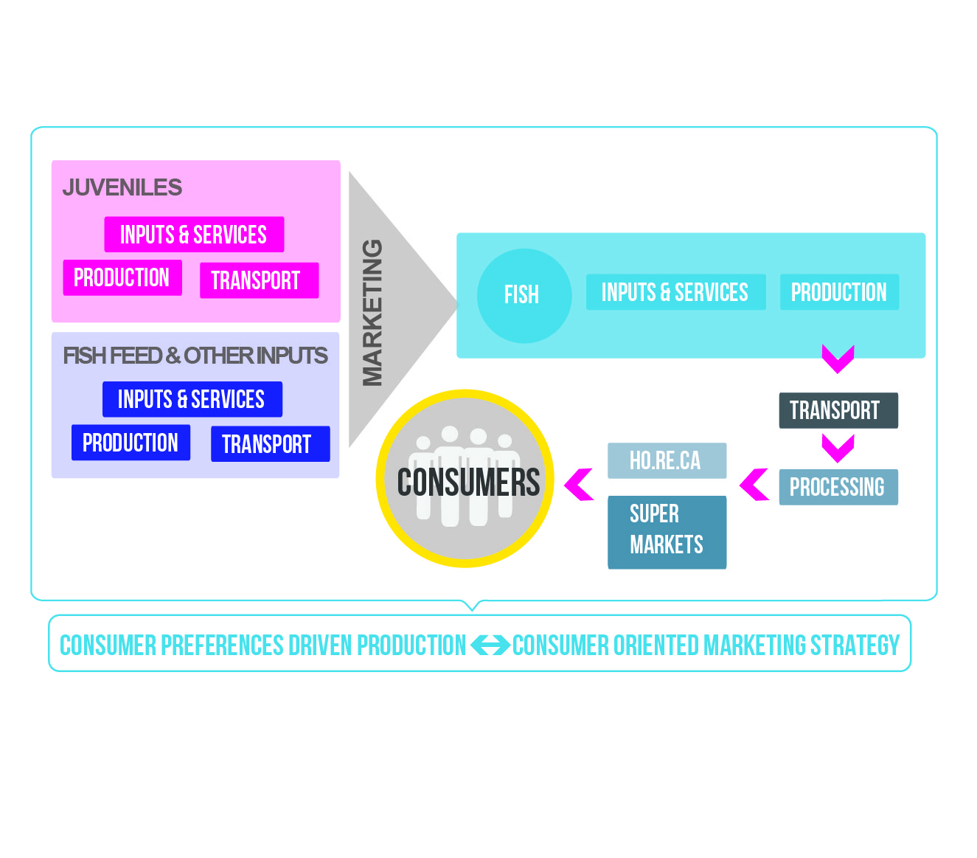
Overall Approach
The project will cover aspects throughout the aquaculture value chain
BlueMED CSA Coordinators’ Meeting, Malta 11-12 January 2018

Slide 5
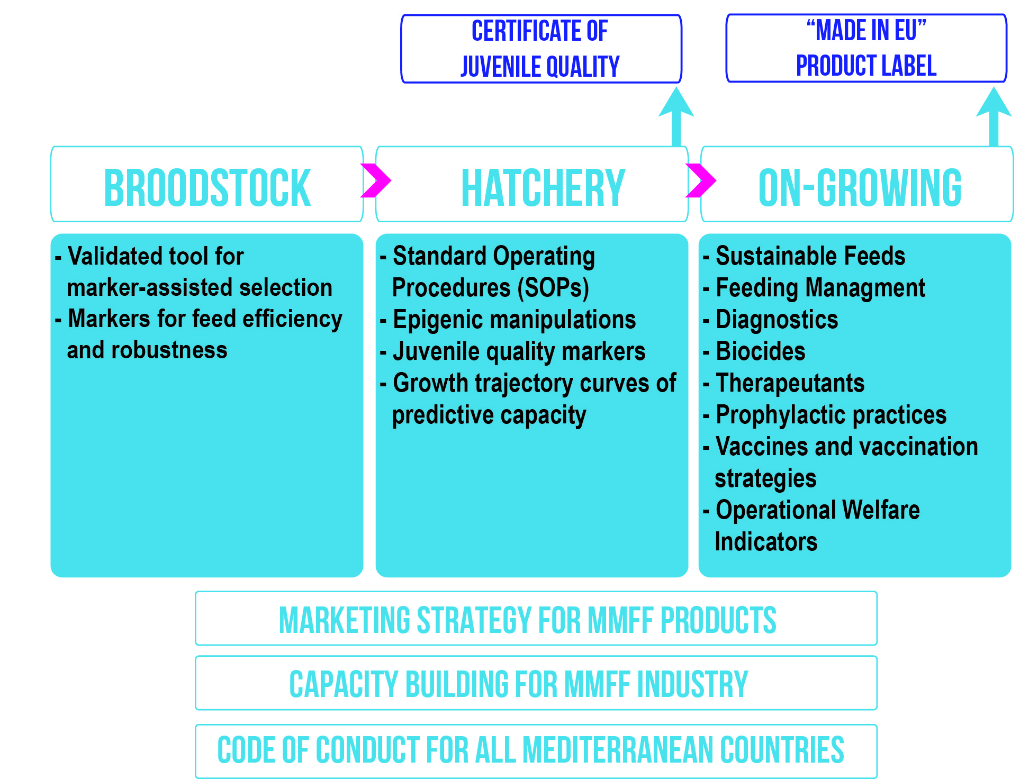
Overall Approach
“Implementation to Impact”
BlueMED CSA Coordinators’ Meeting, Malta 11-12 January 2018

Slide 6
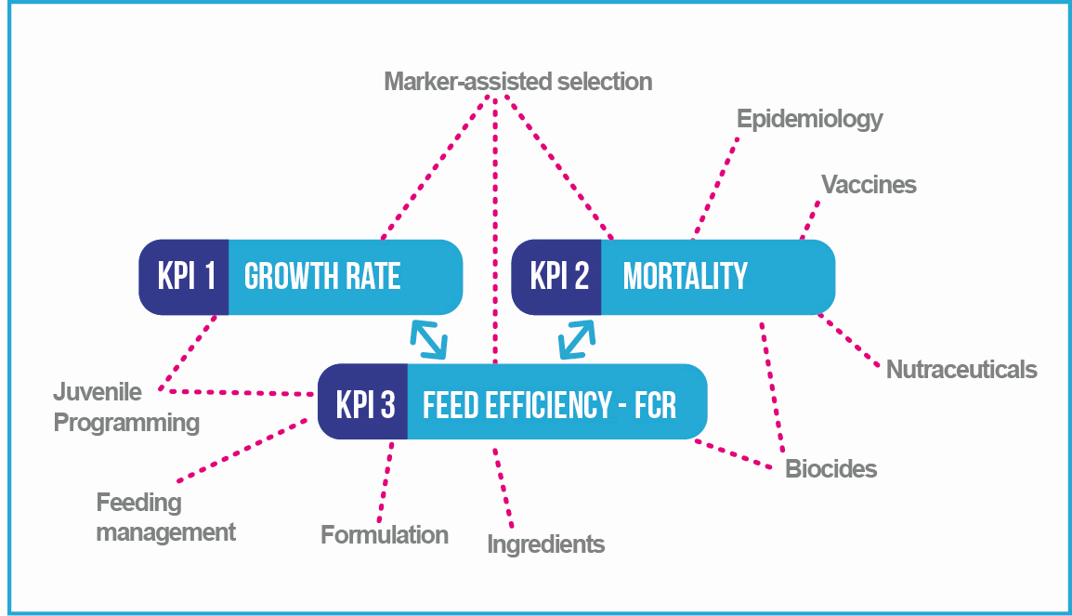
Overall Approach
Performance assessment based on measurable KPIs
BlueMED CSA Coordinators’ Meeting, Malta 11-12 January 2018

Slide 7
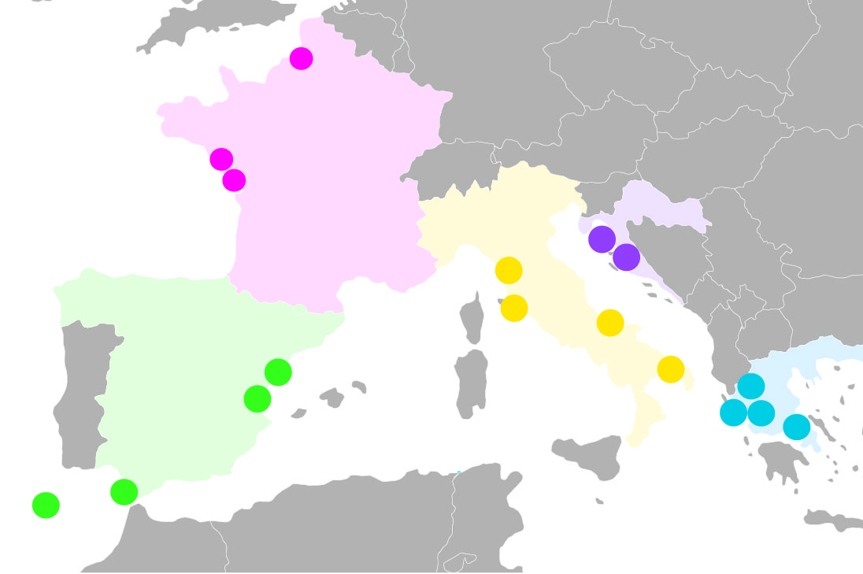
Solutions will be validated in
real production environments
Professional Associations
and linked third parties
Spain – APROMAR
Andromeda Iberica Acuicultura S.L.
Alevines y doradas SA
Aquicultura Els Alfacs SL
Greece – FGM
KALLIERGEIES YDROVION ORGANISMON ANONYMOS ETAIREIA
Selonda Aquaculture S.A.
NIREFS ICHTHIOKALLIERGEIES ANONYMI ETAIRIA
Italy – API
Panittica Italia Società Agricola Srl
COSA Società Agricola arl
AZIENDA AGRICOLA ITTICA CALDOLI
Croatia - CCE
Cromaris dioničko društvo za marikulturu
France - SFAMN
FERME MARINE DU DOUHET SAS
ECLOSERIE MARINE DE GRAVELINES ICHTUS
Fish producing companies will offer varying operational environments for comparative validation and demonstration of integrated solutions
BlueMED CSA Coordinators’ Meeting, Malta 11-12 January 2018

Slide 8
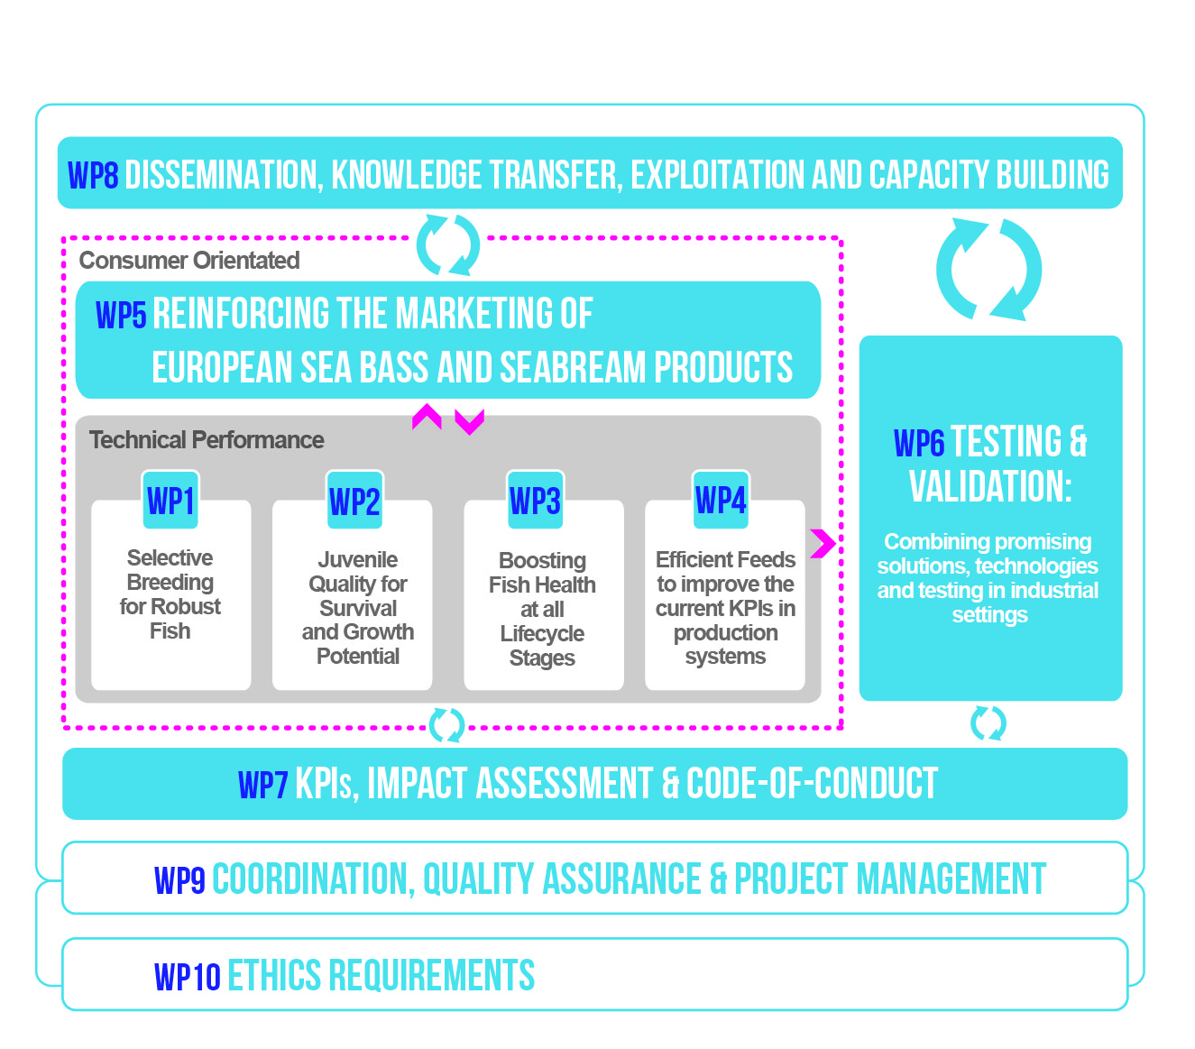
Project Structure
BlueMED CSA Coordinators’ Meeting, Malta 11-12 January 2018

Slide 9
WPs address different KPIs
WP1
KPIs:
KPI-1: Growth Rate (BW, TL, TGC, DGR,…)
KPI-2: Mortality (TM, CM, NSM, FSRs,…)
KPI-3: Feed Efficiency –(FCR, NR, LER, PER, …)
KPIs related to Welfare
Economic sustainability
Environmental sustainability
Specific definition of the PKIs agreed with the industry is required
WP2
WP3
WP4

Slide 10
Expected Outputs
Industry
Policy
Environment and Society
European Certificate of Juvenile Quality
Products for disease management and health boost
Operational Welfare Indicators
Technology for optimizing feed efficiency
Key Performance Indicators to build a robust benchmarking system based on KPIs
Code of conduct to safeguard quality along the product line and of the final product and establish proper and responsible practices to serve the vision of economic and ecological sustainability
High quality and healthy MMFF products (EU certified)
Consumer driven marketing plans promoting “locally produced, locally consumed” “farmed in EU” products and “confidence in culture” for the MMFF sector
Environmentally friendly and sustainable production
BlueMED CSA Coordinators’ Meeting, Malta 11-12 January 2018

Slide 11
Expected Results
Substantial improvement of the performance of the focal fish species, through the formation and measurement of sector accepted Key Performance Indicators (KPIs)
Increased competitiveness and improved consumer and society perceptions of MMFF by enabling the industry to adopt a holistic approach to:
• produce safe and healthy food with a low ecological footprint
• provide employment and trade in rural, peripheral and coastal regions
• reduce European dependency on importation of seafood
Consolidated and promoted best practice in fish farming through:
• endorsed certification and quality assurance
• development of human capacity building
• engagement with consumers and societal actors to promote the brand of MMFF practices and products
BlueMED CSA Coordinators’ Meeting, Malta 11-12 January 2018

Slide 12
Expected Impact
Industry
Policy
Environment and Society
Competitiveness of MMFF sector
Production of high quality Sea Bass and Sea Bream
Highly skilled professionals
Revenues for Mediterranean industry
Improved image of aquaculture production systems and products
Contribution to the implementation of CFP, BLUEMED Initiative and Marine Strategic Framework Directive
Job creation
Consumer driven production
of MMFF products
Lower environmental impact
of MMFF activities in the Mediterranean basin
BLUE GROWTH
BlueMED CSA Coordinators’ Meeting, Malta 11-12 January 2018

Slide 13
Contribution to BLUEMED Initiative
PerformFISH is fully aligned with the aims and the SRIA of BLUEMED
Ecosystem-based Management of Mediterranean Aquaculture and Fisheries
It will increase the competitiveness of the Mediterranean aquaculture sector that is considered a Key Sectoral Enabler in the Mediterranean through…
developing new strategies, technologies and practices to make aquaculture sustainable while promoting the investment in best technologies
cooperation between the public and private sectors
maximisation of the leverage effects of research investments and their influence on public policy
public understanding of the value of the Mediterranean blue economy
improved skills for a well-equipped workforce
BlueMED CSA Coordinators’ Meeting, Malta 11-12 January 2018

Slide 14






Expected Impacts
BlueMED CSA Coordinators’ Meeting, Malta 11-12 January 2018

Slide 15
Questions?
Katerina Moutou kmoutou@bio.uth.gr
Find out more:
www.performfish.eu
@PerformFISH_EU

