Slide 1

H2020 BlueGrowth projects:
SEA LITTER CRITTERS
CLAIM
BlueMed CSA Coordinators’ Meeting
Malta, 11th-12th January 2017

Slide 2
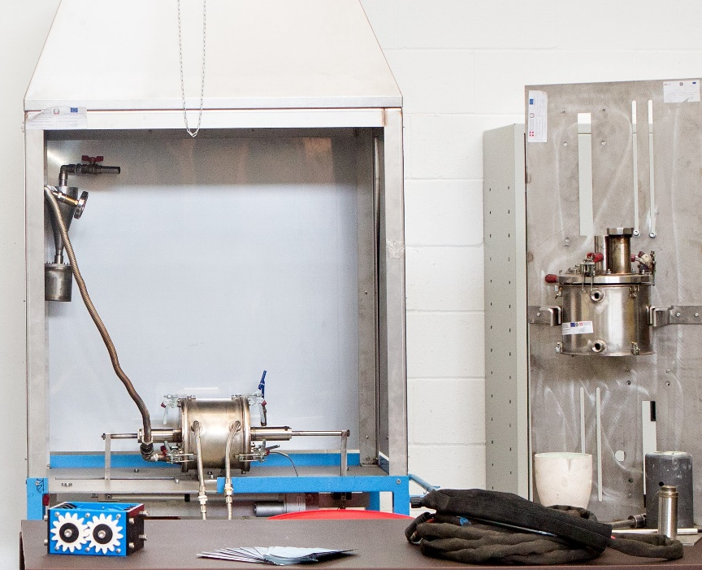
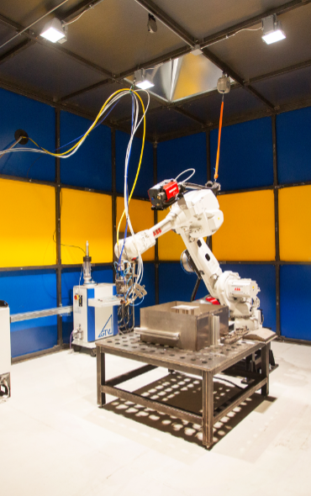
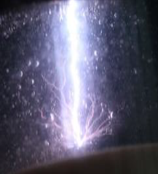
Our company
Innovative SME born in 2012 in Turin, Italy
11 members of staff of which 7 engineers (including a PhD), 2 scientists and an architect
Background in plasma technology, industrial laser, CNC machining, materials, energy, waste and water management.
Main field of specialisation: development of small scale innovative solutions for treatment of liquids (water, foodstuff) and solid waste (residual municipal, urban and marine litter, hazardous) with recovery of energy and materials.
H2020 activity:
SME Instrument Phase 1 champion with SeaLitterCritters feasibility study (BlueGrowth topic)
Winner of an SME Innovation Associate grant (FormulaGP, started Sept 2017 – call INNOSUP02-2016)
Technology provider within CLAIM project (BG07-2017)
Active in: Factories of the Future, MSCA ITN, Circular Economy and a Fuel Cell – Hydrogen Joint Undertaking

Slide 3
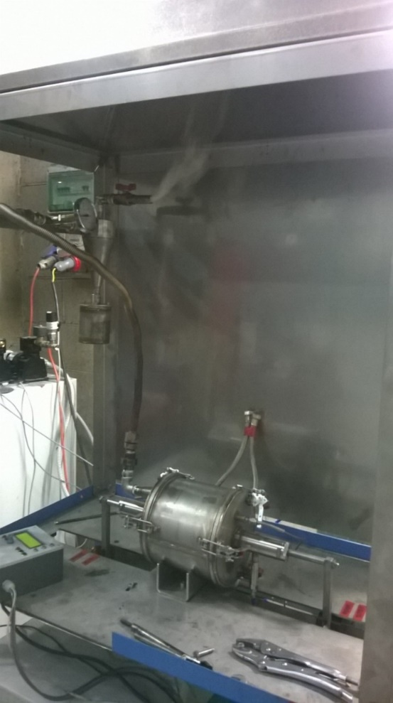
GreenPlasma
The origins
ESF funded project that started from proof of concept and arrived at TRL5
Plasma based thermal treatment that pyrolises waste producing a syngas, i.e. a mixture of combustible gases – mainly hydrogen, carbon monoxide, some methane, some other hydrocarbons and a solid, inert residue recyclable as aggregate for cement/bitumen bound applications
Designed for small scale (up to 50kg/day), self contained, working in semi-batch mode with v. quick ramp up and down
Best application where spare heat can also be exploited : positive energy balance
Applications:
  small isolated communities where waste collection has a significant cost because of logistics (mountain villages, small islands)
  wherever small volumes but “difficult” waste arisings are produced (e.g. boats, ports, WEEE processors, hospitals etc)
https://youtu.be/Uya2Tjd24yk?t=5m27s

Slide 4
SeaLitterCritters
BlueGrowth Topic, 2016
CORDIS: https://tinyurl.com/y8xy2fzr
Market analysis and technical feasibility study.
Conclusions:
  completely unmanned vehicles not yet allowed by regulations for navigation
  market explored not yet ready: who pays for cleaning marine litter?

Slide 5
H2020 BG07-2017
Nov ‘17- Oct ’21
Coordinators: HCMR https://tinyurl.com/ybspb78d

Slide 7
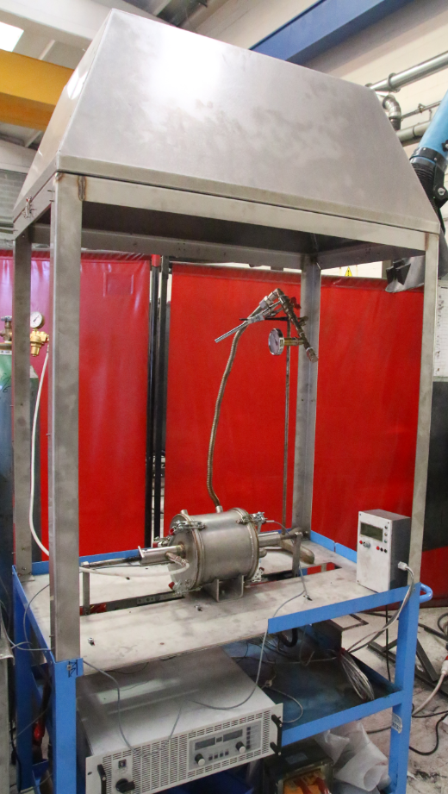
Our role in the project
Technology provider for treatment of floating (macro) litter (mainly plastic)
Integration on board a vessel for near coast cleaning activities, namely: collecting waste accumulating at booms placed at river mouths
Self contained facility at a fishing port on Baltic Sea (Hirtshals)
WP2 (TECHNOLOGY DEVELOPMENT) co-leaders and Task 3.3 (DEMONSTRATION ACTIVITIES) leaders
Contributors to WP5 for exploitation aspects (business planning)
Main outputs for IRIS:
Reaching TRL7
Demonstrating business opportunity

Slide 8


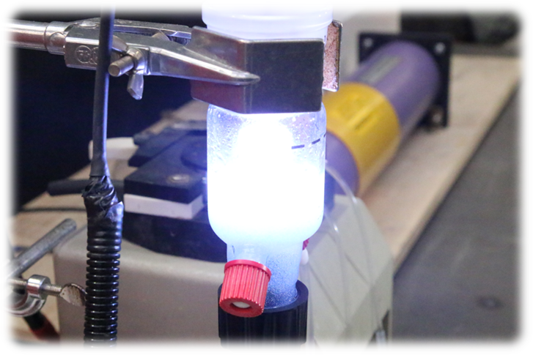
www.irissrl.org
ilaria.schiavi@irissrl.org
Twitter: @we_are_IRISsrl
LinkedIn: IRISsrl

