Slide 1

Solaqua 2- Floating Photovoltaics
Luciano Mule’Stagno
Ryan Bugeja
Federica Strati
Martin Grech
luciano.mule-stagno@um.edu.mt
Institute for Sustainable Energy

Slide 2
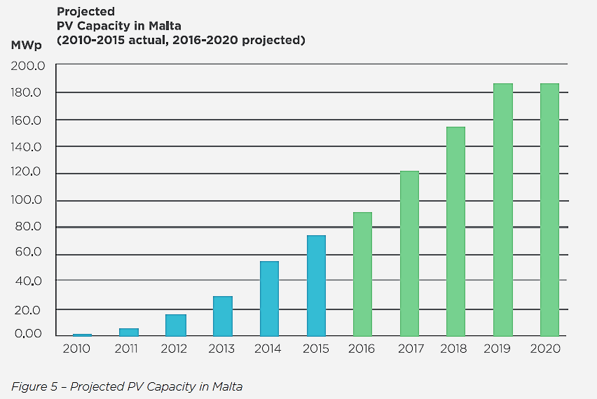

Alignment with National Priorities
180MWp will be installed by 2020. How much more useable land is available?
Institute for Sustainable Energy

Slide 3
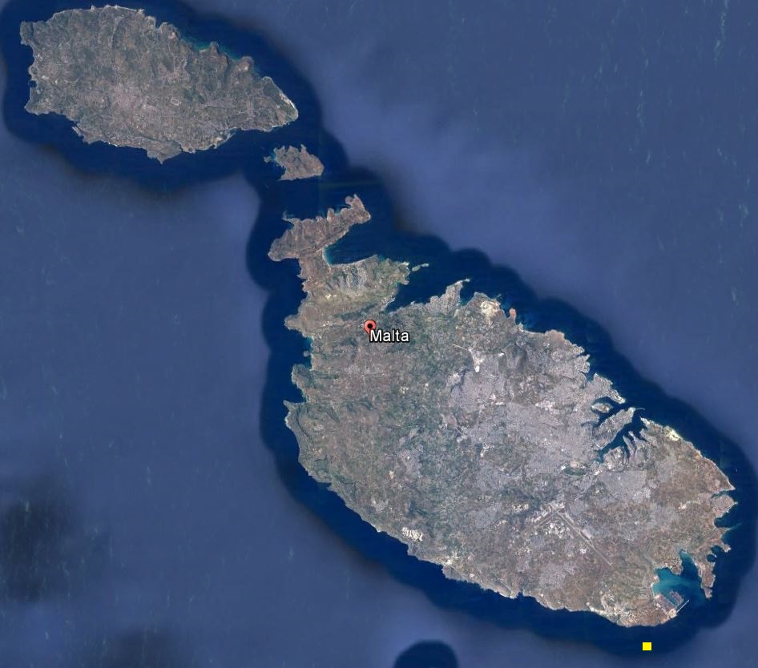
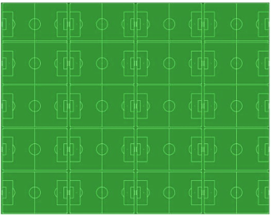
Cost and Availability of Land
Land is expensive in small islands and large coastal cities.
Not easy to find space for 10 MWp (>100,000m²) size farms in places like Malta …. Except at sea.
Institute for Sustainable Energy

Slide 4
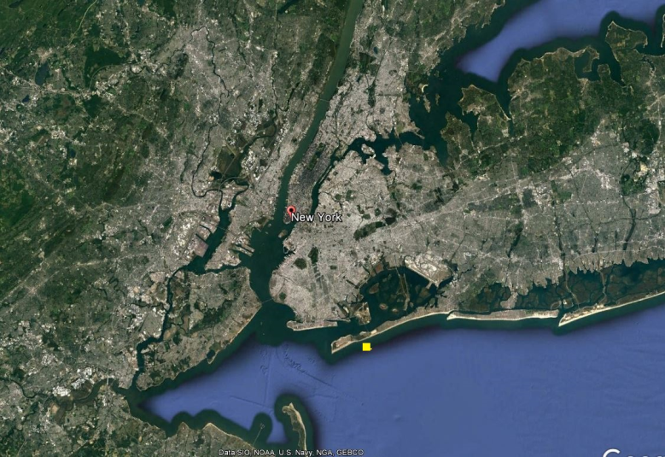
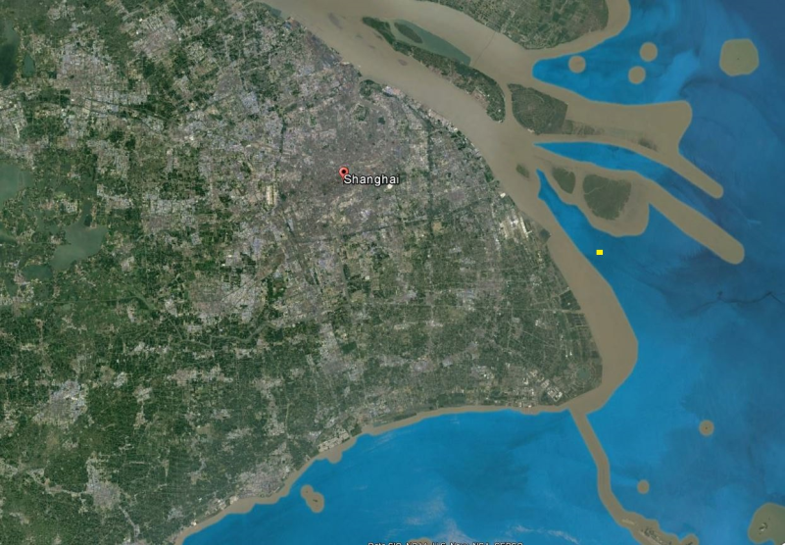
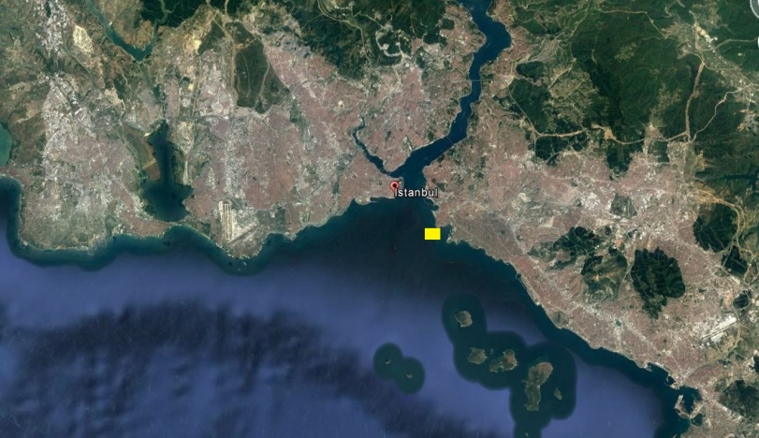
Cost and Availability of Land
Same problems in large cities
Many of which are on the coast...
(Yellow squares represent 100MWp area)
Istanbul
New York
Shanghai
Institute for Sustainable Energy

Slide 5

Cost of Land
Land in Malta suitable for solar farms costs €40-50,000 per tumolo. In large cities it is even more expensive.
Solar farms can be built outside city limits, requiring expensive cabling and the resultant transmission losses.
Floating solution would be
cost effective if its costs are
similar to the cost of land.
Institute for Sustainable Energy
5
5

Slide 6
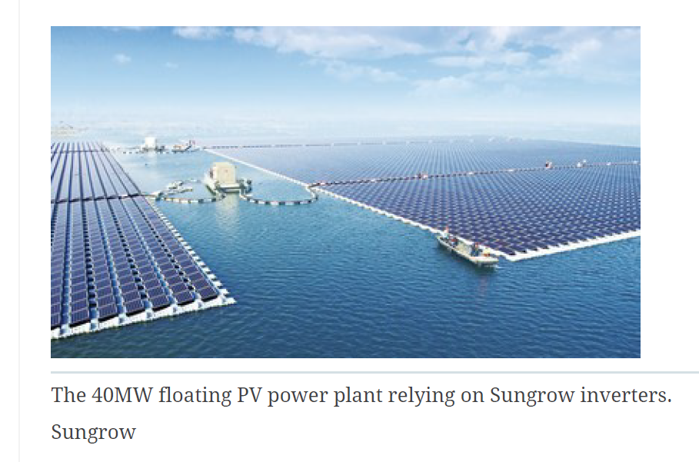
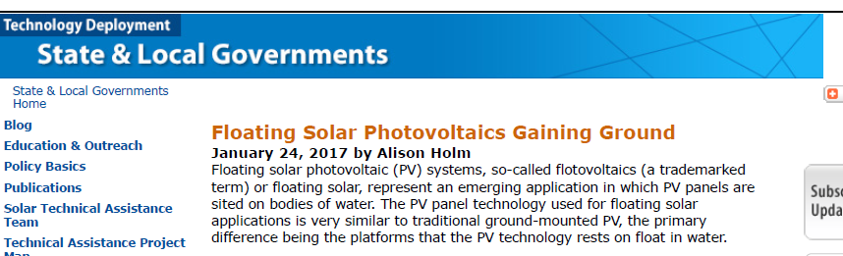
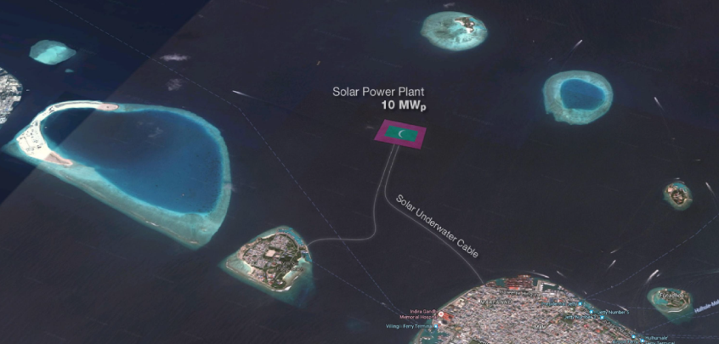
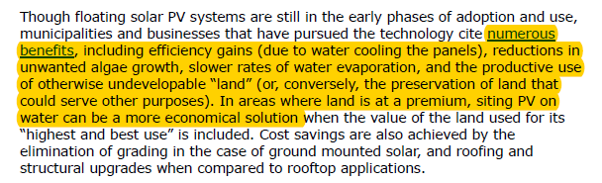
The Market
Floating solar is happening around the world – in lakes, reservoirs and ponds. We pioneered solar at sea, but others are following.
Institute for Sustainable Energy

Slide 7
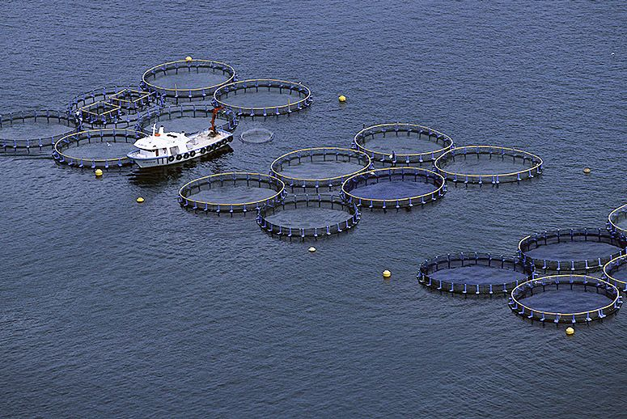
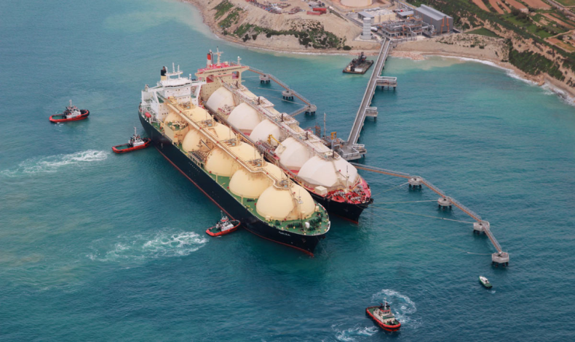
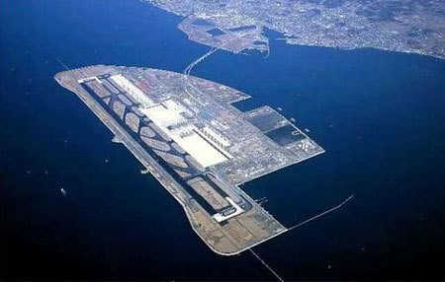
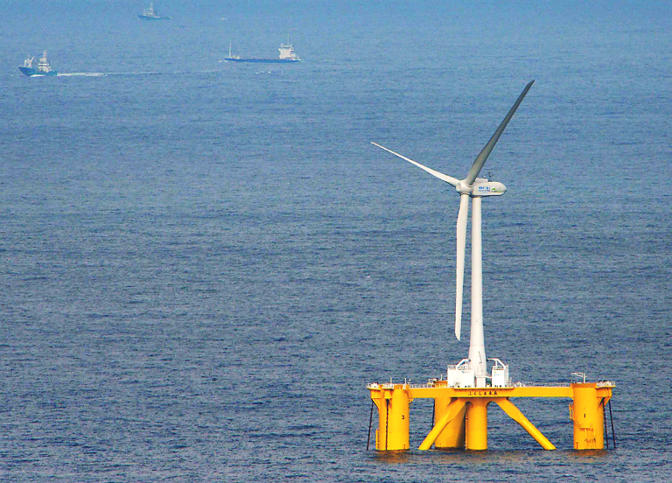
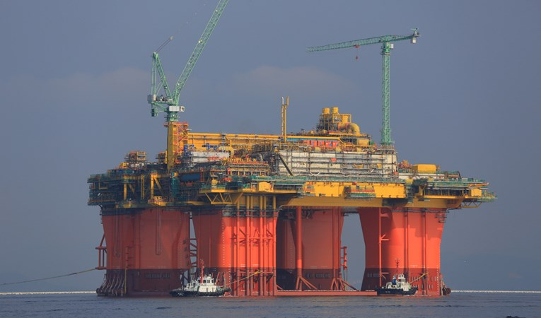
Technology
Permanent moored structures already exist.
So why not PV farms?
Institute for Sustainable Energy

Slide 8
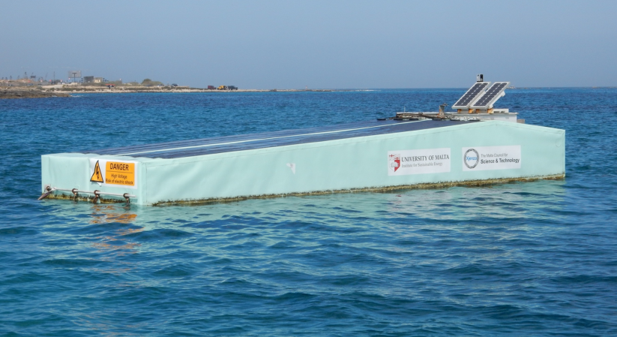
Capabilities
We already have 4 years of experience working on this area.
We have tested various floating structures
Our prototypes were at sea for almost 3 years.
We have gained valuable experience as to what works and what doesn’t in practice
Institute for Sustainable Energy

Slide 9
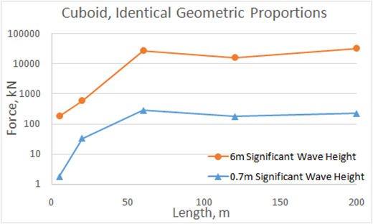
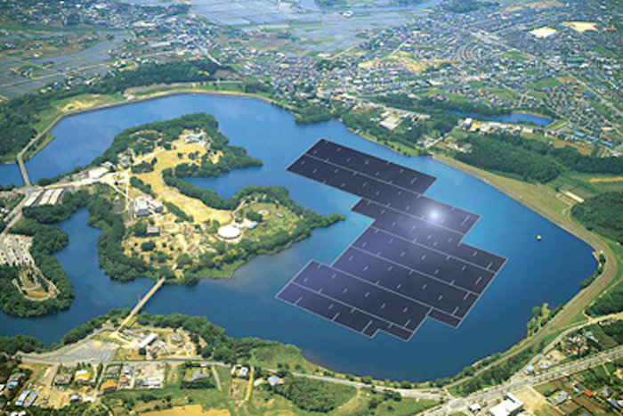
Technology
As a direct result of our research,
We believe the winning technology is large, cheap floating structures.
Large: greater than 50-100m
Cheap – costing no more than €50/m2.
Durable – with a lifetime >10 years and low maintenance.
With these parameters such a farm would be directly competitive with on-ground systems.
Institute for Sustainable Energy

Slide 10
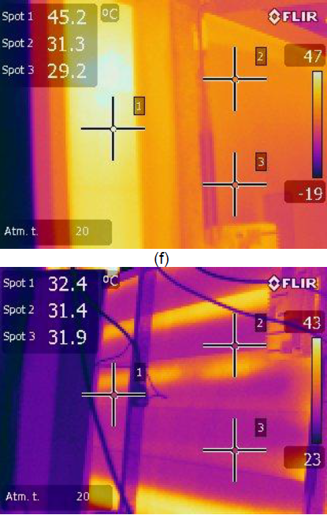
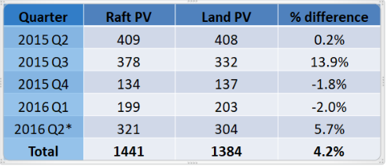
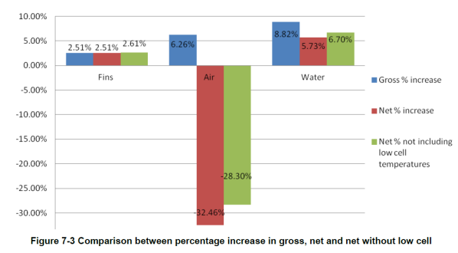
Technology
Solaqua has also demonstrated that at-sea panels produce 5-10% more than land based systems.
Active cooling can augment this even further.
Taking advantage of reflection
off the water module optimisation
Choice of PV materials
Design and mooring for maximum
durability.
Experience has been gained in all these areas
In previous projects.
Institute for Sustainable Energy

Slide 11
Our Goals
Robust
Lifetime 10-20 years
Low maintenance
Modular
Overall cost per kWh competitive with on-land systems.
Design v1.0 in 2018
Output improvements v1.0 in 2018
Wave tank testing – scale model 2019
Full-scale prototype - 2019-2020
Institute for Sustainable Energy

Slide 12
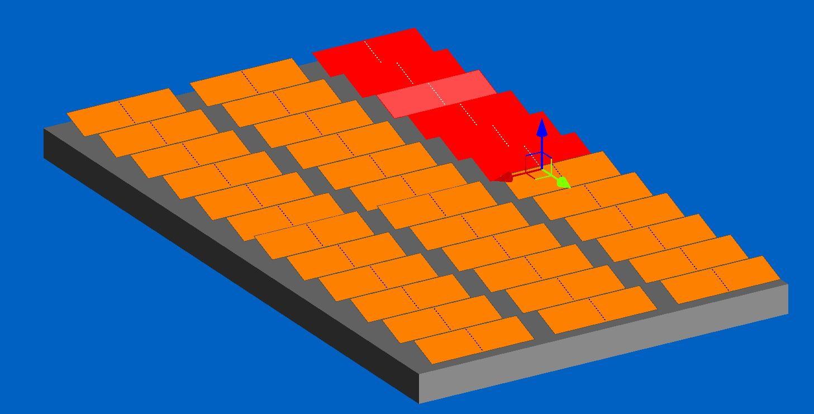
Improving Energy Output
Various ways of improving the output of at-sea panels will be analyzed
Active cooling
Best installation configuration
Type of panels used.
Institute for Sustainable Energy

Slide 13
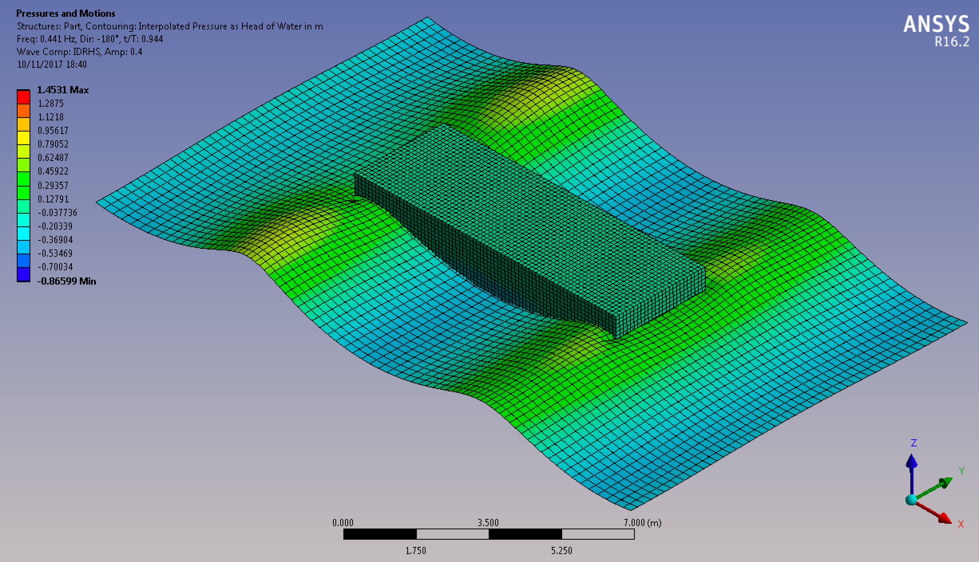
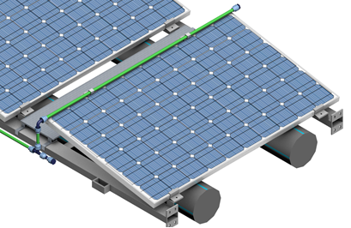
Best Design
We will study, design and model the cheapest option to make the most durable and lowest maintenance structure.
Frame structure
Solid material
Dimensions
Modularity
Materials.
Institute for Sustainable Energy

Slide 14
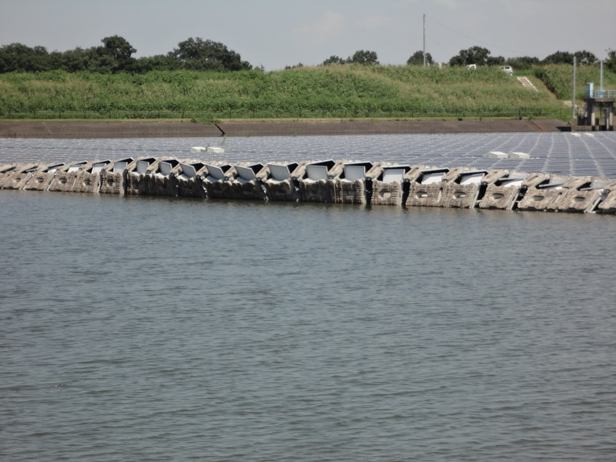
Way Forward
The current leading solution for floating PVs is not suitable for installations at sea.
…. And has other problems.
Susceptible to lifting in high winds
Our goal is to design a
System that is.
Institute for Sustainable Energy

Slide 15



Thank you
Institute for Sustainable Energy

