Slide 1
Do you know the BlueMed Pilot Action?
Joining outreach efforts for public engagement and education

Slide 2
Pollution needs no VISA
The BlueMed Young Communication Ambassadors Action Plans

Slide 3
http://www.bluemed-initiative.eu/the-young-communication-ambassadors/

Slide 4
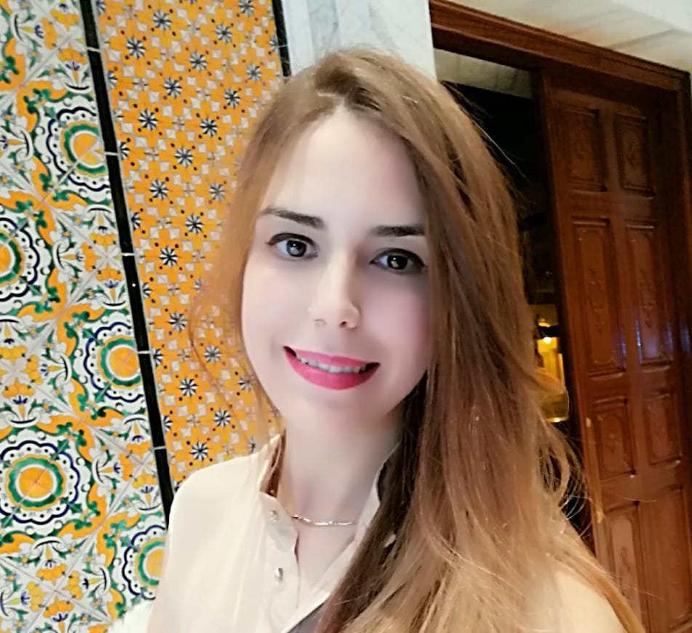
Pollution needs no VISA #1
BlueMed engaging civil societies across the Mediterranean: the young Ambassadors’ voices
Inès’ Action Plan in one tweet:
Industrial pollution in #Tunisia and more precisely in #Gabes is threatening the marine biodiversity !
Let’s tackle the #Marine and #Climate #Crisis through #Mitigation & #Adaptation !
Inès Boujmil
BlueMed Y.C. Ambassador in Tunisia
BSc in Geosciences
Meng in Fisheries & Marine Environment
& MSc Geomatics applied to Marine Environment

Slide 5
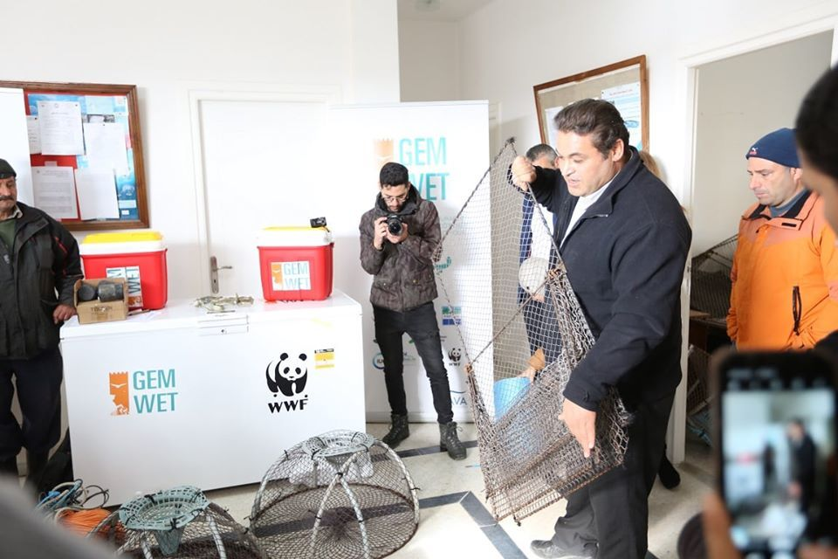
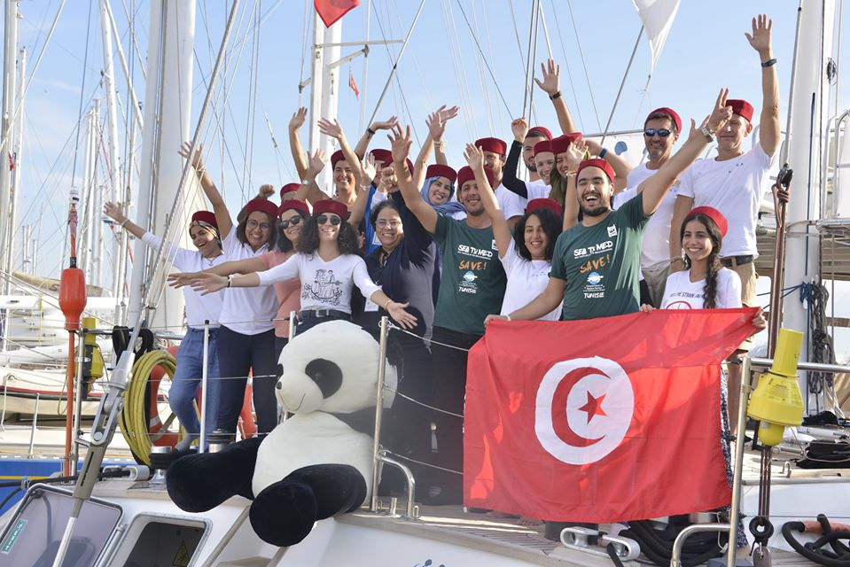
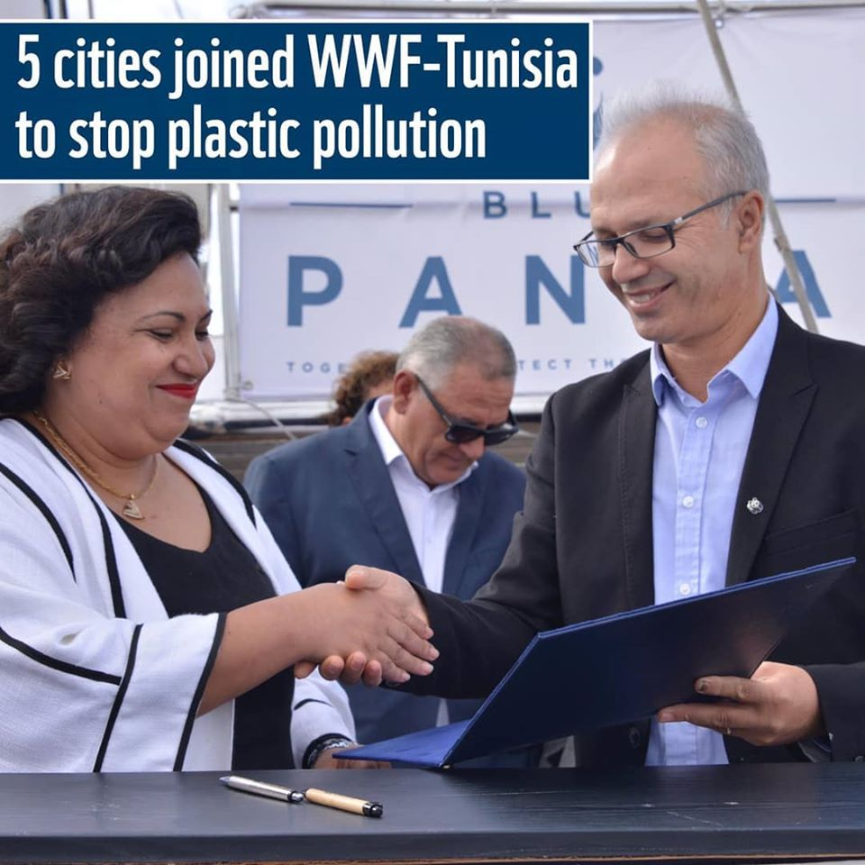
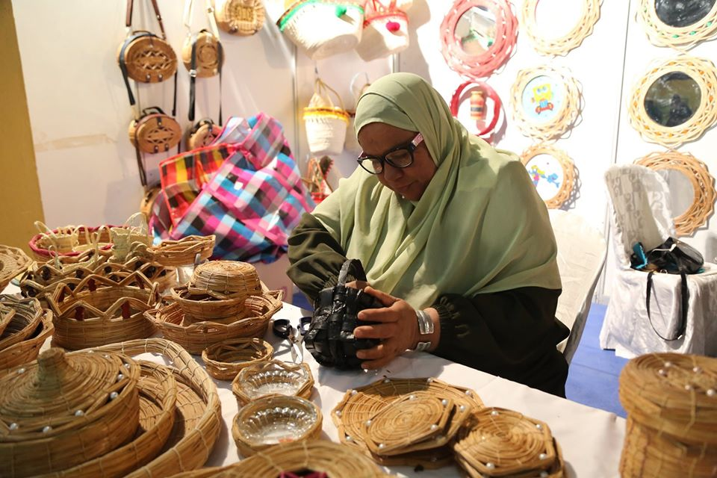
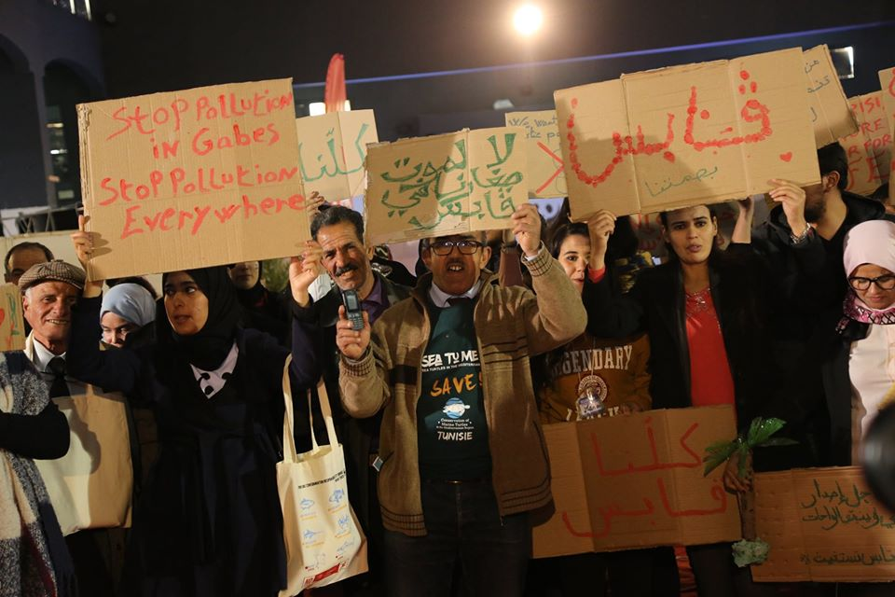
BlueMed engaging civil societies across the Mediterranean: the young Ambassadors’ voices
Pollution needs no VISA #1
Raising awareness in Tunisia through projects & associations
WWF in Tunisia
#Stop_Plastic_Pollution

Slide 6
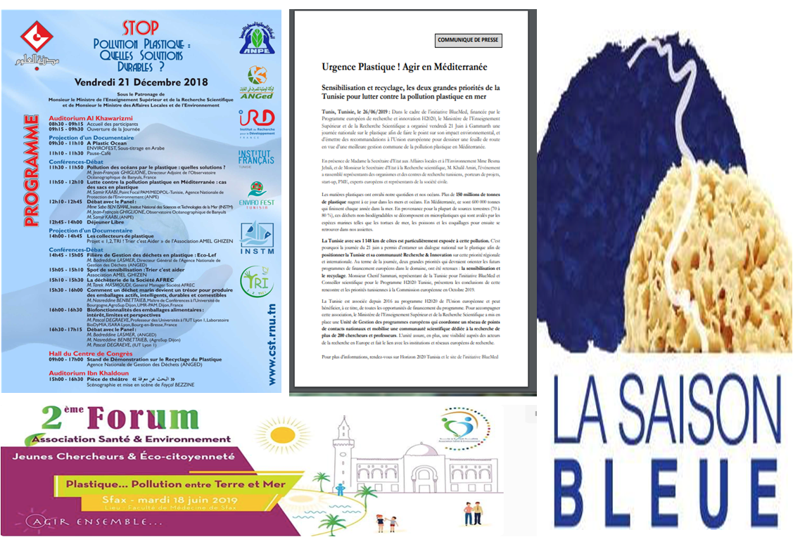
BlueMed engaging civil societies across the Mediterranean: the young Ambassadors’ voices
Pollution needs no VISA #1
Raising awareness in Tunisia through projects & associations

Slide 7
BlueMed engaging civil societies across the Mediterranean: the young Ambassadors’ voices
Pollution needs no VISA #1
JEUNE SCIENCE KERKENNAH

Slide 8
BlueMed engaging civil societies across the Mediterranean: the young Ambassadors’ voices
Pollution needs no VISA #1
ASSOCIATION JLIJ FOR MARINE ENVIRONNEMENT (AJEM)

Slide 9
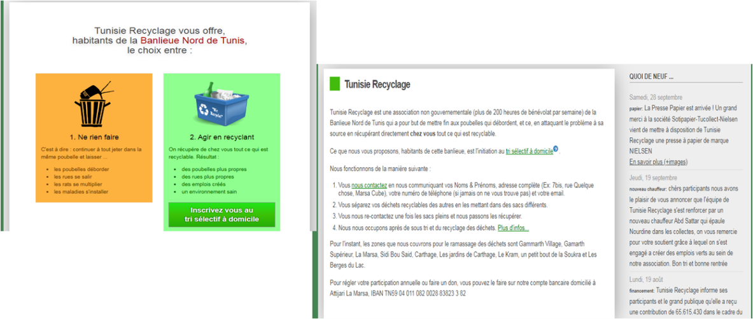
BlueMed engaging civil societies across the Mediterranean: the young Ambassadors’ voices
Pollution needs no VISA #1
TUNISIE RECYCLAGE

Slide 10
BlueMed engaging civil societies across the Mediterranean: the young Ambassadors’ voices
Pollution needs no VISA #1
Heinrich Böll Fondation
The survey carried out by this foundation showed that:
Over 80% of Tunisians agree that a fine should not be imposed on anyone who throws garbage in public space.
75% of Tunisians questioned say they are ready to change their consumption habits and approve the ban of plastic bags.
1/3 of Tunisians APPROUVE to pay more taxes for more cleanliness in their living area !

Slide 11
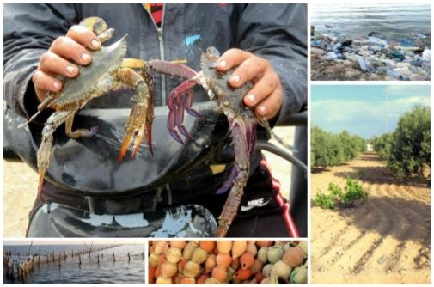
BlueMed engaging civil societies across the Mediterranean: the young Ambassadors’ voices
Pollution needs no VISA #1
TERRI’COOP
Territorial cooperation for sustainable economic development
1. Valorisation of the blue crab exploited in Kerkennah (also in Zarzis):
2. labeling and marketing of seafood
4. Perma-culture and agro-ecology in Kerkennah
3. the fight against plastic pollution

Slide 12
Pollution needs no VISA #1
BlueMed engaging civil societies across the Mediterranean: the young Ambassadors’ voices

Slide 13
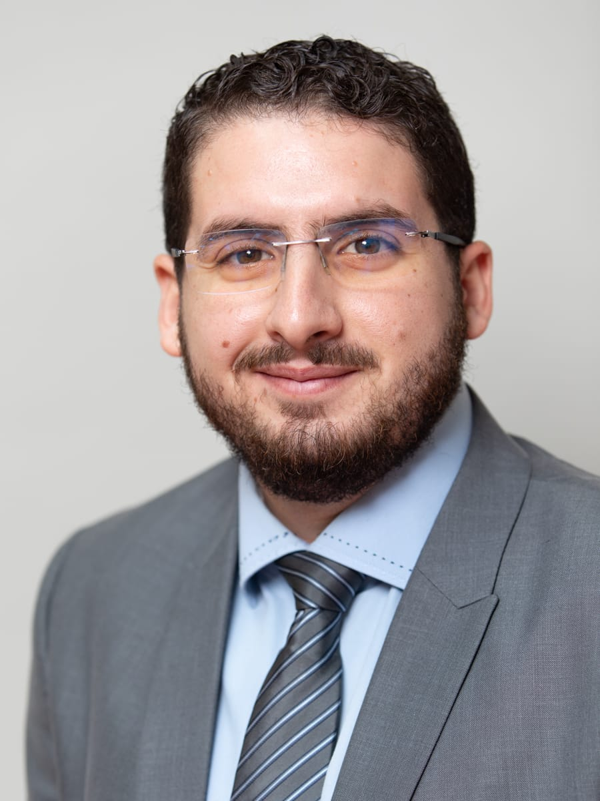
Pollution needs no VISA #2
BlueMed engaging civil societies across the Mediterranean: the young Ambassadors’ voices
Badr’s Action Plan in one tweet:
Saving Moroccan sea at small scale – the white butterfly effect.
Badr El Mahrad
BlueMed Y.C. Ambassador in Morocco
BSc in Geological & Earth Sciences and MSc in Engineering/hydrodynamics; Water & coastal management; Environmental assessment and management

Slide 14
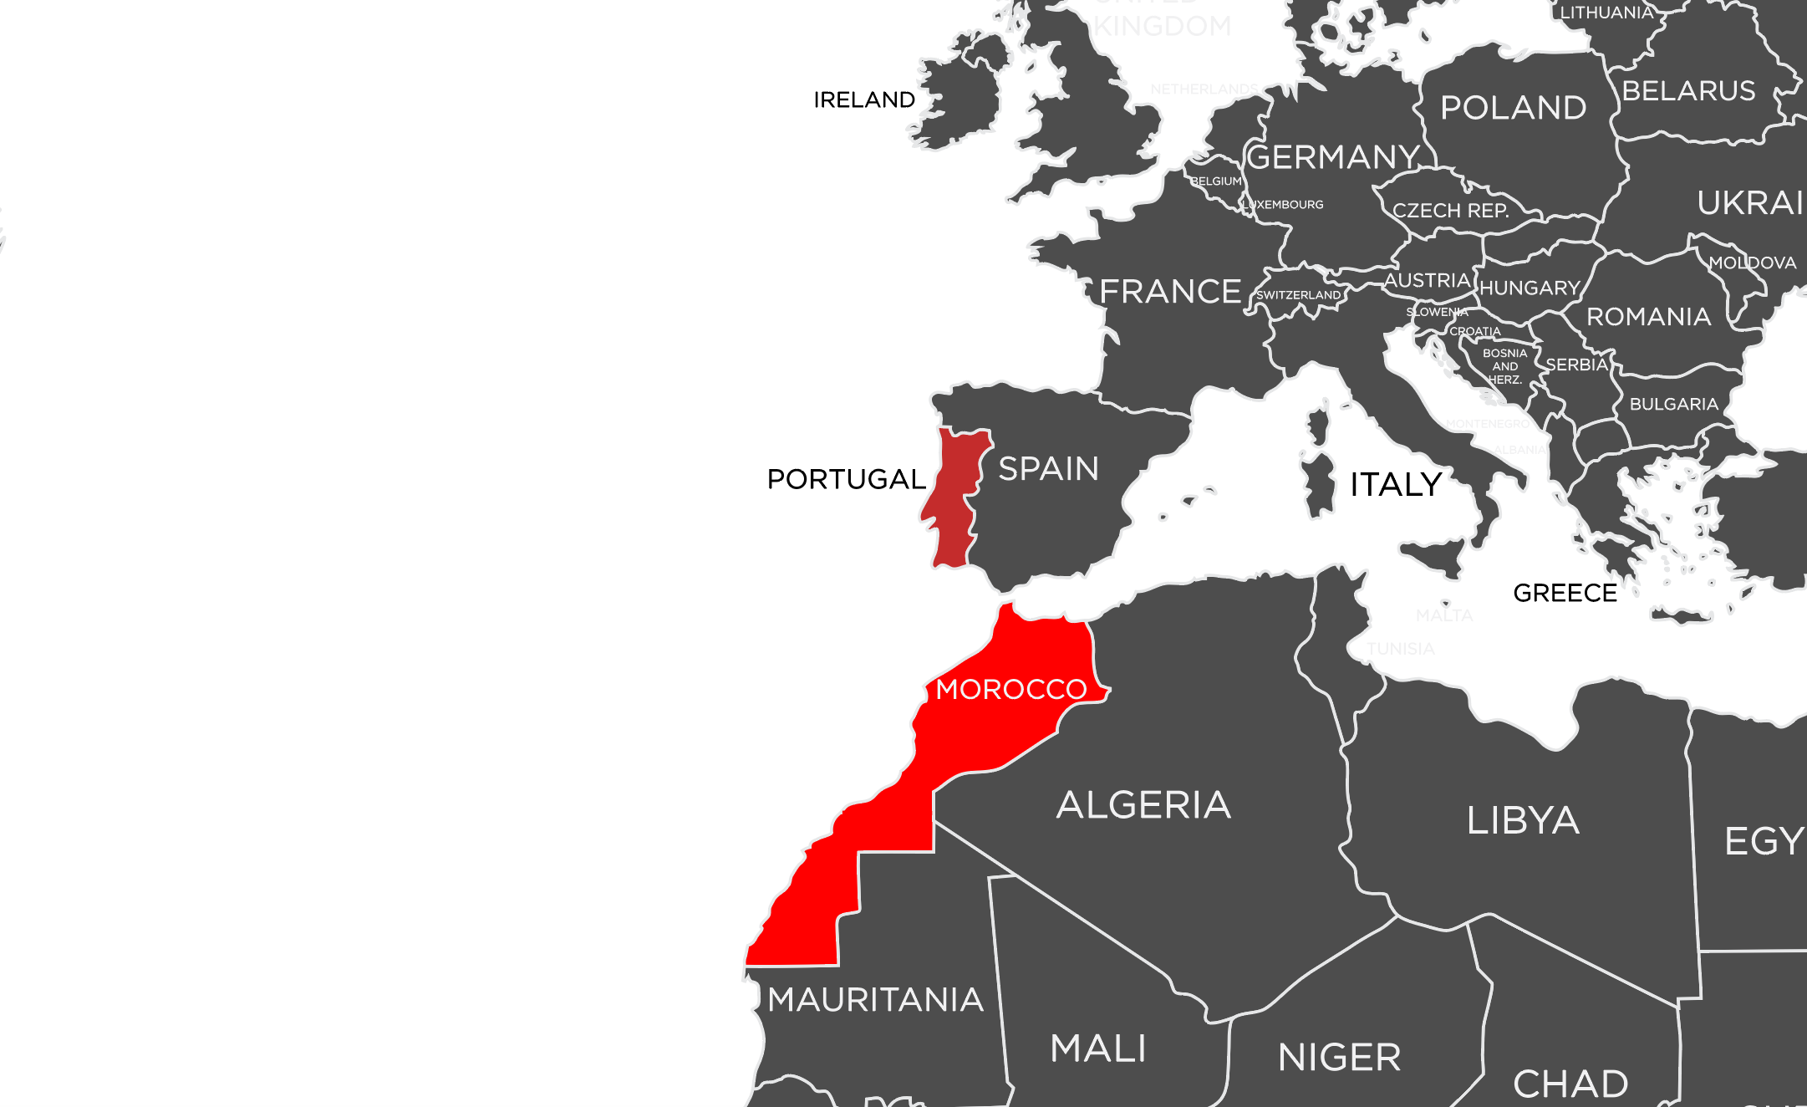
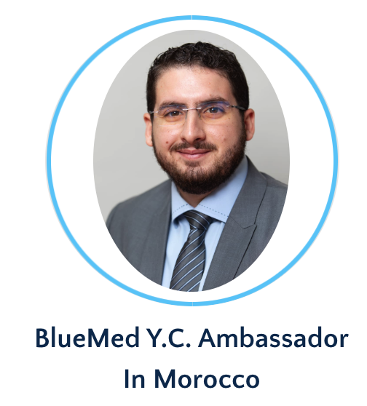
BlueMed engaging civil societies across the Mediterranean: the young Ambassadors’ voices
Badr El Mahrad
Research Fellow
Water Engineering
Coastal and Marine Management

Slide 15
BlueMed engaging civil societies across the Mediterranean: the young Ambassadors’ voices

Slide 16
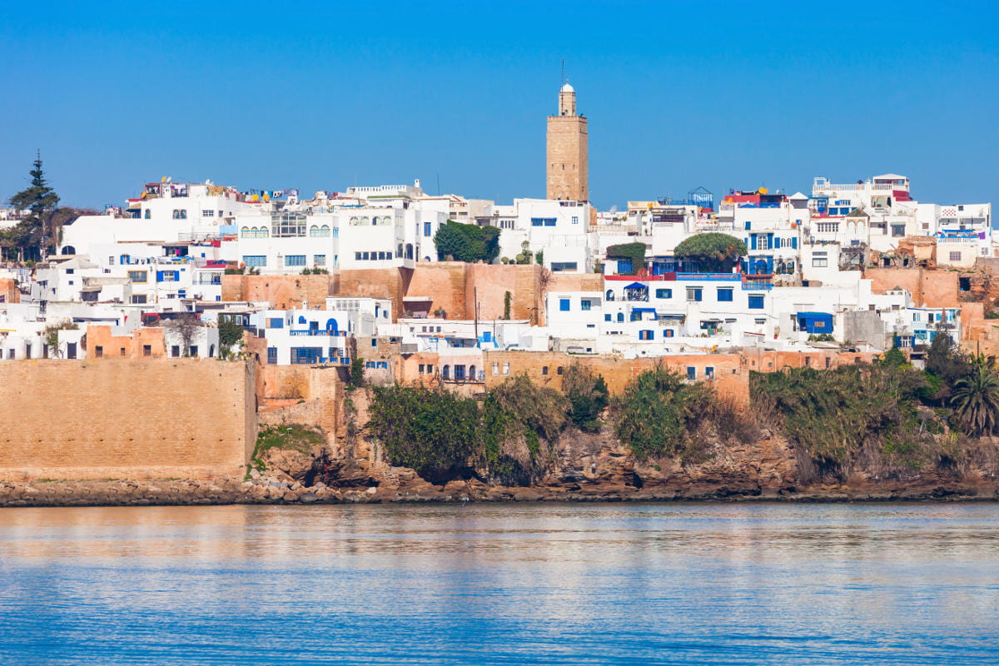
BlueMed engaging civil societies across the Mediterranean: the young Ambassadors’ voices

Slide 17
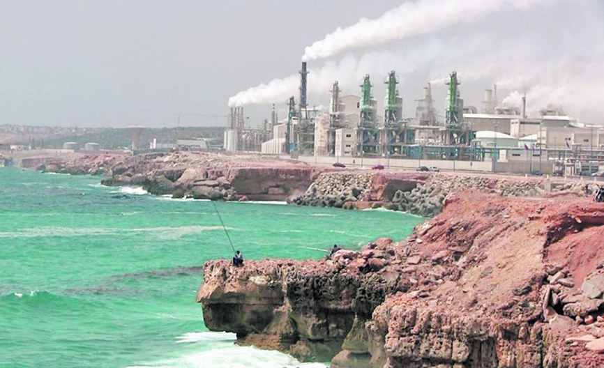
BlueMed engaging civil societies across the Mediterranean: the young Ambassadors’ voices

Slide 18
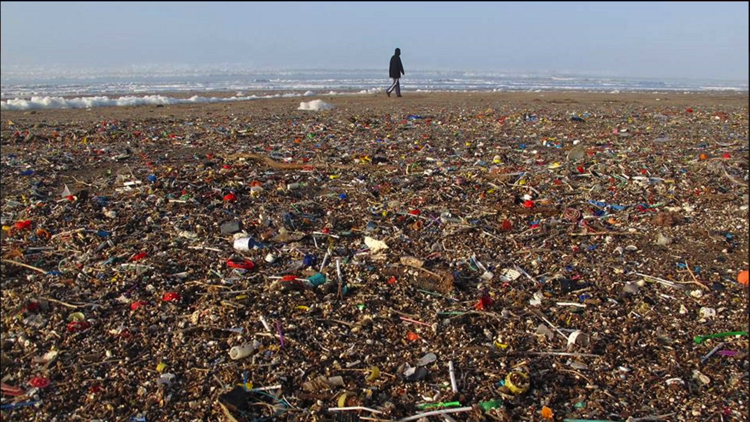
BlueMed engaging civil societies across the Mediterranean: the young Ambassadors’ voices

Slide 19
BlueMed engaging civil societies across the Mediterranean: the young Ambassadors’ voices

Slide 20
BlueMed engaging civil societies across the Mediterranean: the young Ambassadors’ voices
85 %
Plastics

Slide 21
BlueMed engaging civil societies across the Mediterranean: the young Ambassadors’ voices
690.000 T Plastics/Year
57% ➔ Leaked into nature
18% ➔ Mediterranean Sea
River leakage intensity calculated based on the total river flow of Moroccan rivers compared to the Po river in Italy
Source: Dalberg Analysis, Jambeck & al (2014), World Bank (2018), Liubartseva et al “Tracking plastics in the Mediterranean: 2D Lagrangian model”.
Disclaimer: Moroccan government data, which includes territory on the UN list of “non-self governing territories”.
Notes:
tHINK Big

Slide 22
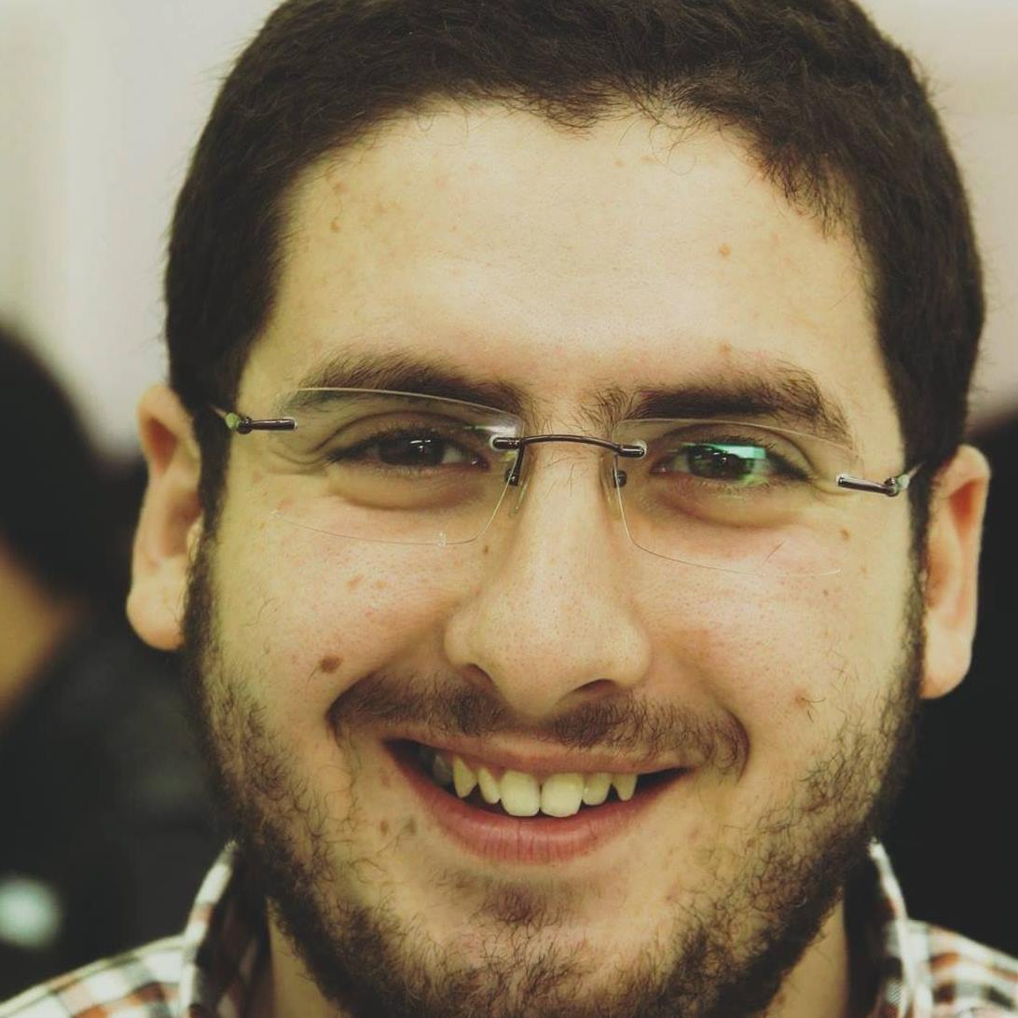
BlueMed engaging civil societies across the Mediterranean: the young Ambassadors’ voices
Notes:
tHINK Big

Slide 23
BlueMed engaging civil societies across the Mediterranean: the young Ambassadors’ voices
Notes:
tHINK Big

Slide 24
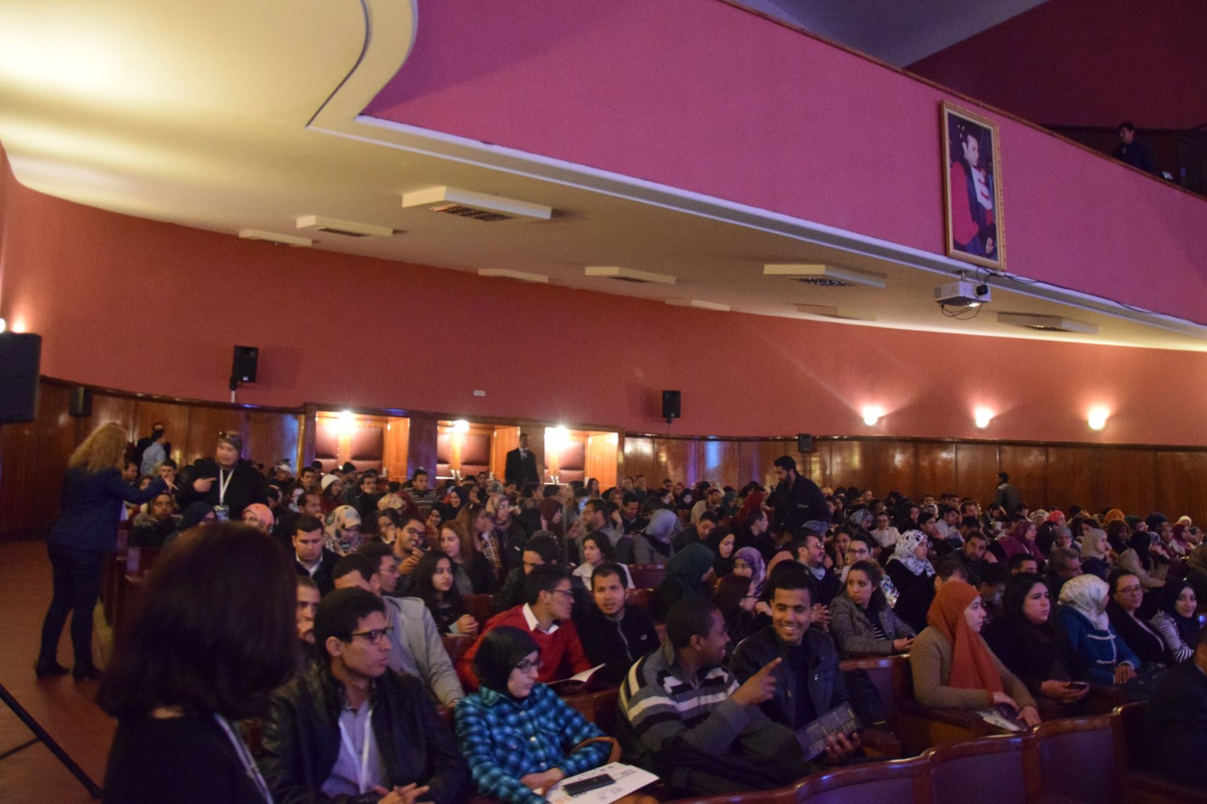
BlueMed engaging civil societies across the Mediterranean: the young Ambassadors’ voices
Notes:
tHINK Big

Slide 25
BlueMed engaging civil societies across the Mediterranean: the young Ambassadors’ voices
Scientist
Policy
Makers
NGO’s
Stakeholders
Notes:
tHINK Big

Slide 26
BlueMed engaging civil societies across the Mediterranean: the young Ambassadors’ voices
Startup Challenge
Notes:
tHINK Big

Slide 27
BlueMed engaging civil societies across the Mediterranean: the young Ambassadors’ voices
Notes:
tHINK Big

Slide 28
BlueMed engaging civil societies across the Mediterranean: the young Ambassadors’ voices
Notes:
tHINK Big

Slide 29
BlueMed engaging civil societies across the Mediterranean: the young Ambassadors’ voices
Notes:
tHINK Big

Slide 30
BlueMed engaging civil societies across the Mediterranean: the young Ambassadors’ voices
Notes:
tHINK Big

Slide 31
BlueMed engaging civil societies across the Mediterranean: the young Ambassadors’ voices
Power of future generation on
saving our BlueMed
@ Badr El Mahrad

Slide 32
BlueMed engaging civil societies across the Mediterranean: the young Ambassadors’ voices
BIG
#THINK
BLUE
@ Badr El Mahrad

Slide 33
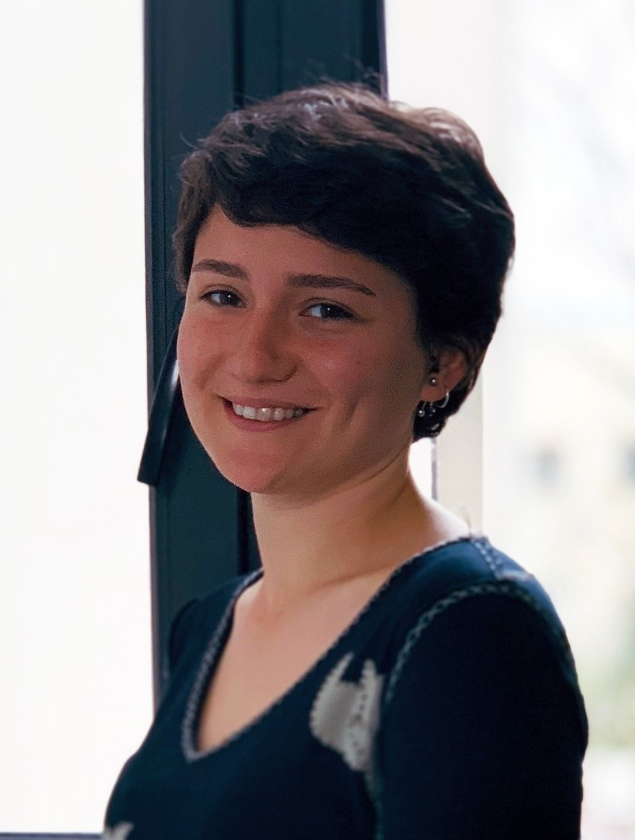
Pollution needs no VISA #3
BlueMed engaging civil societies across the Mediterranean: the young Ambassadors’ voices
Deniz’s Action Plan in one tweet:
Human's false needs, creates true pain.
Deniz Yapılcan
BlueMed Y.C. Ambassador in Turkey
BSc in Communication

Slide 34
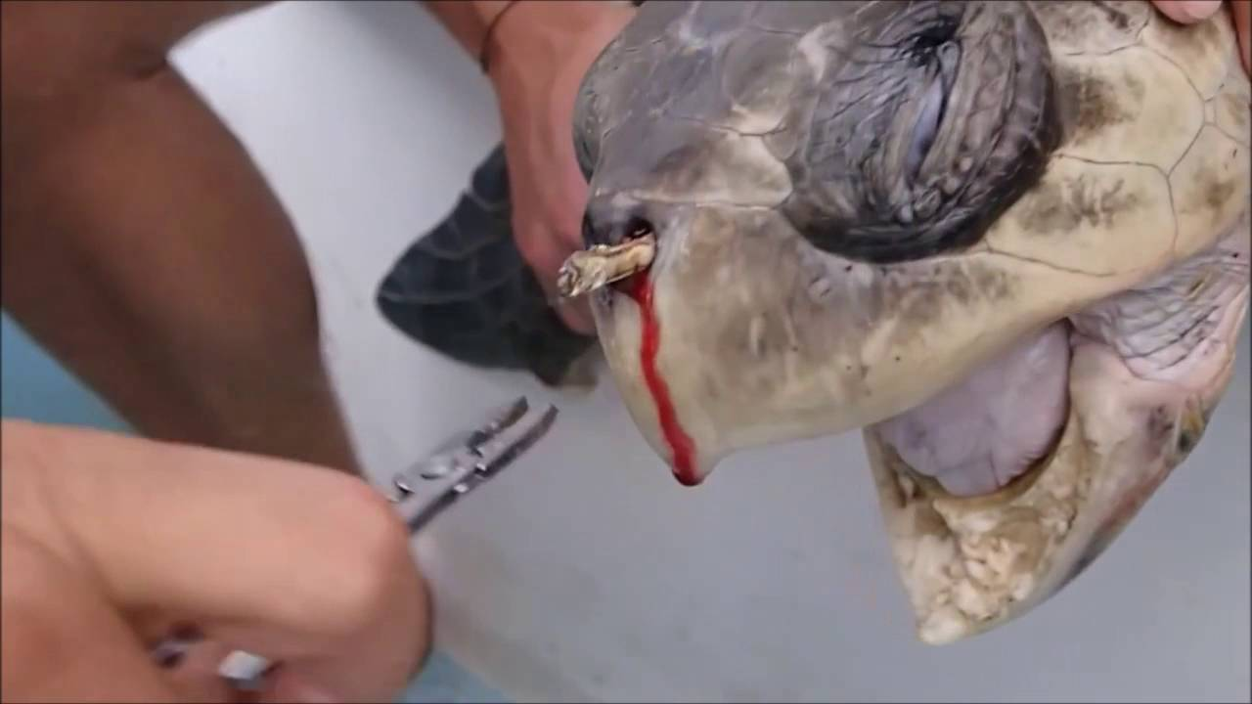
Pollution needs no VISA #3
BlueMed engaging civil societies across the Mediterranean: the young Ambassadors’ voices
Deniz Yapılcan
BlueMed Y.C. Ambassador in Turkey
BSc in Communication

Slide 35
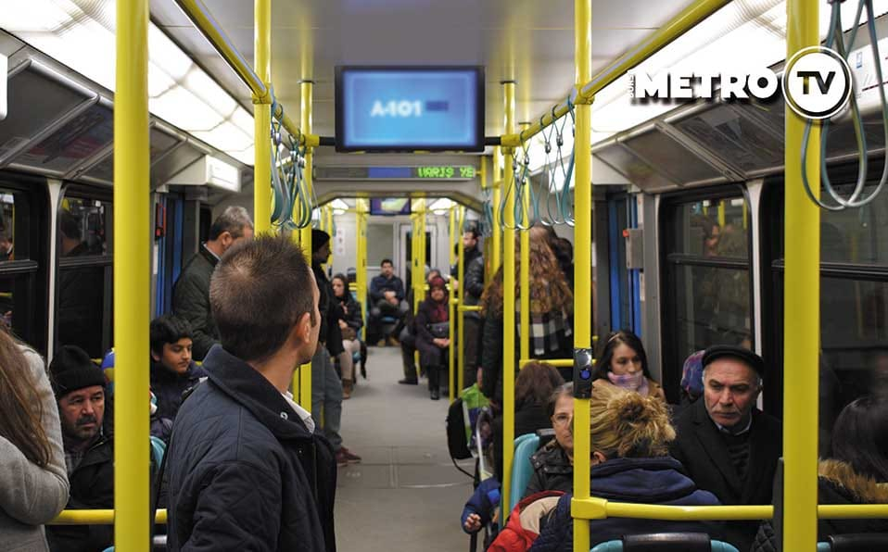
Pollution needs no VISA #3
BlueMed engaging civil societies across the Mediterranean: the young Ambassadors’ voices
Deniz Yapılcan
BlueMed Y.C. Ambassador in Turkey
BSc in Communication

Slide 36
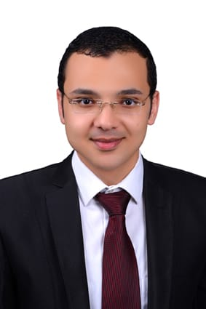
Pollution needs no VISA #4
BlueMed engaging civil societies across the Mediterranean: the young Ambassadors’ voices
Mustafa’s Action Plan in one tweet:
#Together for Blue Clean Mediterranean
Mustafa Ghazal
BlueMed Y.C. Ambassador in Egypt
BSc Chemistry/Biochemistry and MSc in Chemistry

Slide 37
BlueMed engaging civil societies across the Mediterranean: the young Ambassadors’ voices
Issue(s) addressed
Marine Litter
Blue Growth
Fisheries and aquaculture
Maritime transport
Coastal and Marine Management
Environmental and Climate
Target group(s)
Fishermen
Young researchers
University students
School students
School teachers
Policy makers
Citizens
Channels and Instruments
Social media.
Workshop and Conferences.
Universities & research centers.
Personal engagement with publics and fishermen.
Open discussion with researchers, policy makers, universities and fishermen.
Objective(s)
Increase the awareness about these issues (importance & danger) between university students, young researchers and local people.
Establishment of a group of young researchers to reach the target people (school teachers, students, university students, fishermen and the public).

Slide 38
BlueMed engaging civil societies across the Mediterranean: the young Ambassadors’ voices
Key message
Matching the right message according to BlueMed SRIA & Priorities to the right audience- adapt language to the audience to make science relevant (for policy maker, for industries, for NGOs, for School and Universities students, for researcher, for Environmentalist, ......).
Action/product
Training of some young researchers from different branches of NIOF and other research centers in Egypt and some universities to be regional ambassadors in different Governorates.
Studying the marine issues well and organizing some meetings between researchers, policy makers, universities and fishermen to make open discussions about the detected issues and determine the recommendation and prepare the final plan.
Organizing different workshops in NIOF different branches, in Universities and some research centers. Also, participating in conferences of water and water treatment.
Communicating with the public, fishermen, policy makers, visiting the harbours of the Mediterranean to spread the awareness with the risks of the determined issues.
Creating different Pages on social media (Facebook, twitter, instagram, …etc.) to spread the awareness of risks of plastic litter and water pollution.

Slide 39
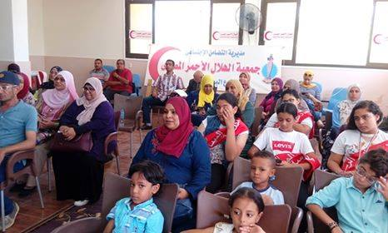
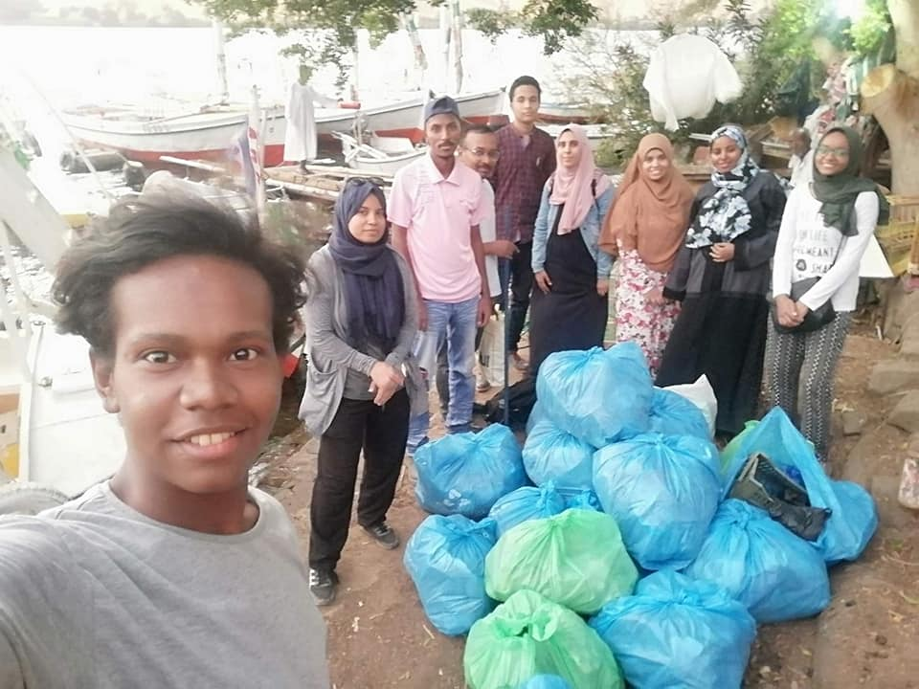
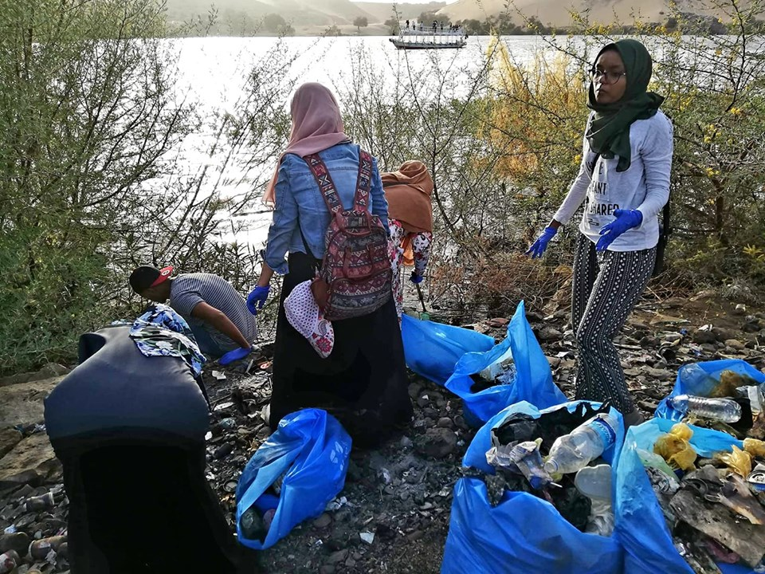
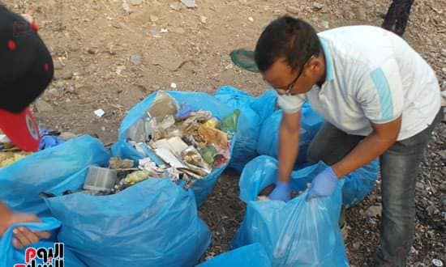
BlueMed engaging civil societies across the Mediterranean: the young Ambassadors’ voices
Beach Cleaning and Public Awareness

Slide 40
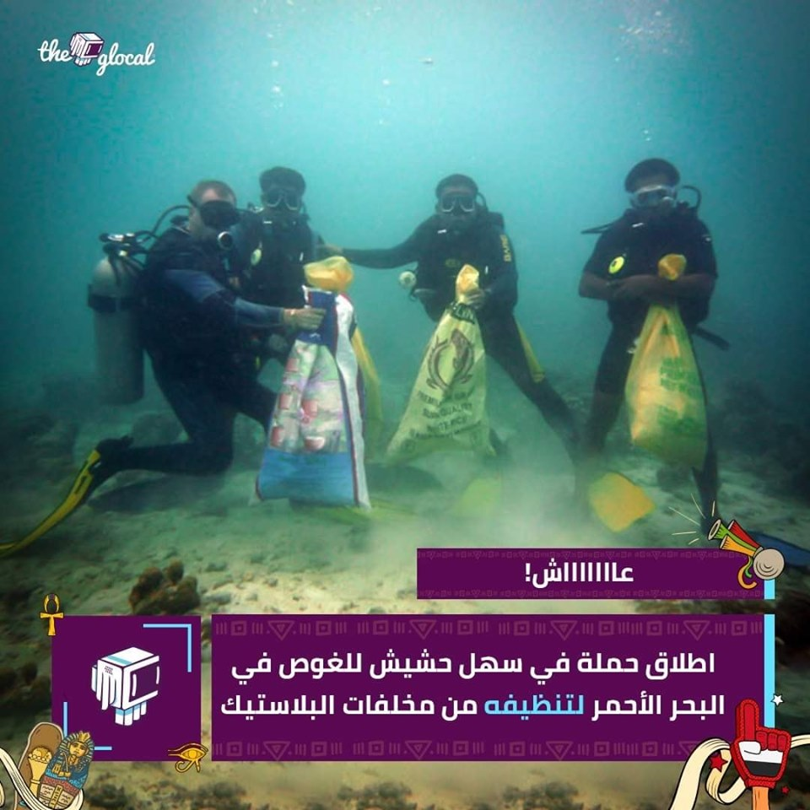
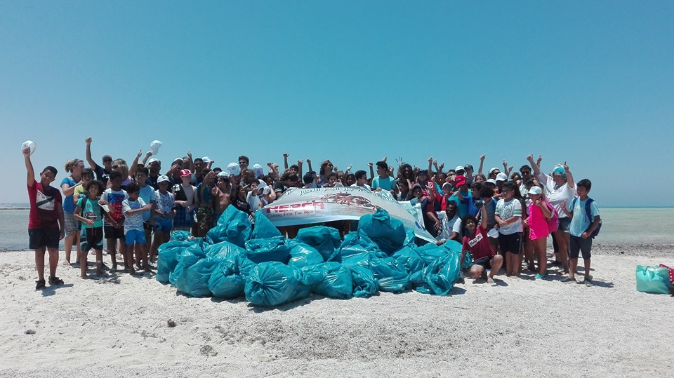
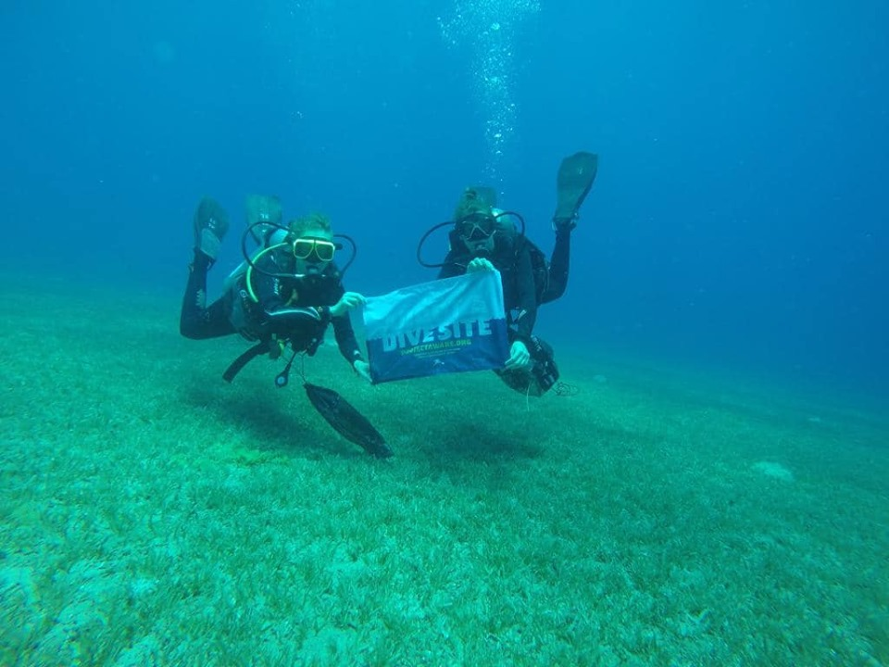
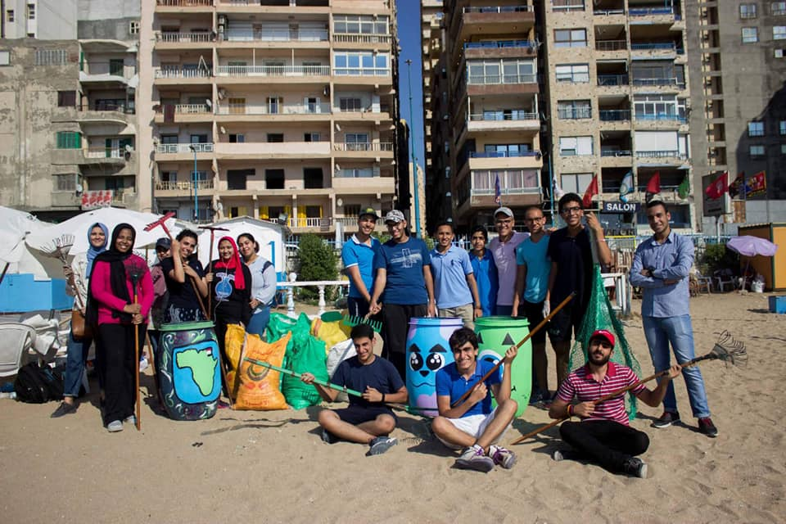
BlueMed engaging civil societies across the Mediterranean: the young Ambassadors’ voices

Slide 41
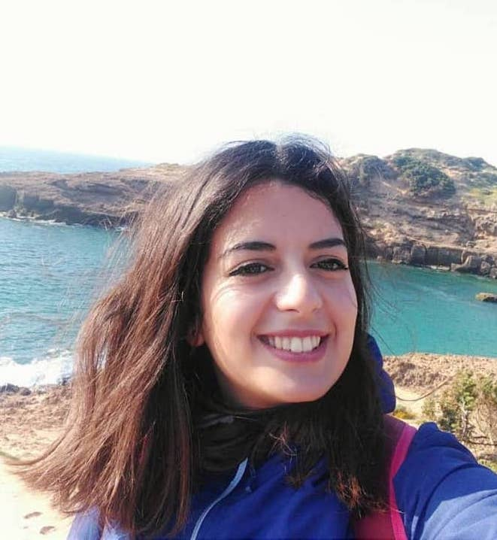
Pollution needs no VISA #5
BlueMed engaging civil societies across the Mediterranean: the young Ambassadors’ voices
Fella’s Action Plan in one tweet:
Take it out of my sea #Plastic
Fella Moualek
BlueMed Y.C. Ambassador in Algeria
BSc in Marine Enviroment and MSc in Enviroment

Slide 42
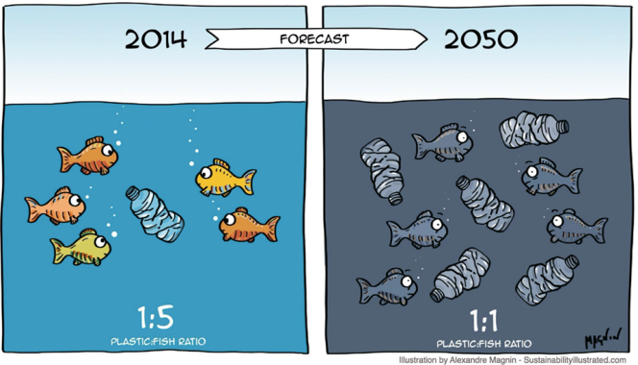
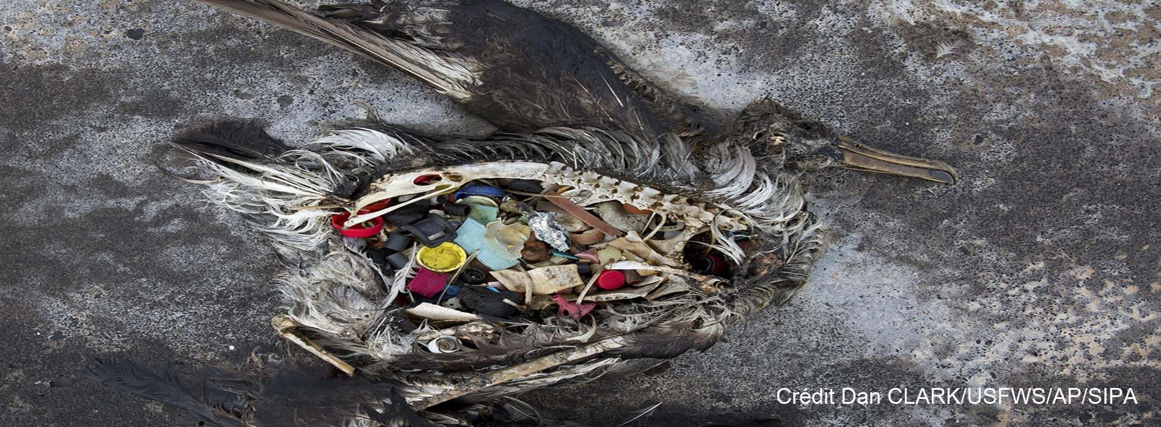
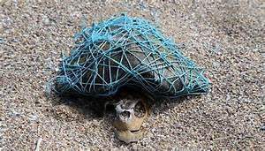
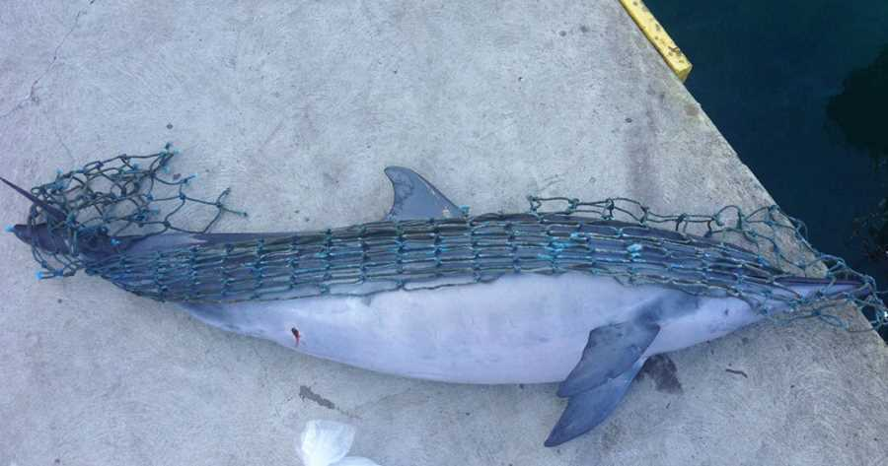
BlueMed engaging civil societies across the Mediterranean: the young Ambassadors’ voices
Plastic waste kills up to 1 million sea birds and 100,000 mammals every year
https://www.mieux-vivre-autrement.com/oceans-en-danger-des-especes-disparaissent-avant-meme-detre-decouvertes.html

Slide 43
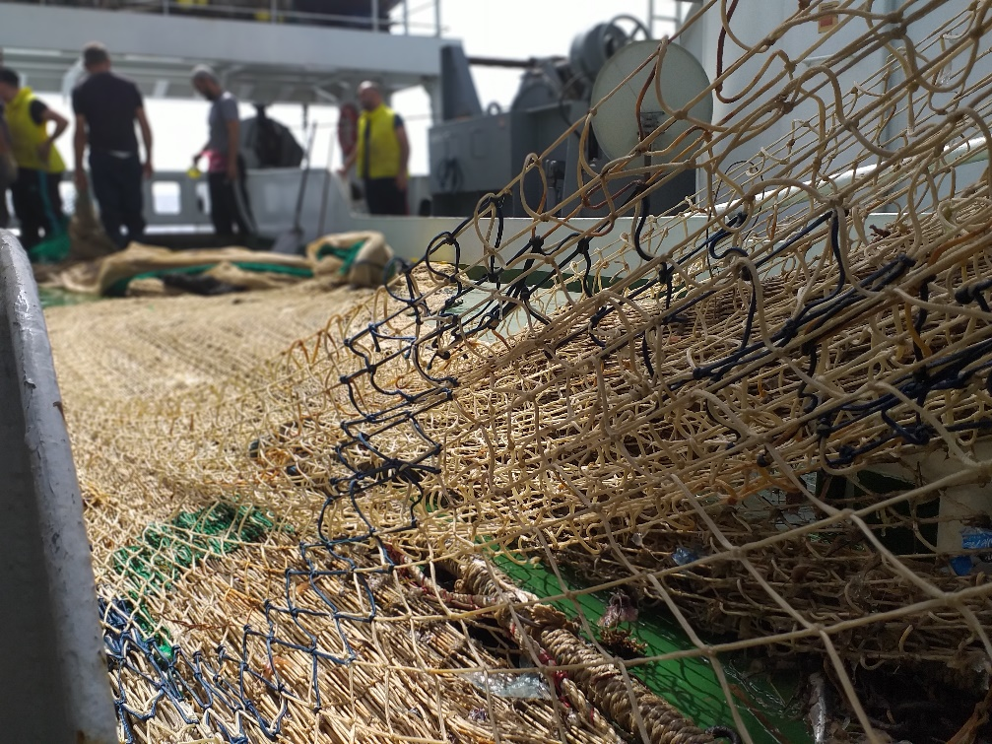
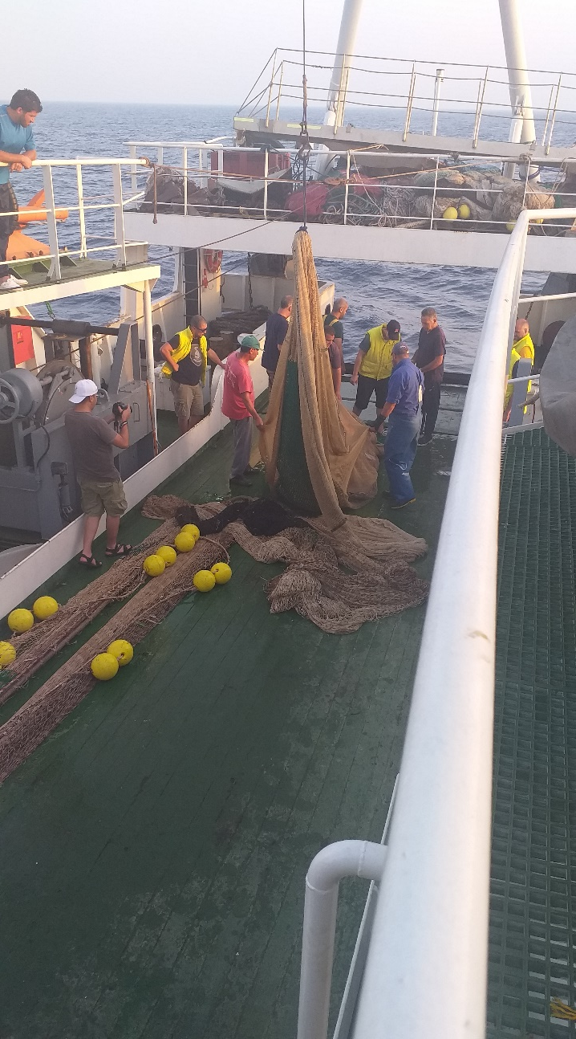
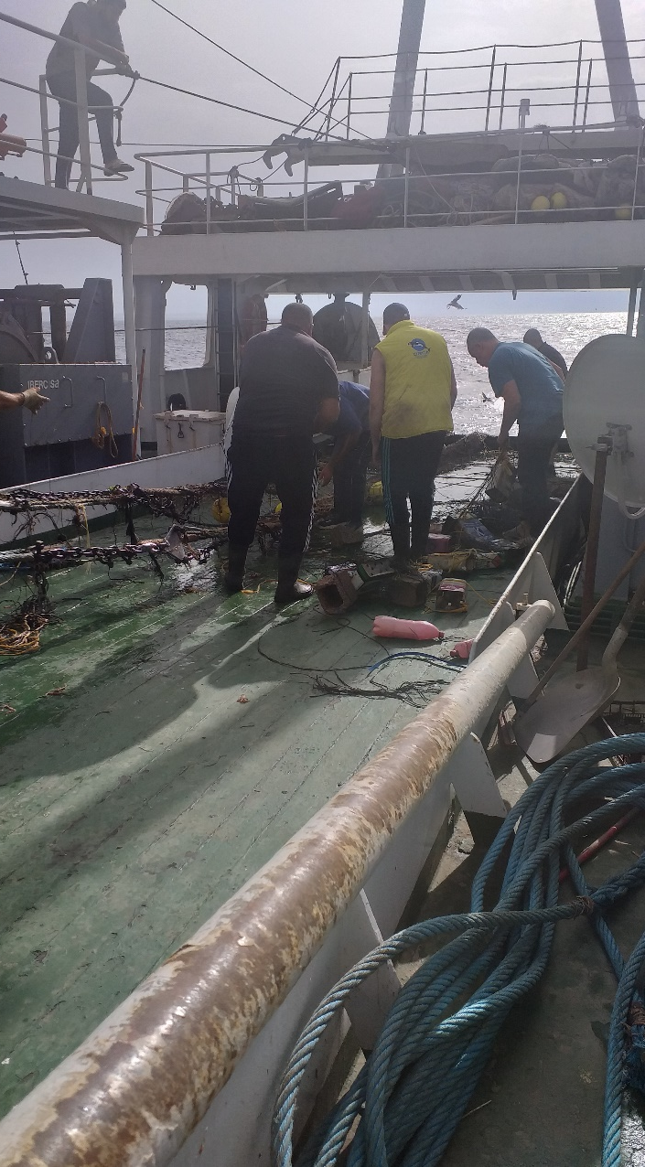
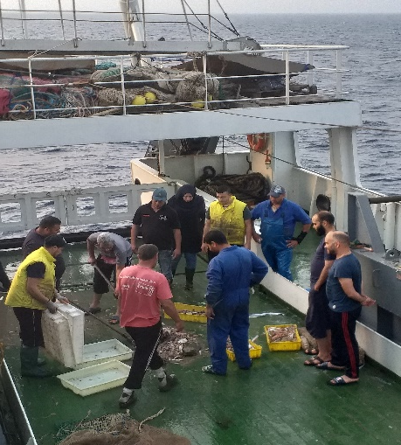
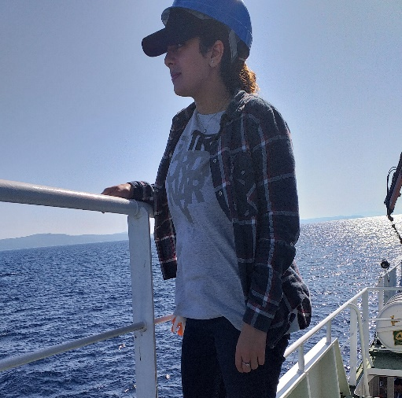
BlueMed engaging civil societies across the Mediterranean: the young Ambassadors’ voices
Anecdote

Slide 44
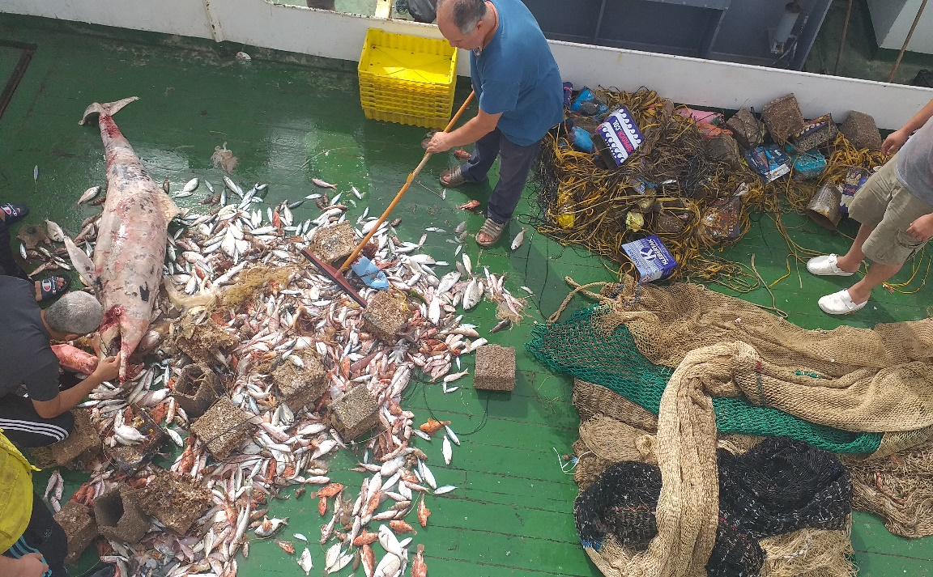
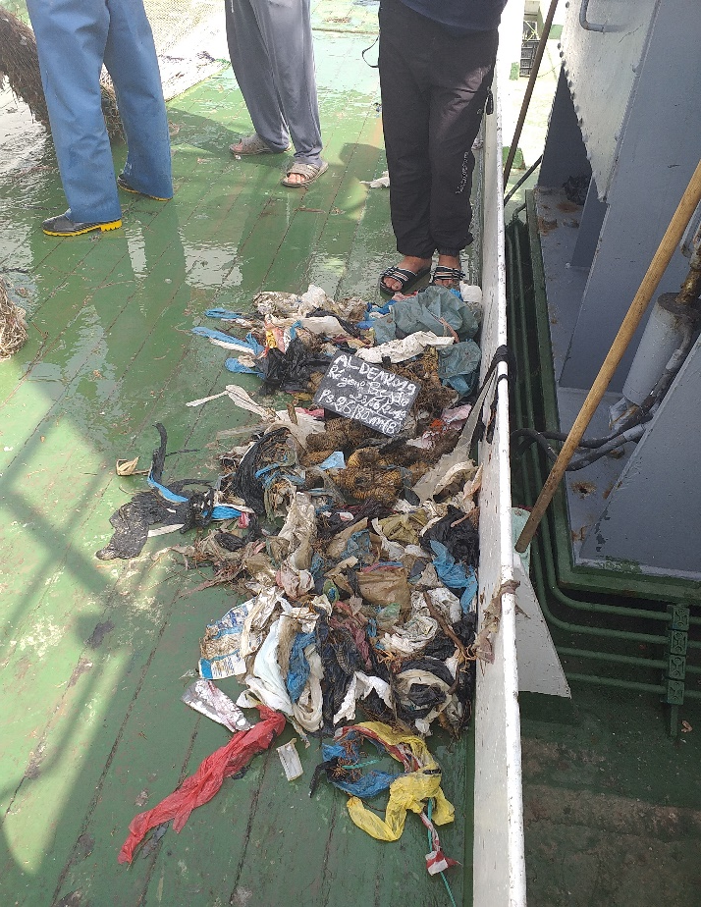
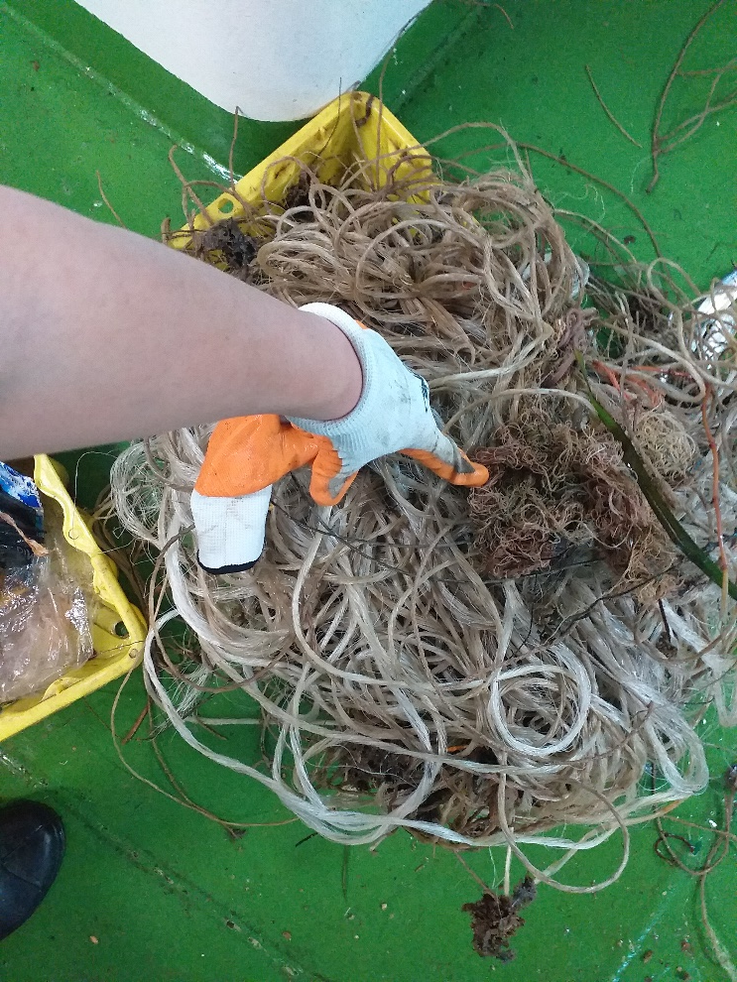
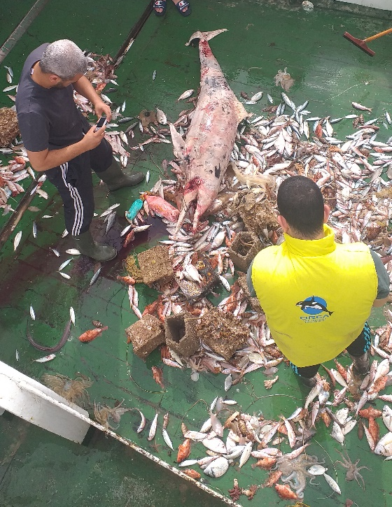
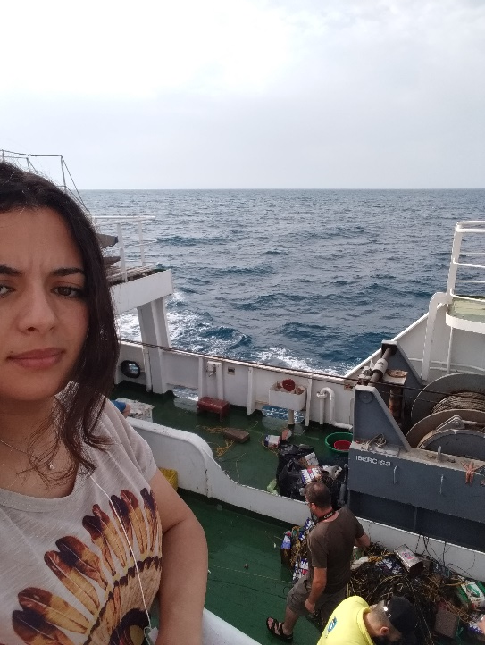
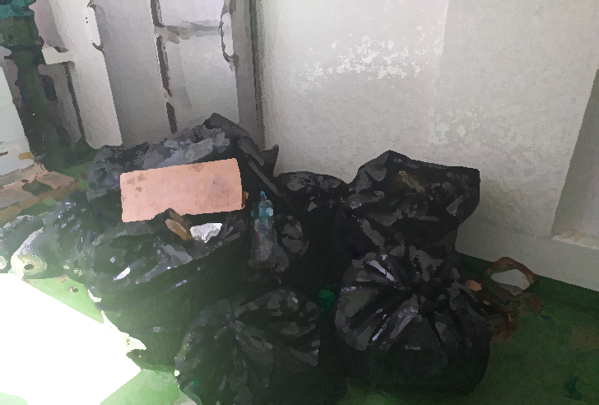
BlueMed engaging civil societies across the Mediterranean: the young Ambassadors’ voices

Slide 45
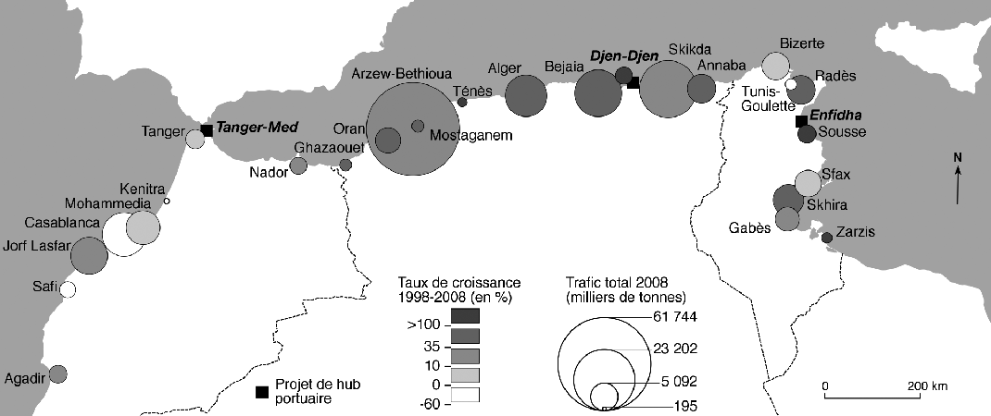
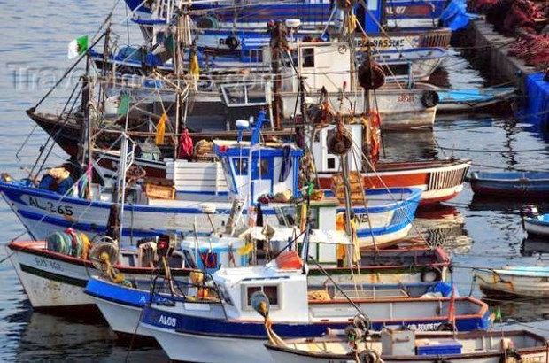
BlueMed engaging civil societies across the Mediterranean: the young Ambassadors’ voices
33 fishing harbours
Tipaza City:
Harbour of Aïn Tagourait
Harbour of Bouharoun
Harbour of Bou Ismaïl
Harbour of Cherchell
Harbour of El Hamdania
Harbour of Gouraya
Harbour of Khemisti
Harbour of Tipaza

Slide 46
Seabed Without Plastics
BlueMed engaging civil societies across the Mediterranean: the young Ambassadors’ voices
Global objectives:
Objective 1: Raising awareness of plastics dangers and reduce their single use
Objective 2: Encourage fisher-men to stop dumping waste collected at sea
Objective 3: Creation local database

Slide 47
Expected Activities:
BlueMed engaging civil societies across the Mediterranean: the young Ambassadors’ voices
Result 1: Awareness against Plastic threat and reduction of its use
Activity 1: Workshop Awareness of fishermen and trainees of the fishing school;
Activity 2: Awareness campaign in primary schools, colleges and High school;
Activity 3: Documentary projection on the plastic impact;
Activity 4: Elaboration of communication tools on the project: Video doc.
Result 2*: Recuperation of sea plastic waste
Activity 1*: Nets Installation in fishing vessels for waste collection;
Activity 2*: Discovery dives for fishermen;
Activity 3*: Dive for recuperation of ghost nets;
*: depends on financial support
Result 3: Seabed plastic waste estimation
Activity 1: Macros waste collection and quantification;
Activity 2*: Scientific dives;
Activity 3: Questionnaire survey.

