Slide 1

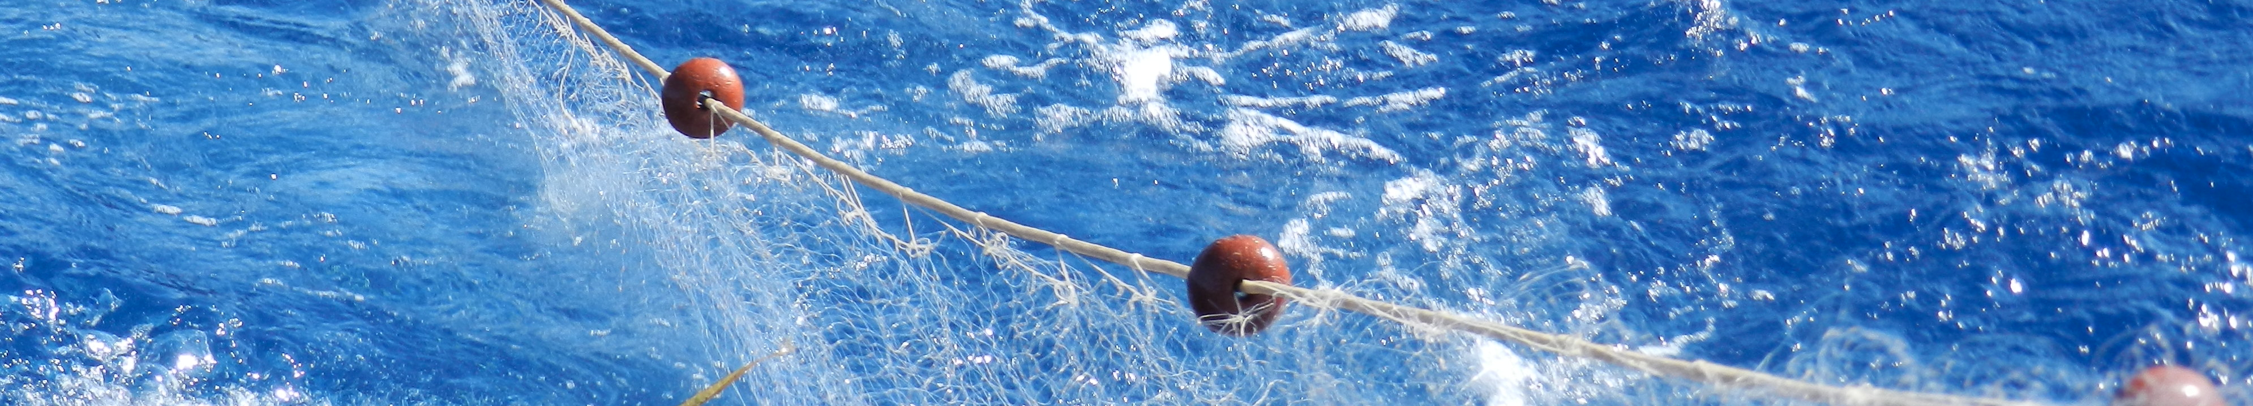
GFCM contribution to a plastic-free Mediterranean Sea
Miguel Bernal, GFCM Secretariat
A Plastic-free healthy Mediterranean Sea: operationalizing the BLUEMED R&I Pilot Action
43rd session of the GFCM
20 January 2020, Venice, Italy
4 – 8 November 2019 - Athens, Greece

Slide 2
A tailor made approach to semi-enclosed seas
  The Mediterranean and Black Seas are semi-enclosed basins; special marine environments more susceptible to human impacts (UNCLOS)
  Cumulative impacts require integrated approach and collaboration between all actors
“We need to maintain healthy ecosystems to allow for productive and sustainable fisheries”

Slide 3
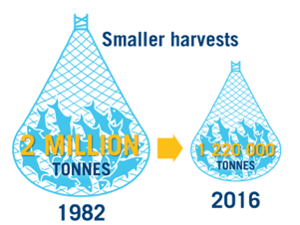
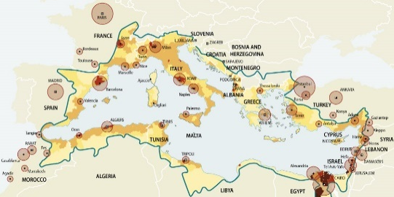

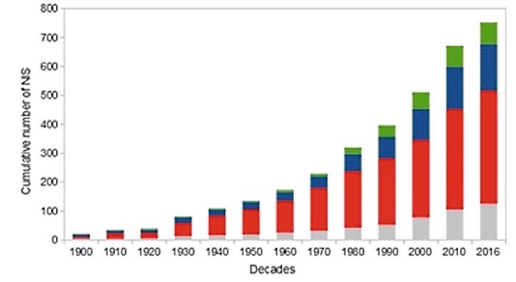
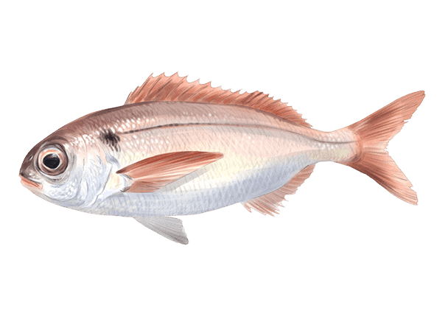






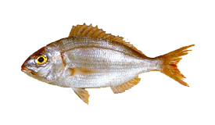
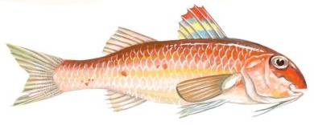




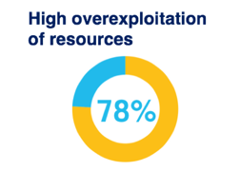

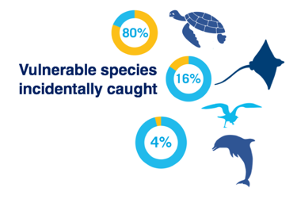
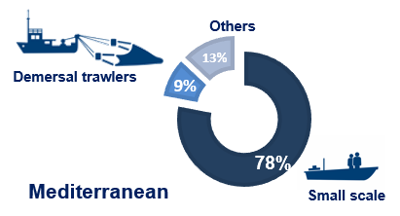

Mediterranean and Black Sea: challenges
Multispecies, multigear fisheries
Highly populated
Pollution (plastic)
Degraded habitats
Climate change
Increasing NIS
Mainly small-scale vessels
275 000 tonnes discarded
Reports of incidentally-caught vulnerable species
High prevalence of IUU

Slide 4
The GFCM response: The mid-term strategy
Taking strategic action in direct response to the SDGs:
Improve, by 2020, the sustainability of
Mediterranean and Black Sea fisheries

Slide 5
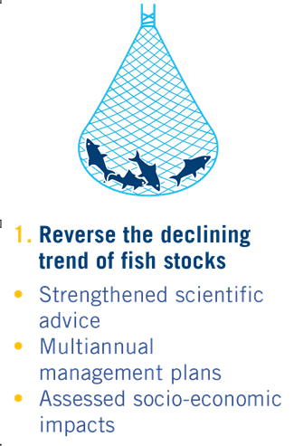
GFCM Contribution to plastic free Mediterranean
Manual for surveys at sea includes dedicated indications for the harmonized collection of information on plastic abundance and distribution
Surveys are being carried out through all the Mediterranean (dedicated GFCM action + FAO regional projects activities + EU MEDITS programme); regional analysis expected in 2020 / 2021

Slide 6
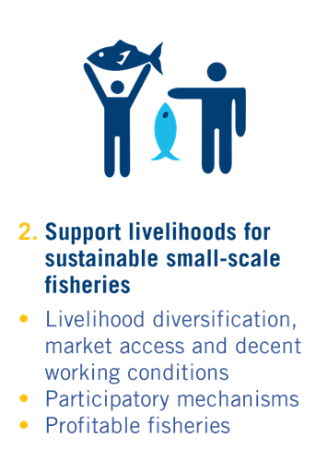
GFCM Contribution to plastic free Mediterranean
Regional plan of action for Small Scale Fisheries (RPOA - SSF) includes specific activities for marine (and plastic) litter such as:
  Promoting the participation of fishers in the circular economy, including schemes for compensating fishers for collecting marine litter
  Combatting ghost fishing by promoting the recovery of nets as well as SSF gear traceability

Slide 7
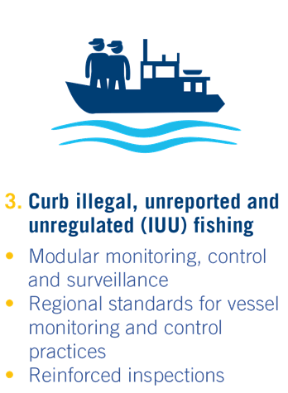
GFCM Contribution to plastic free Mediterranean
Adoption of decisions towards better identification and management of fishing gears (in line with FAO guidelines)
Adoption of decisions requiring the use of more environmentally friendly fishing gear

Slide 8
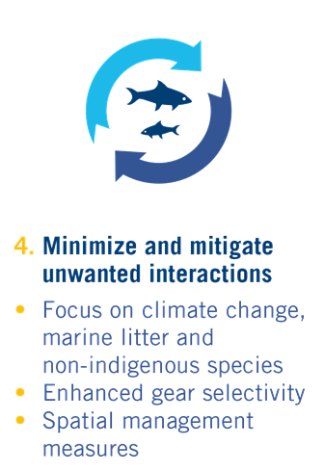
GFCM Contribution to plastic free Mediterranean
Alternative fishing gears, including degradable FADs and tailor made fishing gears for “fishing for litter” being tested
Information collected during the strategy (2017 – 2020) expected to inform an adaptation plan for marine litter and fisheries

Slide 9
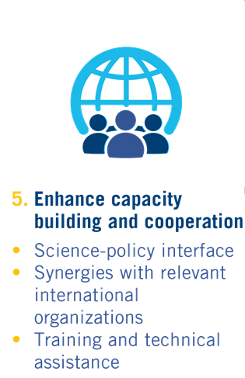
GFCM Contribution to plastic free Mediterranean
Strong collaboration with UN Environment / MAP, including on the implementation of regional plan for marine litter
Ongoing training activities in Mediterranean countries (implementation of manuals for the collection of scientific information on plastic, monitoring control and surveillance, etc.)
+ plastic-free meetings policy adopted

Slide 10
Thank you for your attention
A Plastic-free healthy Mediterranean Sea: operationalizing the BLUEMED R&I Pilot Action
43rd session of the GFCM
43rd session of the GFCM
20 January 2020, Venice, Italy
4 – 8 November 2019 - Athens, Greece
4-8 November 2019 - Athens, Greece

