Slide 1

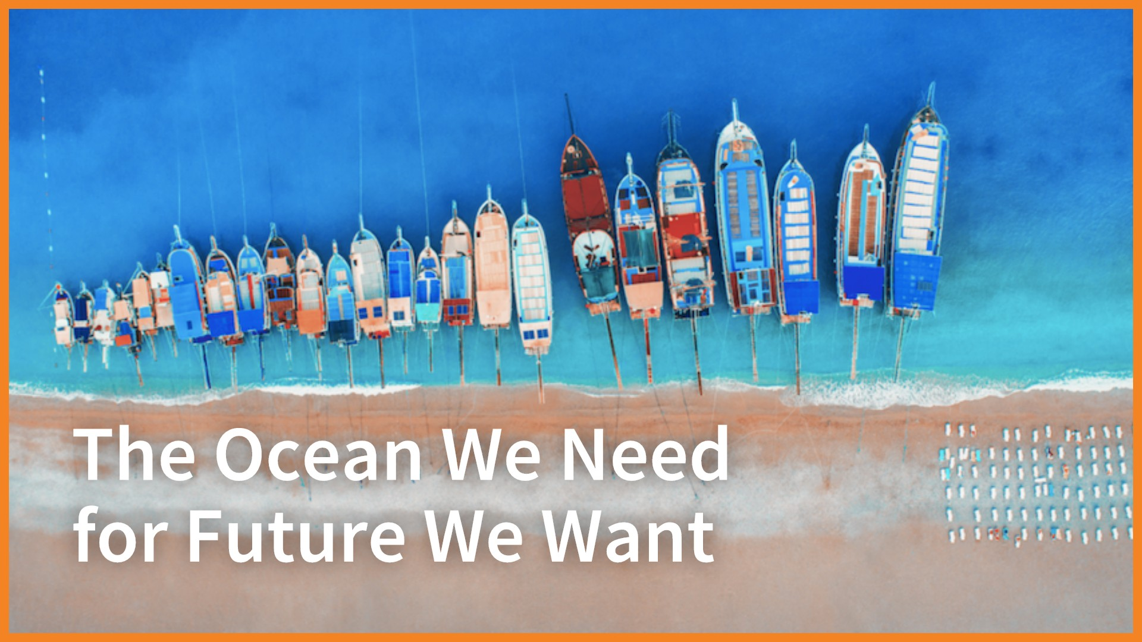
Healthy Mediterranean
January 20th , 2020, Venice, Italy
What is UN Decade of Ocean Science - and why do we need it now???
Prof. Suzan Kholeif
NIOF/ EPG for UN Decade of Ocean Science
Notes:
We know that changes the image you may have of our ocean; It changed ours, too, when we learned about it,

Slide 2

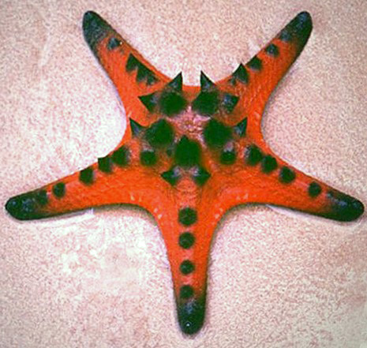
Why do we need Clean, Healthy sustainable Ocean
Globally, the Ocean market value is estimated at $3 trillion per year or about 5 % global GDP;
3 billion depending on the oceans as their primary source of protein
Oceans regulating the climate, absorb about 30%of CO2 produced by humans, buffering the impacts of global warming.
and contribute to poverty reduction by increasing fish catches and income- creating new more than 200 million jobs only of fisheries sector.
Notes:
Ocean supports life on earth- According to statistics recently quoted …..

Slide 3
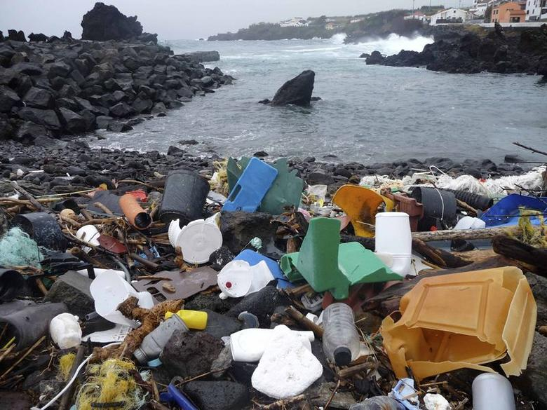
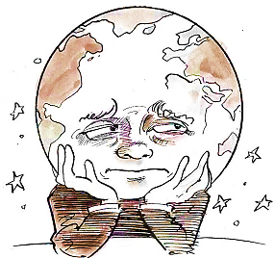
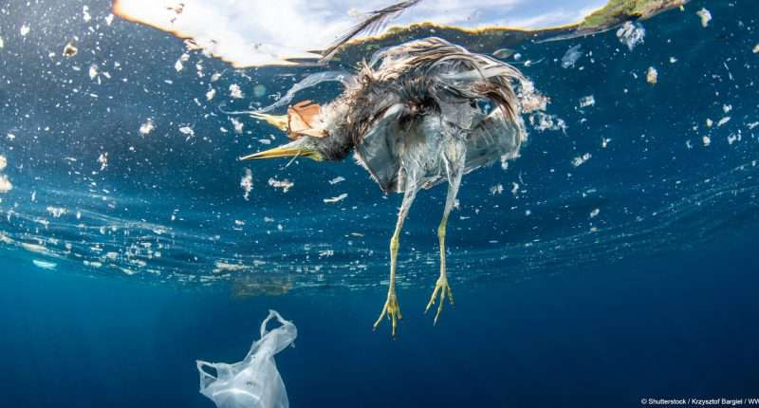
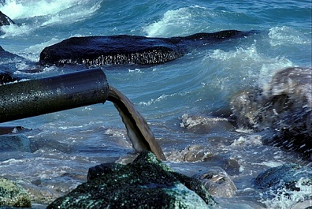
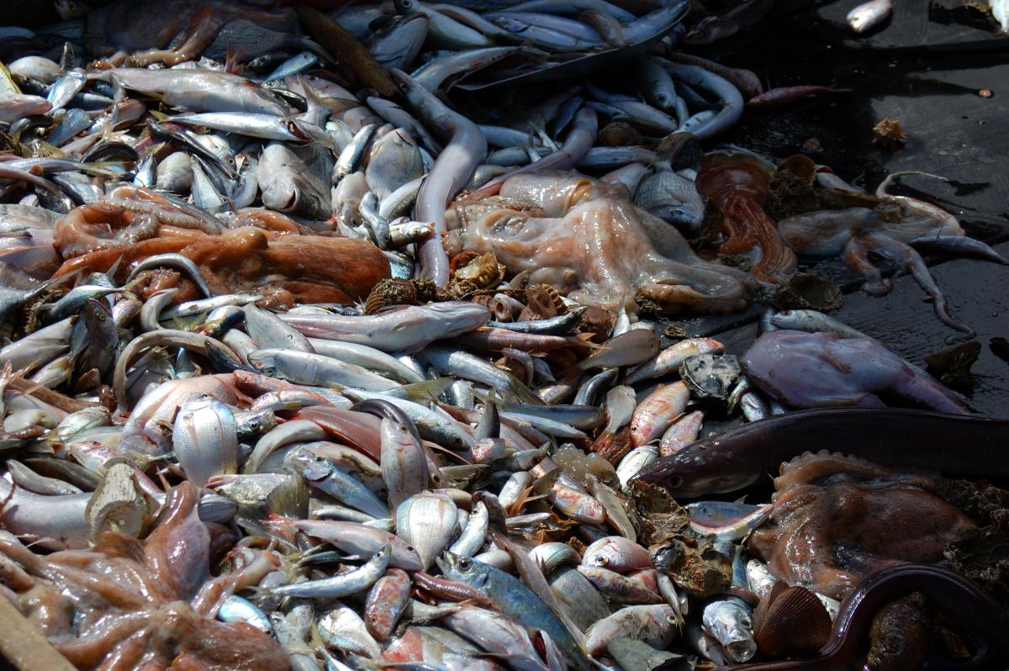
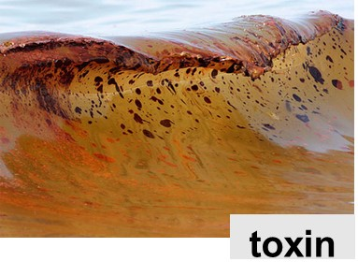
Ocean fights for his life,…
Notes:
We are alarmed by the Ocean challneges: as>>>>>
The ocean is changing rapidly in ways that are still not fully understood or predictable. Important marine ecosystem services that humanity benefit is under threat.
Unsustainable resource extraction, pollution and habitat destruction are on the rise in many parts of the world

Slide 4
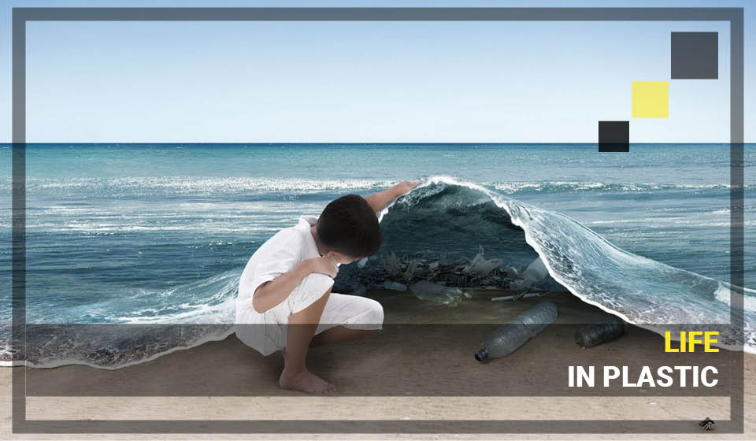
What is the most polluted problem for the Ocean?
If ocean pollution increases than current rates in the next years, experts estimate that by 2025 the ocean is expected to contain 1 tonne of plastic for every 3 tones of fish by 2025, and by 2050, more plastics than fish (by weight).
Notes:
Last World Economic Forum report points out that each year

Slide 5

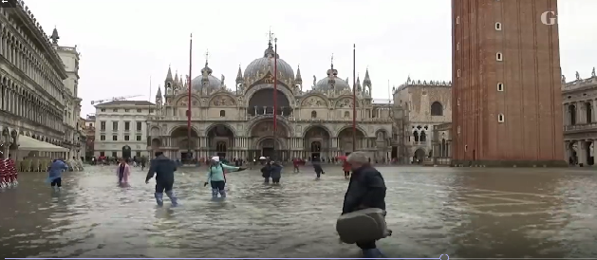
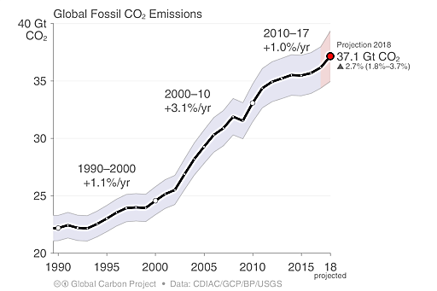
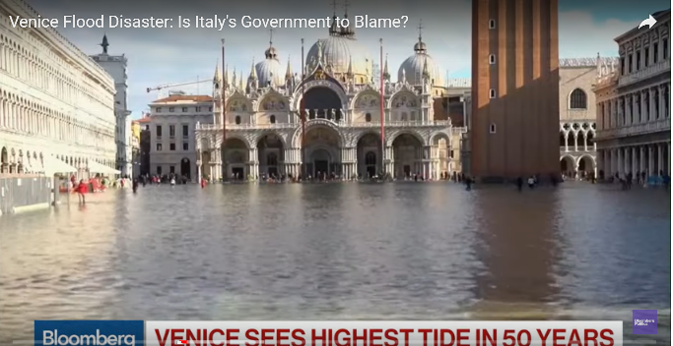
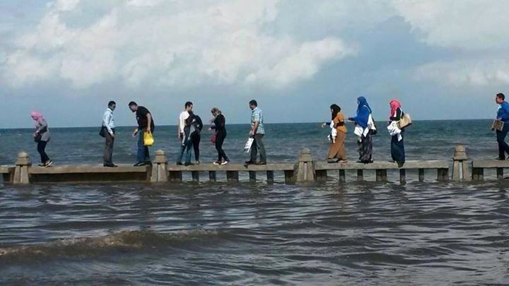
Climat Changes
Carbon (GHG)
emissions: Warming, heat, waves, demise
of coral reefs, pH, sea-level rise, storms, De-O₂ ,
sea ice, etc., etc.
last report of climat Changes by the IPCC SROC
Notes:
last report of climat Changes by the IPCC SROC

Slide 6

Our world and the future we want are at risk
Even with significant efforts in the past four years, we are not on track to achieve the Sustainable Development Goals by 2030
The world's population is expected to reach 9 billion by 2050, and the ocean impacts associated with this growing will increase if we continue working ‘ business –as –usual”

Slide 7
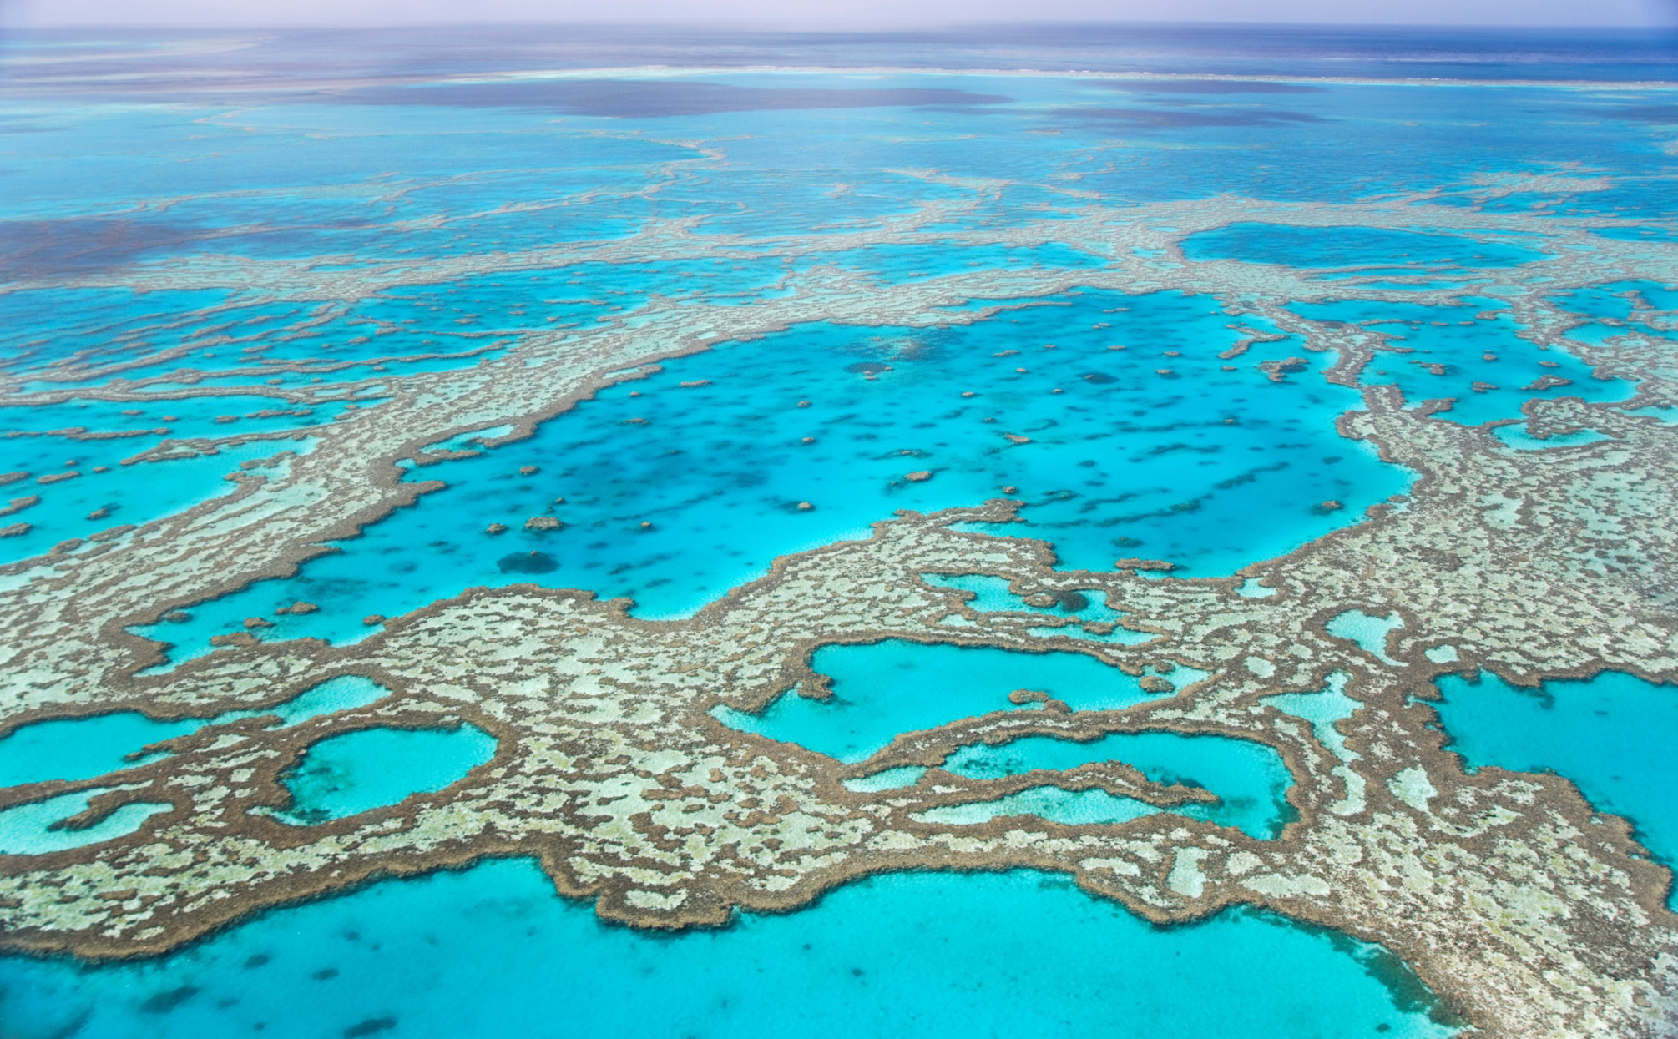
Despite
the progress made in the potential of national, regional, international bodies & the rapid development of technology,
{ the pressures and risks remain
on the ocean and make it the
most vulnerable area for all.}
Notes:
But these steps will be effective only if they are based on sound and informed knowledge of science.

Slide 8
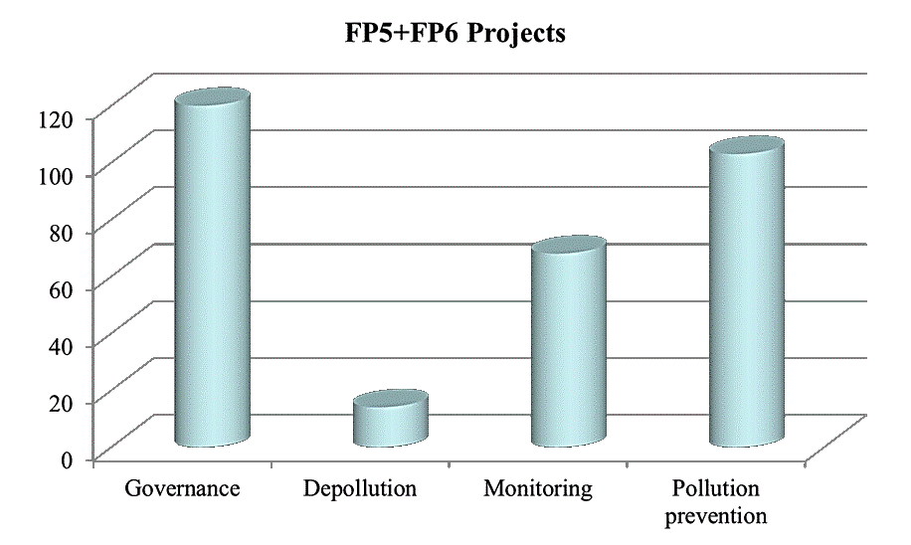
Research programs F5 + F6 + F7
2007-2016
Notes:
EU announced new 22 new commitments for clean, healthy and safe oceans and launches The Ocean Tracker (at Ocean Conference,2019 Oslo, Norway October

Slide 9
Good intentions and reality
The world met for the first time around a simple and shared agenda of 17 SDGs
UN, SDGs goals identiﬁed to build toward a better and more sustainable future and address the global challenges faced by society.
Notes:
With the SDGs Goals, the world met for the first time around a simple and shared agenda.
Good political will as relfected by SDGs, and many other ocean fora
But still our ocean polluted
The speciﬁc targets in the ocean-focused Goal 14 are to:
Stop pollution ,finishing, acidification - . Manage and restore ecosystems
But these steps will be effective only if they are based on sound and informed knowledge of science.

Slide 10
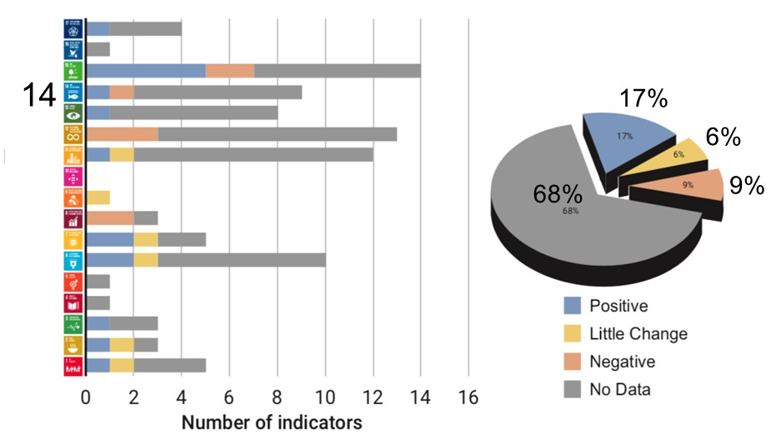
Do we have the knowledge and therefore solutions we need to achieve SDGs?
Oceans
Climate
Notes:
In fact, the sustainable Goals have been partially achieved overall, and some say we haven't made any progress of some of the goals, such as goal 17
== Whey do we need Decade of Ocean science now?

Slide 11
What is the way forward……?
To meet this challenges the UN General Assembly called for an acceleration of Ocean Science data exchange to reverse declines in the health and functioning of the ocean system.
Declare the UN Decade of Ocean Science for Sustainable Development 2021-2030, within existing structures and available resources,
and called upon the IOC to prepare an implementation plan for the Decade in consultation with …(everyone).
Notes:
But these steps will be effective only if they are based on sound and informed knowledge of science.

Slide 12
UN Decade of Ocean Science fo sustainable Development
The Ocean We Need for the Future We Want
Notes:
== Whey do we need Decade of Ocean science now?
In fact, Ocean Science has made many remarkable achievements in some areas
Proclaimed the UN Decade of Ocean
Science for Sustainable Development
2021-2030, within existing structures
and available resources,
and called upon the IOC to prepare an implementation plan for the Decade
in consultation with …(everyone).

Slide 13
Where we are and where we would like to be
Science largely competent
for problem diagnostic
Science providing solutions and motivation for action
Observing system for climate
and emerging data service
Adequate ocean data and information system
Major knowledge gaps,
weak ocean literacy
Ocean literate society and
well-informed decisions
Funding base mostly
in research mode
Clear value chain leading to resourcing and solutions
Hugely uneven capacity, especially developing countries/IDS
CD/ transfer of technology: no one remains behind
Investment in Science, Technological Innovation and Capacity development

Slide 14
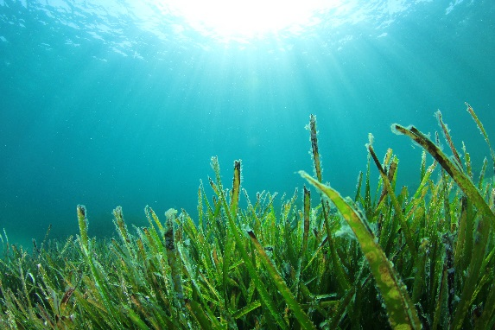






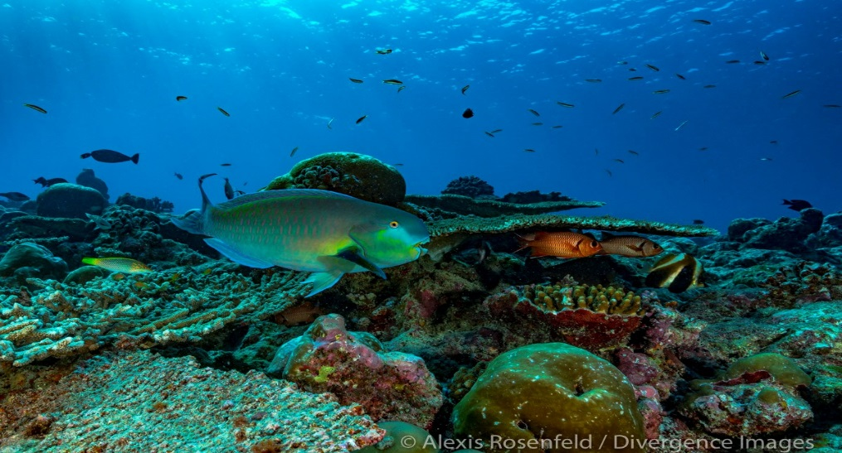




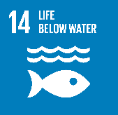


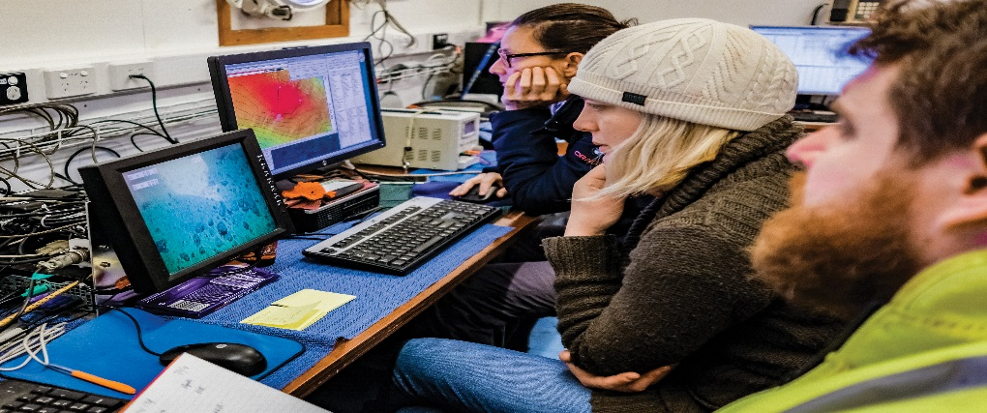
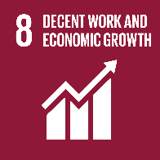
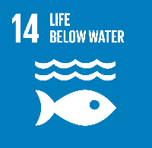


Acting for Societal Outcomes
A Clean Ocean
Sources of pollution removed from the Ocean -------→ Zero Pollution
A Healthy and Resilient Ocean
Marine ecosystems are mapped and protected, multiple impacts, including climate change, are measured and reduced, maintained.
A predicted Ocean
Society has the capacity to understand current and future Ocean conditions, forecast their change and impact on human wellbeing and livelihoods.
Notes:
Responsive to societal needs:
If the societal benefits of the sustainable use of the ocean are to be accrued through achievement of the SDG targets as well as other frameworks, it is important to define a number of outcomes that the Decade will address over the course of its implementation.
These outcomes are considered to be highly transformative because they are expected to trigger environmental, societal and policy changes.
The Decade will address both deep disciplinary understanding of ocean processes and solution-oriented research to generate knowledge.
This knowledge will support societal actors in reducing pressures of the ocean, preserving and restoring ocean ecosystems and safeguarding ocean-related prosperity for generations to come.
The Decade should turn the scientific knowledge and understanding into effective actions supporting improved ocean management, stewardship and sustainable development.
Here are 6 societal outcomes.

Slide 15
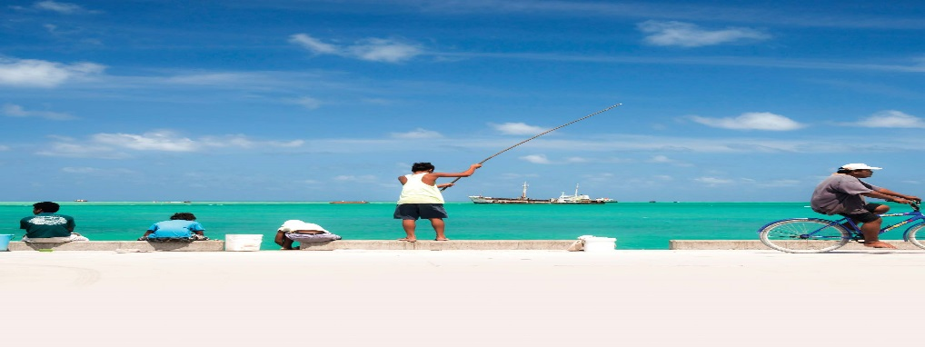




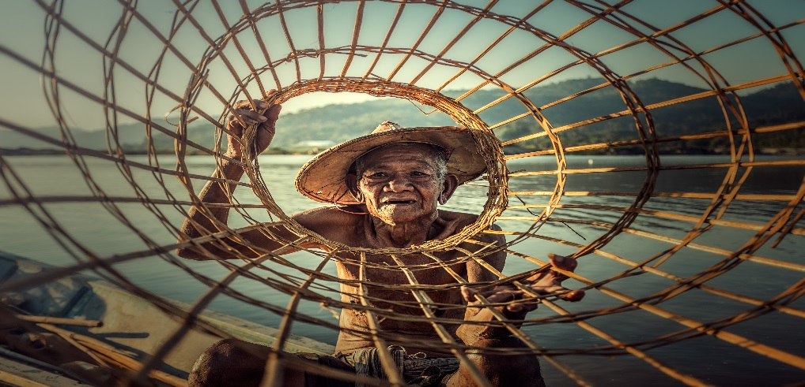
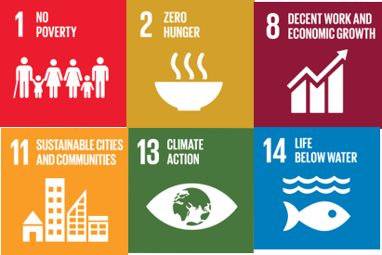

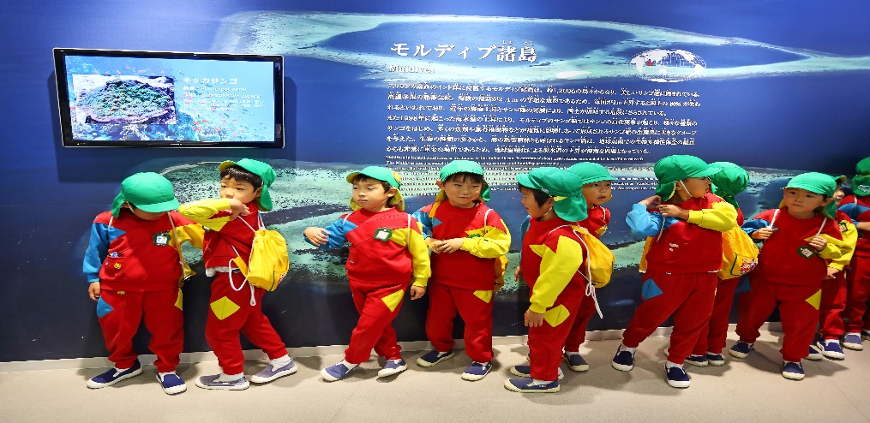


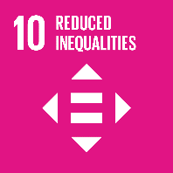



Acting for Societal Outcomes
A Safe Ocean
Human communities are protected from ocean hazards .
A Sustainable
Productive Ocean
The provision of food supply and alternative livelihoods are secured.
A Transparent and Accessible Ocean
All nations have access to ocean data and information, technologies, and are capable of making informed decisions.

Slide 16
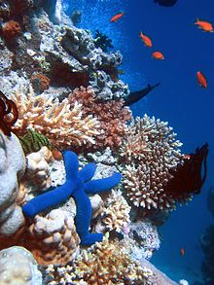
Decade Building on the several decades of international cooperation in ocean research and observations, as well as the policy-relevant goals defined by the 2030 Agenda and other ocean frameworks.
Filling the gaps through Science, Technology and Innovation and scaling of the best practices and potentialities
At heart of Decade, it reaffirms the values of equity and public, youth, women, indigenous people participation in all implementation phases. The Decade will leave no one behind.
Notes:
Decade will not start from scratch , it will build on….

Slide 17







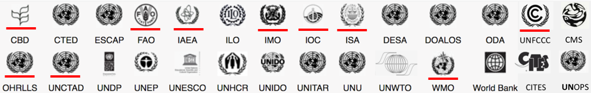
Working with Stakeholders from all Sectors: From
co-design of the Decade to delivery of Sustainable Solutions
Science community
Private Sector
Foundations
UN partners
Call for input / Partnership with science networks (eg ICS, SCOR, PICES, Future Earth…)
Building on existing networks / engagement in global/regional WS / innovation ecosystems / UN Global compact / G-STICs / OECD
Ocean Foundations Alliance, Copenhagen, 27-28 February
Youth / Early Career Professionals

Slide 18

How to engage in the #OceanDecade discussion?
Arctic Workshop – Tromsø, Jan. 2020
Copenhagen, March 2020
North Atlantic Halifax
7-9 Jan. 2020
North Pacific Workshop (WESTPAC/PICES)
Tokyo
Aug 2019
Med.
Venice Jan. 2020
Carribean
Mexico
Tbd
Africa
Nairobi
Indian Ocean
Chennai
8-10 Jan. 2020
South Atlantic Workshop
Brazil
25-27 Nov.
Southeast Pacific (CPPS)
Ecuador
23-26 Sept.
Pacific Community Workshop (SPC)
23-25 July 2019
Antarctic Workshop (?)
Notes:
5 regional workshops will take place in 2019 to cover the main Ocean basin and will contribute to the Regular Process (corresponding to the workshops organized to assist the Regular Process for global reporting and assessment of the state of the marine environment, including socioeconomic aspects):
The North Pacific;
The South Pacific;
The Indian Ocean (including the Arabian Sea and the Bay of Bengal), the Red Sea and Gulf of Aden and the ROPME/RECOFI area; 5
The North Atlantic, the Baltic Sea, the Mediterranean Sea and the Black Sea;
and The South Atlantic (between the African and American coasts) and the wider Caribbean.

Slide 19
Science Action Plan for the Decade
Inputs from Reg/Thematic
Workshops
Science action plan
Inputs from science and stakeholder consultations
Focus on Early Career Professionals/Gender
The SAP will be high-level, providing a framework to guide actions by which ocean science can more effectively deliver its contribution to achieving the societal outcomes of the Decade.
  New science/technological actions
  Contribution of existing science plans/organisations
  Commitments/investments from stakeholders
Notes:
The SAP will then present the intended science action outcomes of the Decade. These will anticipate the impacts of the Decade on ocean in order to bridge knowledge generated by ocean science with actions needed to achieve ocean sustainability.
This section of the SAB will be populated with the existing, conventional science plans (e.g. ICES Science Plan; the WCRP Strategic Plan 2019–2028) that will have undertaken, on the basis of the principles of the SAP (

Slide 20

Thinking about the future
“We are the first generation that can end poverty – and the last generation to tackle climate change before it is too late.”
Ban Ki-Moon, UN Secretary General
Ceri Parker,

Slide 21

شـــــــــــــــــــــــــــــــكـــــــرا
Notes:
I congratulate you, and everybody associated with these efforts, for getting so much done so quickly. But we must always keep moving

