Slide 1
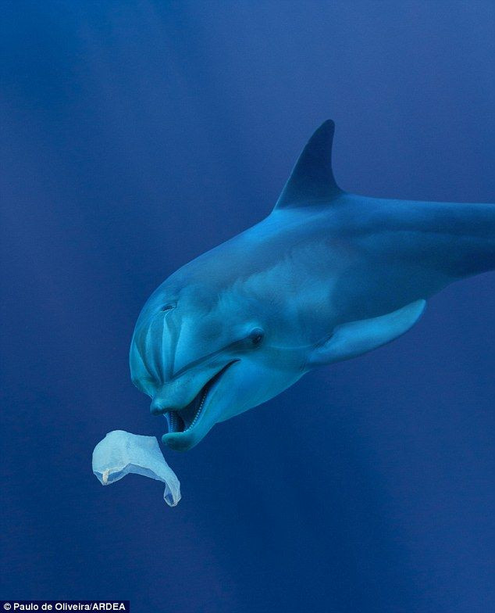
Scaling up the BLUEMED Pilot for a plastic-free, healthy Mediterranean Sea
A Plastic-free healthy Mediterranean Sea:
operationalizing the BlueMed R&I Pilot
20 January 2019
Building bridges for the future
The UfM Secretariat
is co-funded by the EUROPEAN UNION

Slide 2
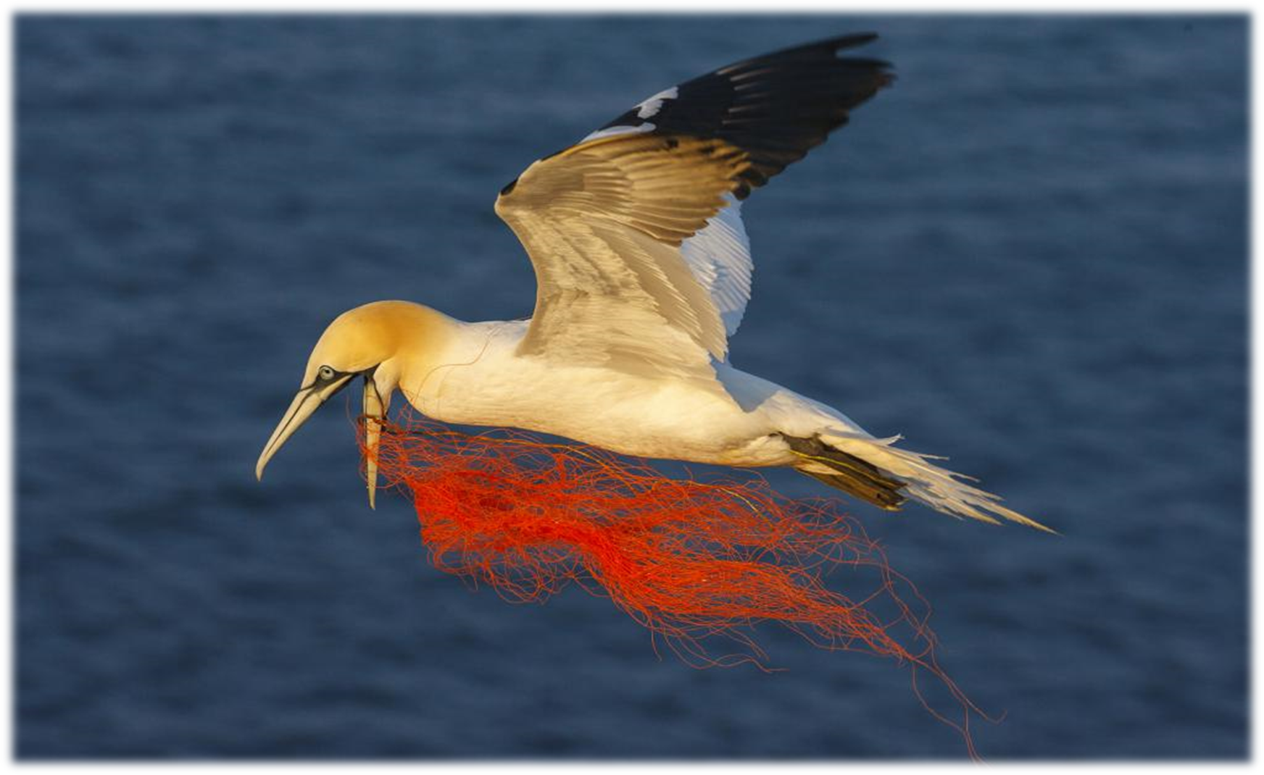
The 2020 UfM Blue Economy agenda
25 February 2020 (tentative) – Brussels - 1st ad hoc SOM: discussion on the 1st draft declaration
10-11 March 2020 – Barcelona - 2020 UfM Blue Economy Stakeholder Conference – collecting inputs from the stakeholders to feed the Ministerial process (http://www.medblueconomyplatform.org; www.ufmsecretariat.org)
01-02 April 2020 (tentative) – Brussels – 2nd ad hoc SOM: finalizing the declaration.
2nd of July 2020 (tentative and tbc by the SOM) – Malta – 2nd UfM Ministerial on Blue Economy

Slide 3
Education and effective communication for a plastic-free, healthy Mediterranean Sea
The UfM Secretariat
is co-funded by the EUROPEAN UNION

Slide 4
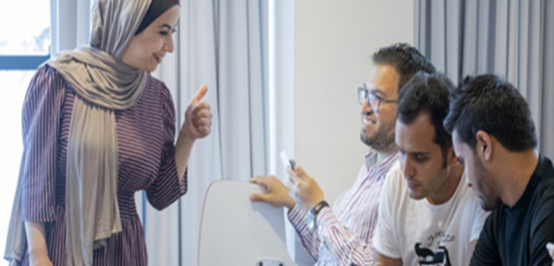
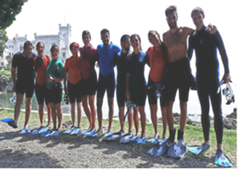
BlueSkills – Higher Education and Blue Growth
The project promotes opportunities for “Blue” marine and maritime careers by developing skills, exchanging knowledge and valorising research for more sustainable Mediterranean Sea.
Promoting capacity building on Blue Economy sectors and knowledge transfer among the blue economy stakeholders;
Boosting transferable skills and promoting employability for young professional and researchers in the Mediterranean;
Raising awareness on ocean governance, climate change and all challenges and opportunities related to the marine and maritime sectors;
Strengthening regional cooperation and networks on blue growth in the Euro-Mediterranean region.
BlueSkills is expected to benefit young scientists, researchers and Ph.D. students; project managers, economists, engineers or other professionals; policy-makers, administrators in the range of 120-140 direct beneficiaries per year, or 600-700 for the five-year project.
The UfM Secretariat
is co-funded by the EUROPEAN UNION

Slide 5
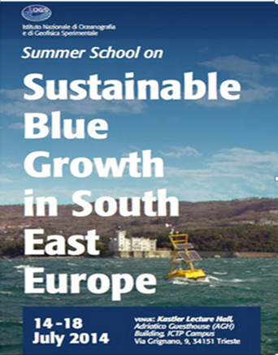
BlueSkills: Blue Jobs and Responsible Growth in the Mediterranean
It has various actions on the ground:
Advanced Studies Master Programme
Summer School
Research Mobility
Professional Traineeships
Specific Workshops, Conferences
Awareness and divulgation
The BlueSkills Network
The UfM Secretariat
is co-funded by the EUROPEAN UNION

Slide 6
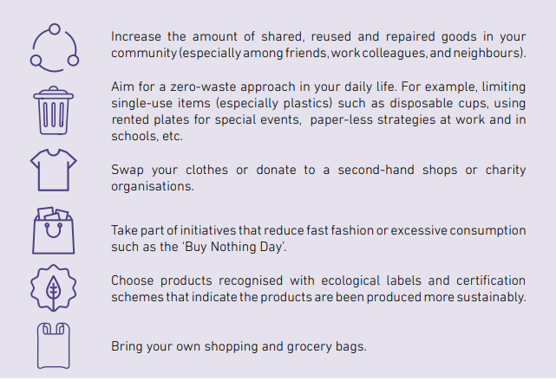
Share and inform on concrete day-to-day practices for taking action
Education for Sustainable Consumption, Behavior and Lifestyles
The UfM Secretariat
is co-funded by the EUROPEAN UNION

Slide 7
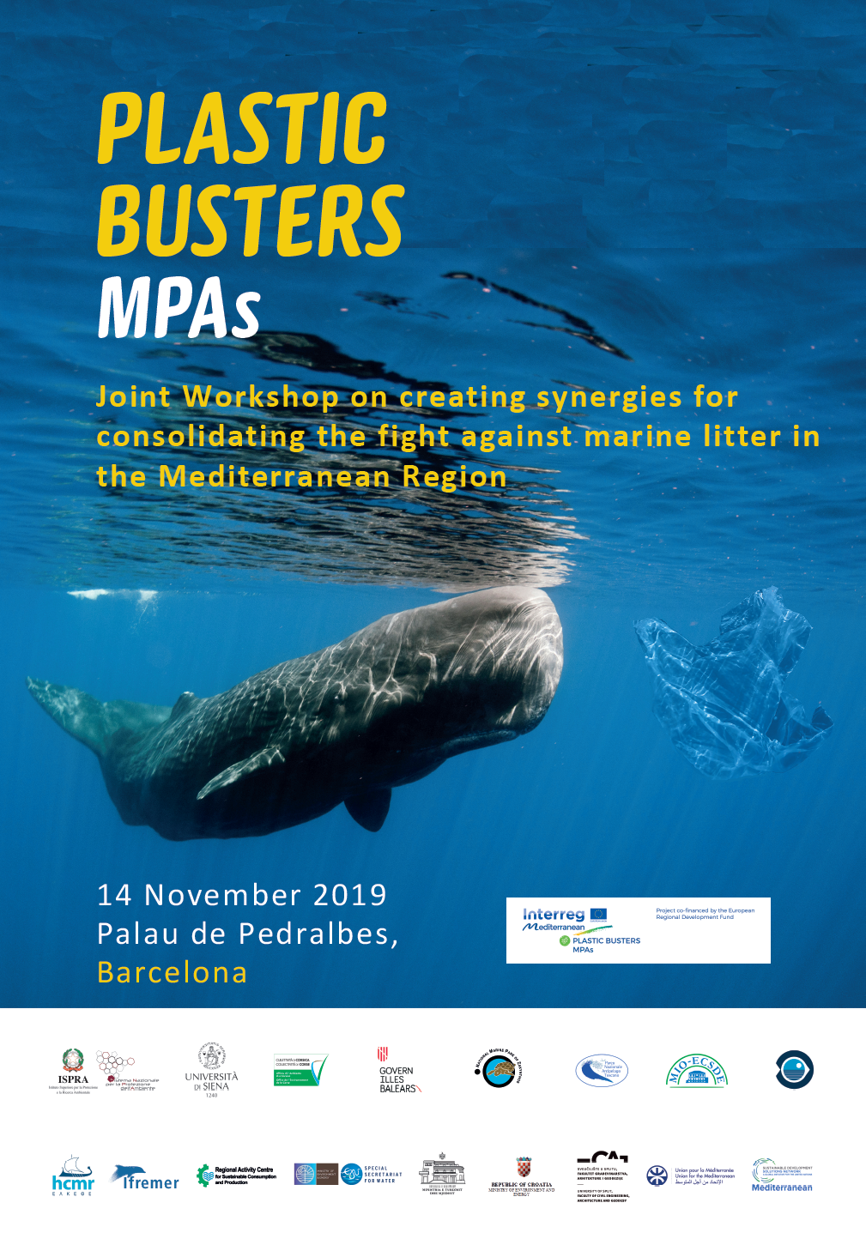
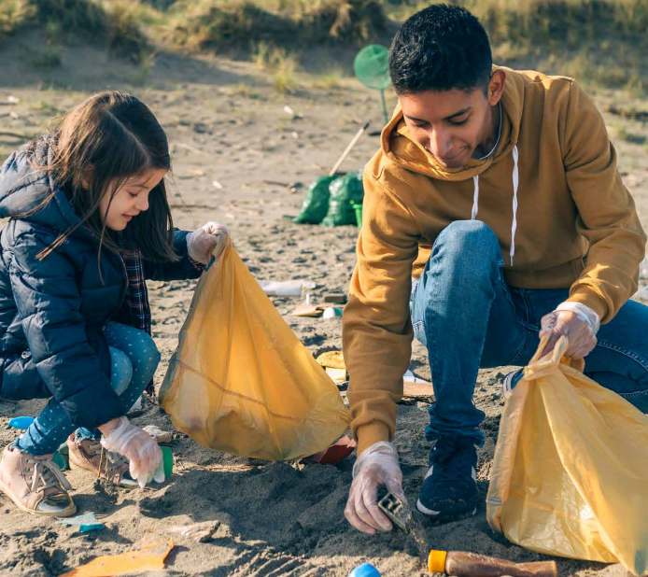
Synergies within the ML community – regional coordination
Creating synergies between the Interreg Med and to the CBC programmes, through their respective financed projects Plastic Busters MPAs and COMMON projects;
Bringing together other key players and projects from both the North and the South of the region to set the basis for further operational synergies, dynamic cross-fertilization and capitalization processes in order to consolidate the fight against marine litter throughout the region
The UfM Secretariat
is co-funded by the EUROPEAN UNION

Slide 8
24th Meeting of the Euro-Mediterranean Group of Senior Officials in Research and Innovation - 25 November 2019, Barcelona
The 24th meeting of the EU-Med Group of Senior Officials (EU-Med GSO) in Research and Innovation took place at the headquarters of the Union for the Mediterranean (UfM) in Barcelona on 25 November 2019 in presence of UfM country representatives and partners of EU-funded projects with a focus on the Mediterranean.
First time meeting since the establishment of the BLUEMED Working Group
Note was taken of the progress achieved since the singing of the Valletta Ministerial Declaration (May 2017), notably in:
The BLUEMED Initiative and Ocean Research; especially the positive contributions of the BLUEMED pilot project, For a Plastic-free Healthy Mediterranean Sea, towards mobilising key actors and partners from both shores of the Mediterranean for tackling plastic pollution. Participants also take note of the current opportunities for joining the Working Group on BLUEMED, for which nominations are still open for those Member States wishing to join.
As follow-up BLUEMED Working Group will participate in the Virtual Meeting of the GSO Secretariat on 27 January 2020 for discussing opportunities on Research & Innovation field for youth in the Mediterranean region and preparing agenda points for the 25th GSO Meeting

Slide 9
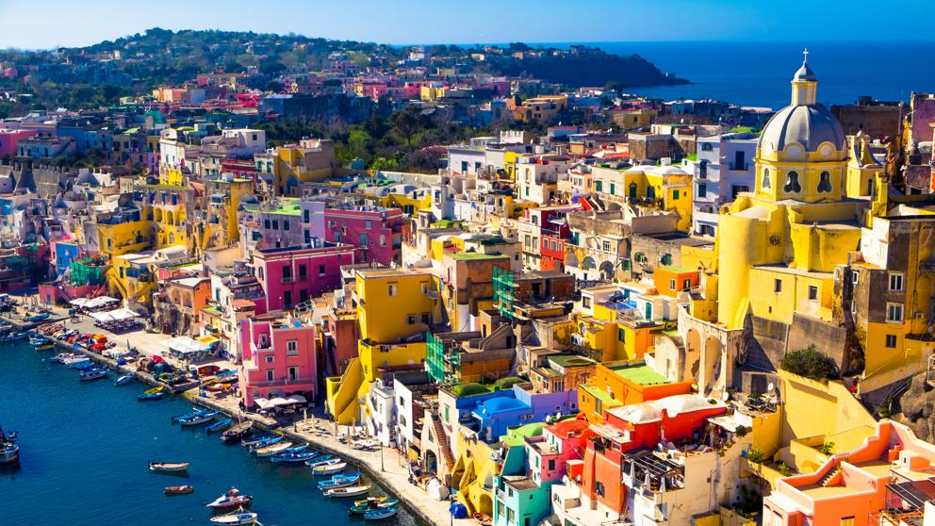
alessandra.sensi@ufmsecretariat.org
Head of Sector – Environment and Blue Economy
Secretariat of the Union for the Mediterranean
The Hashemite Kingdom of Jordan

