Slide 1
“FATTI di plastica”
from the impacts to new solutions against marine litter
Venice, 20 January 2020
Fedra Francocci
Researcher, CNR-IAS
BLUEMED CSA – Plastic Pilot

Slide 2
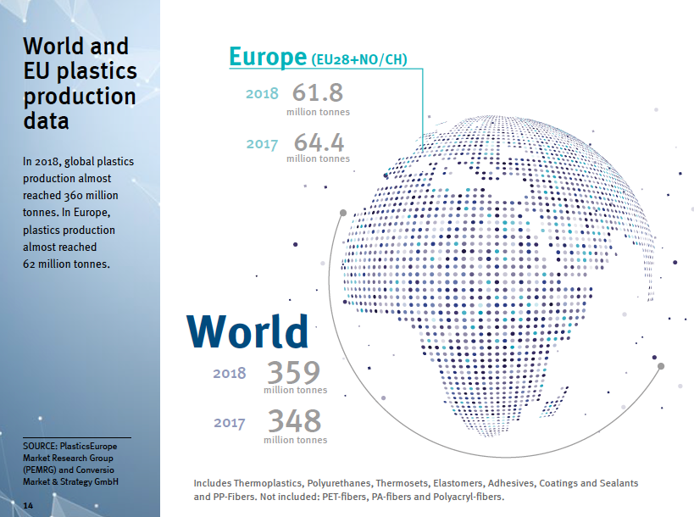
Plastic
production
Plastics – the Facts 2019; PlasticsEurope
Notes:
When we talk about plastics we refers mainly about plastic production and numbers are differents and diverse impressive.
Then we refer to use of plastic, or different application up to its waste, the end of life. We all agree that we should rethink the end of life. Then, from the source we investigate sink, effect o the environment and ultimately on humans.
This complex systems should be transfport pathways,

Slide 3
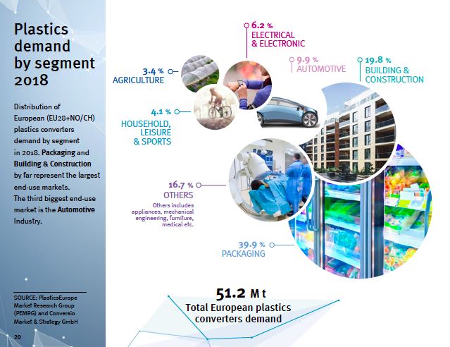
2. Plastic
production/use
Plastics – the Facts 2019; PlasticsEurope
Notes:
When we talk about plastics we refers mainly about plastic production and numbers are differents and diverse impressive.
Then we refer to use of plastic, or different application up to its waste, the end of life. We all agree that we should rethink the end of life. Then, from the source we investigate sink, effect o the environment and ultimately on humans.
This complex systems should be transfport pathways,

Slide 4
65 years of plastics: only 30% of plastic ever produced is currently in use
3. Plastic use
Global production, use, and fate of polymer resins, synthetic fibres, and additives (1950 to 2015; in million metric tons)
Geyer, Jambeck, Law Sci. Adv. 2017
Notes:
8 miliardi di tonnellate

Slide 5
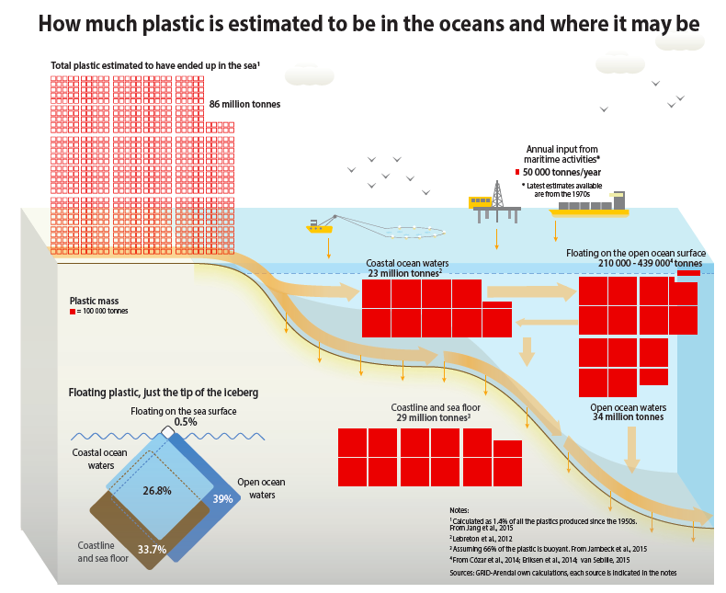
Plastic in the Oceans
4. Plastic accumulation
UNEP and GRID-Arendal, 2016. Marine Litter Vital Graphics.

Slide 6
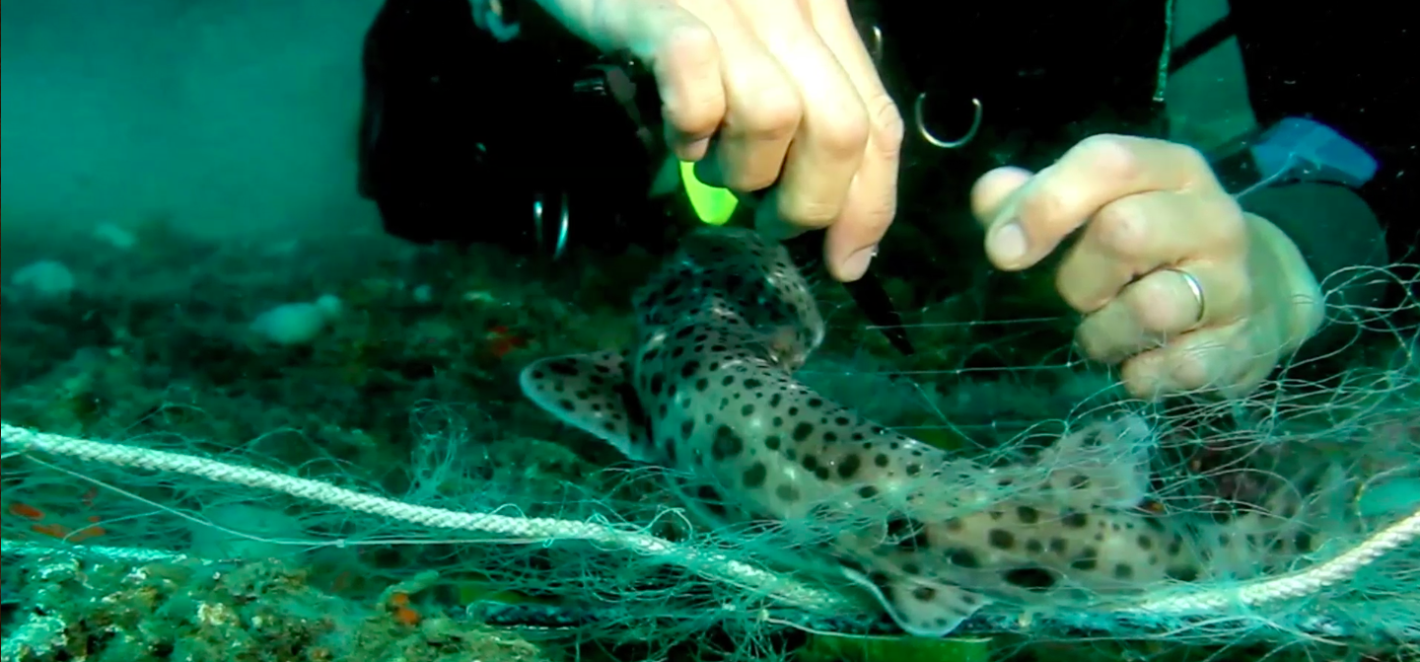
The IMPACT: Ecological Impact, Bioaccumulation, Ingestion, Entanglement, Ecotoxicology
5. Impact
Ghost fishing:
100.000 Mammals
1.000.000 Marine birds
Every year

Slide 7
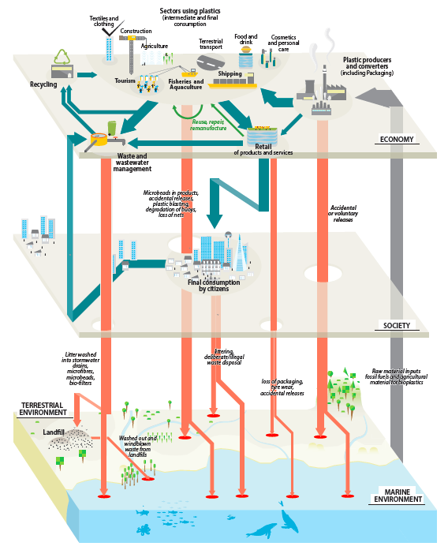
From Source to Sink
economy
Productions
Processing
Waste management
Transport
society
Consumers
etc
Landfils
Rivers
etc
environment
Notes:
Non si può intervenire su un settore al di fuori del contesto. Sono tanti descrittori delle frecce.
Ma non si tratta quindi solo di materiali e del loro utilizzo ma anche di meccanismi più complessi di gestione e di costruzione dell’economia
While further research is needed to gain a better understanding of the source, transport, fate and effects of marine litter, we know enough now to design and implement science-based measures to deal with the problem. Adaptive management and policy will be instrumental in incorporating the wealth of knowledge that is continuously being generated on marine plastic debris and microplastics.

Slide 8
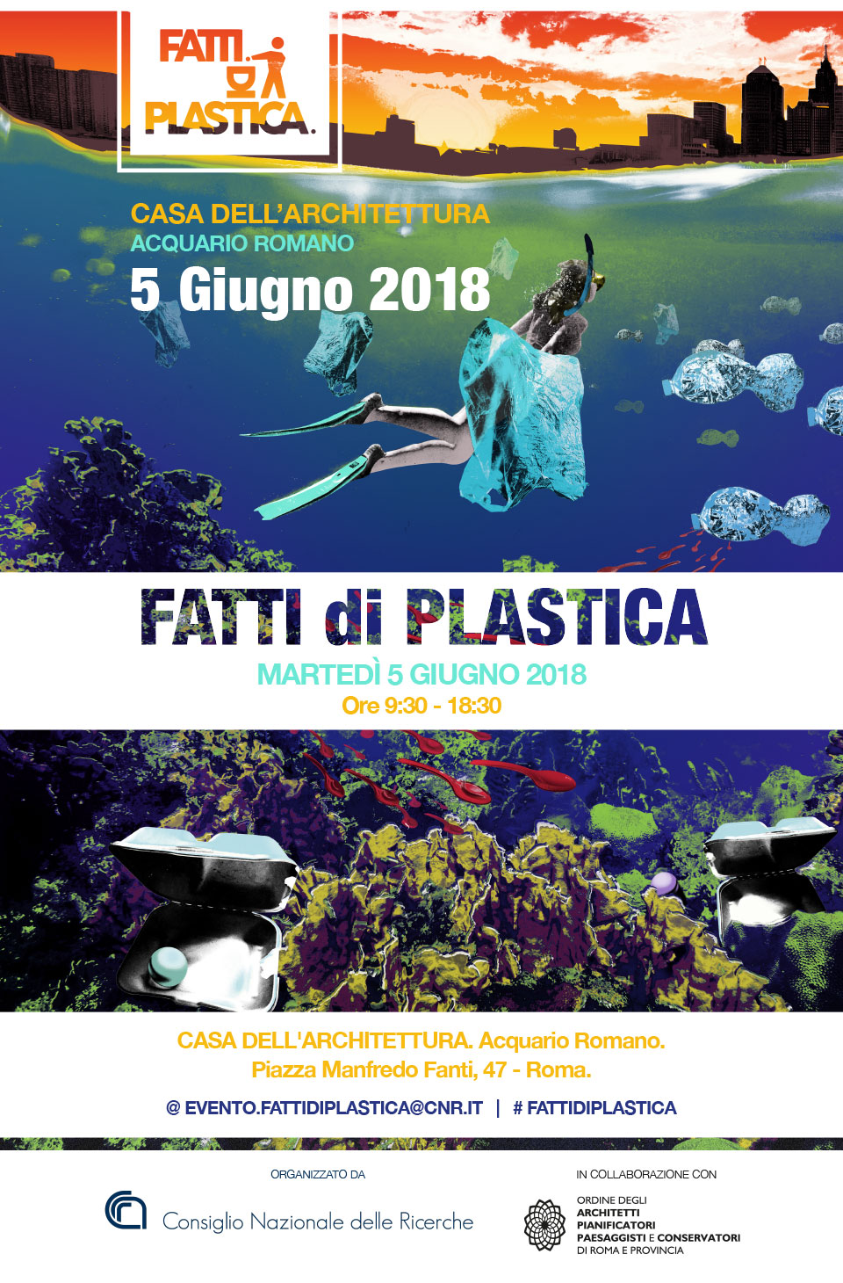
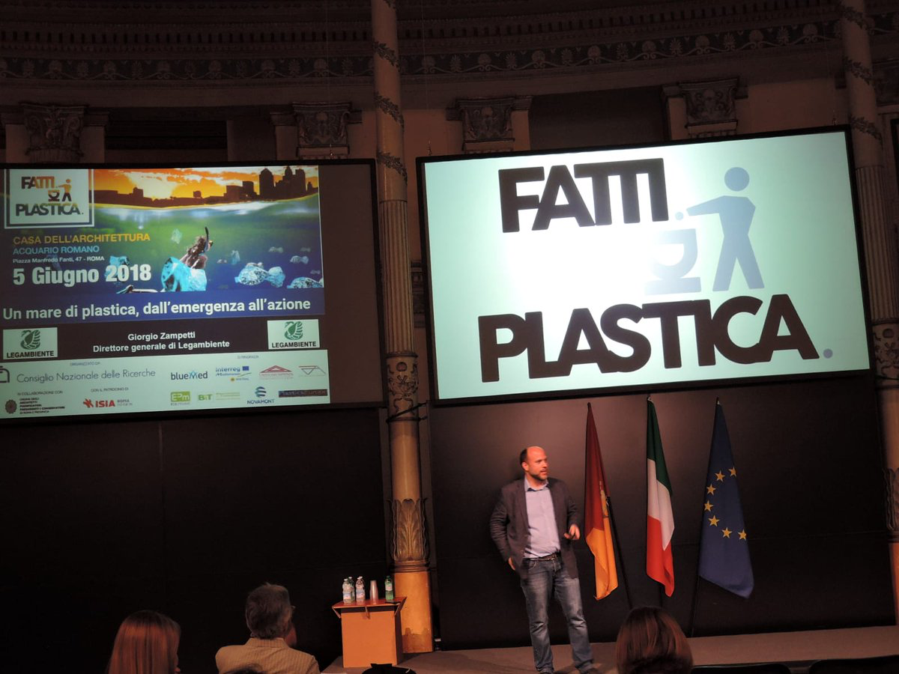
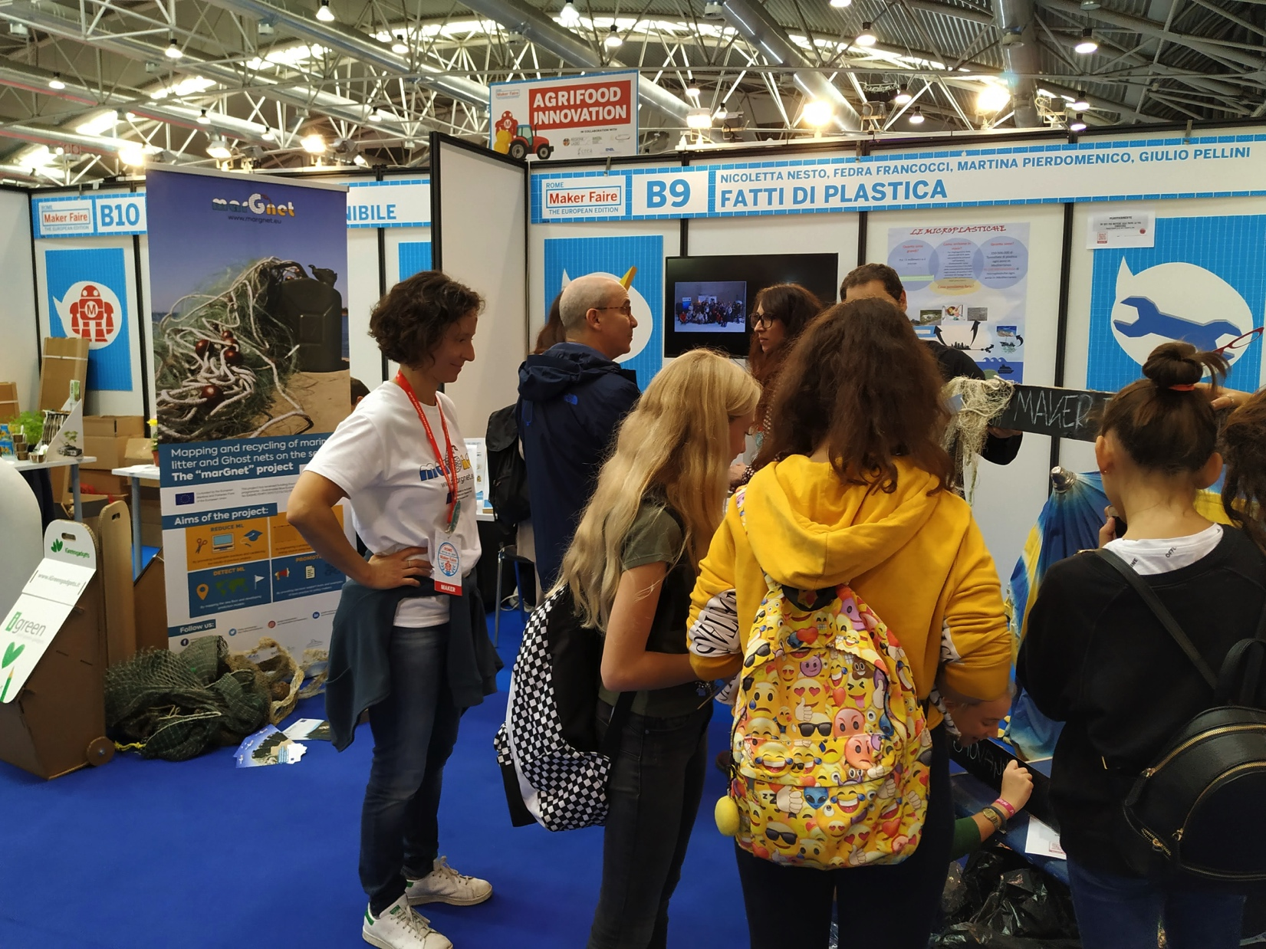
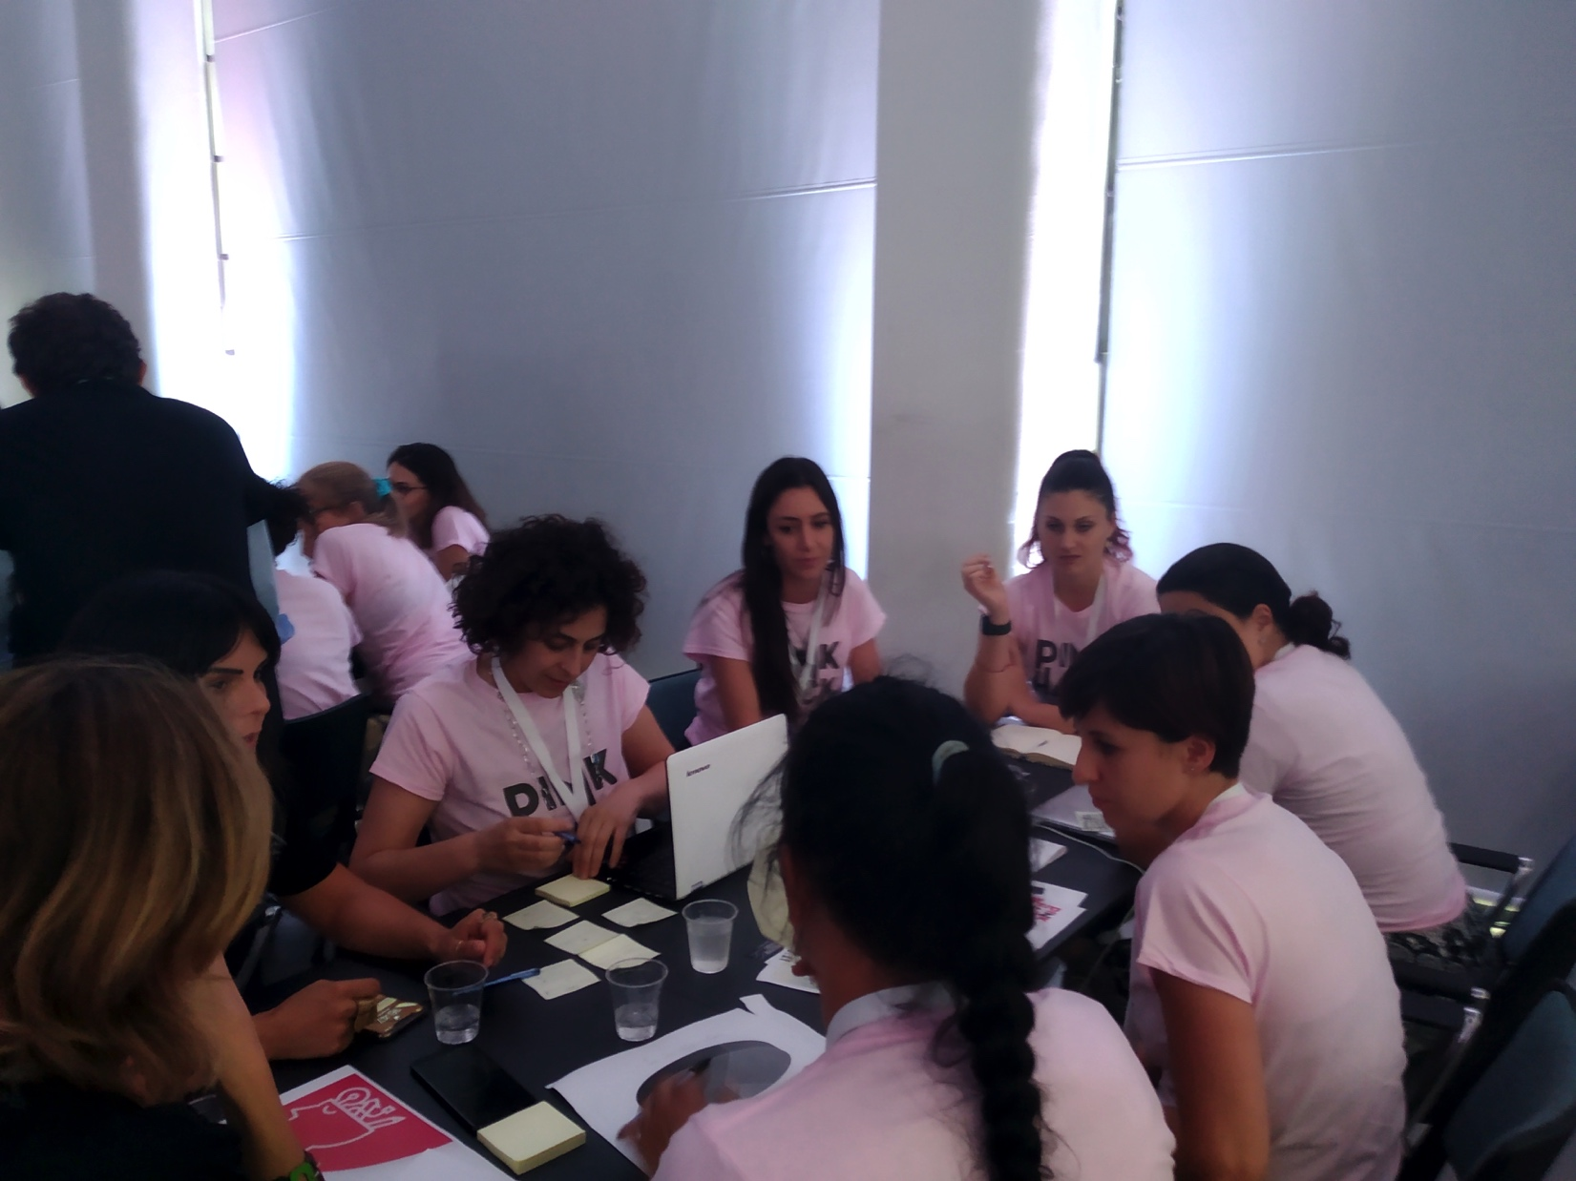
Format for Communication and Dissemination
Stakeholders
Civil Society
Education
Notes:
Problem main traits:
Economic: Plastic production and use
Consumption and use, management
Environmental effects

Slide 9
Format for Communication and Dissemination
Systemic Approach
Marine Litter Impacts
Plastic trends in the circular economy
Good practices and Governance, from policy and industrial stakeholders
Civil society and Innovation
Circular Design
Circular Bioeconomy
Rivers Contract
Notes:
Problem main traits:
Economic: Plastic production and use
Consumption and use, management
Environmental effects

Slide 10
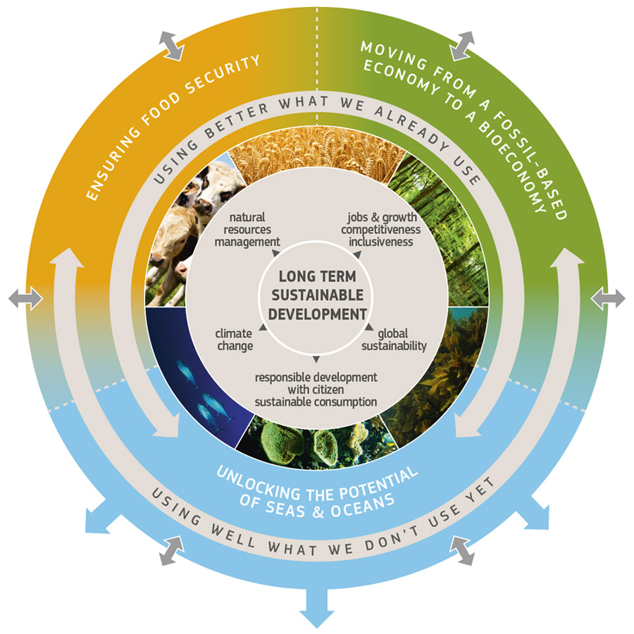
Sustainable and Circular Bioeconomy
“The bioeconomy covers all sectors and systems that rely on biological
resources (terrestrial and marine) … to produce food, feed, bio-based products,
energy and services..” (Europe’s bioeconomy Strategy, European Commission, 2018)
• Preserve nature, and restore healthy ecosystems
• Create 1 million new green jobs by 2030, in particular in rural and coastal areas
• Turn waste from farming, cities, food & forests into new added values products
• Provide additional income for farmers, foresters and fishermen
• Replace fossil material with renewable alternatives
• Increase the carbon sink capacity of soil, forest and ocean
• Develop new biodegradable products, including bio-based plastic substitutes
ec.europa.eu/research/bioeconomy

Slide 11
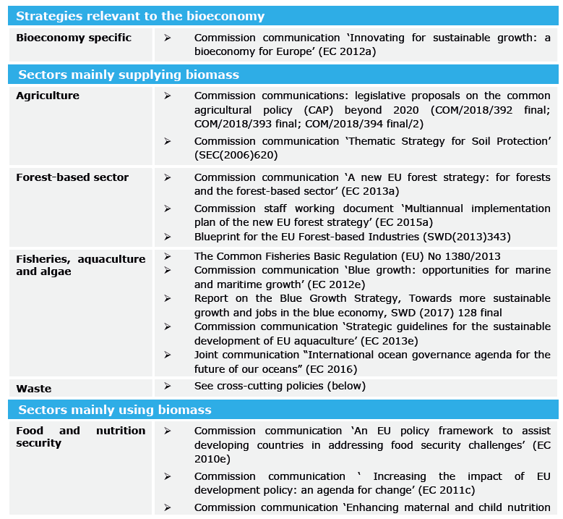
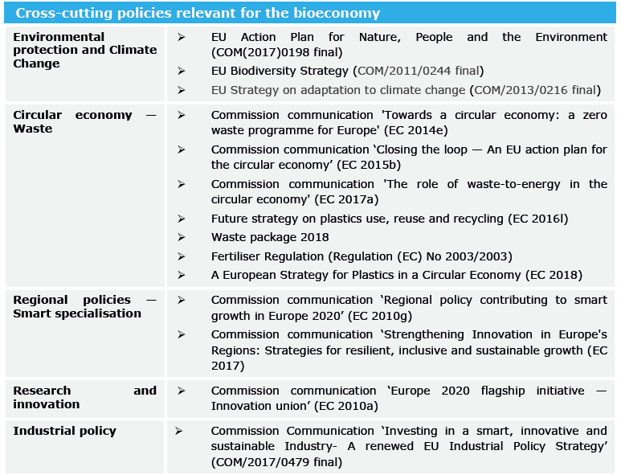
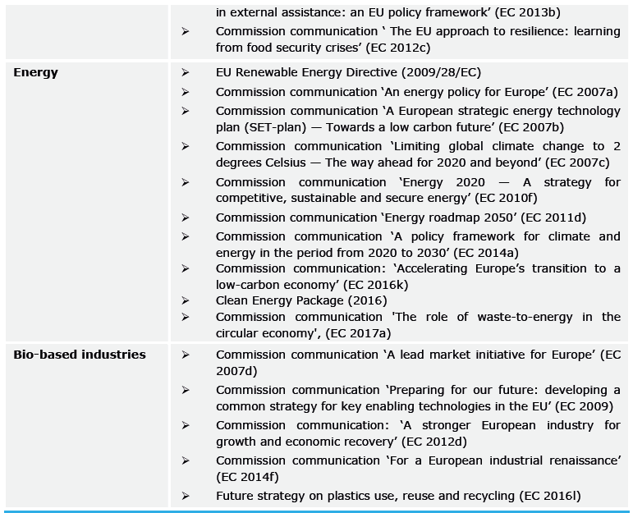
Bioeconomy: the horizontal strategy to build integrated policies
Europe’s bioeconomy
Strategy, European Commission, 2018
Notes:
the strategy refers to policy coming from multiple sectors like supply, biomass use, ecosystem protection, regional policies and smart specialization
. Bioeconomy is key for moving towards a circular, low-carbon economy in the contest of the renewed Industrial Policy Strategy (34), the Circular Economy Action Plan (35) and Accelerating Clean Energy Innovation (36). From the first release in 2012 (3) the strategy proposed a comprehensive approach to address the ecological, environmental, energy, food supply and natural resource challenges that our planet is facing. The updated European Bioeconomy Strategy (better focused the actions to accelerate the deployment of a sustainable European bioeconomy and to maximise bioeconomy impact on the 2030 Agenda its Sustainable Development Goals (SDGs), and the Paris Agreement (33). The strategy looks at circularity as an economy process that provides multiple value-creation while decoupling from the consumption of finite resources (37). Collectively, the strategy refers to policy coming from multiple sectors like supply, biomass use, ecosystem protection, regional policies and smart specialization as reported

Slide 12
From Source to Sink
Cross-sectors
economy
Productions
Processing
Waste management
Transport
Sistemic
society
Bioeconomy
Consumers
etc
Land-sea
Landfils
Rivers
etc
environment
Notes:
Non si può intervenire su un settore al di fuori del contesto. Sono tanti descrittori delle frecce.
Ma non si tratta quindi solo di materiali e del loro utilizzo ma anche di meccanismi più complessi di gestione e di costruzione dell’economia

Slide 13
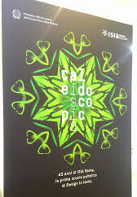

Slide 14
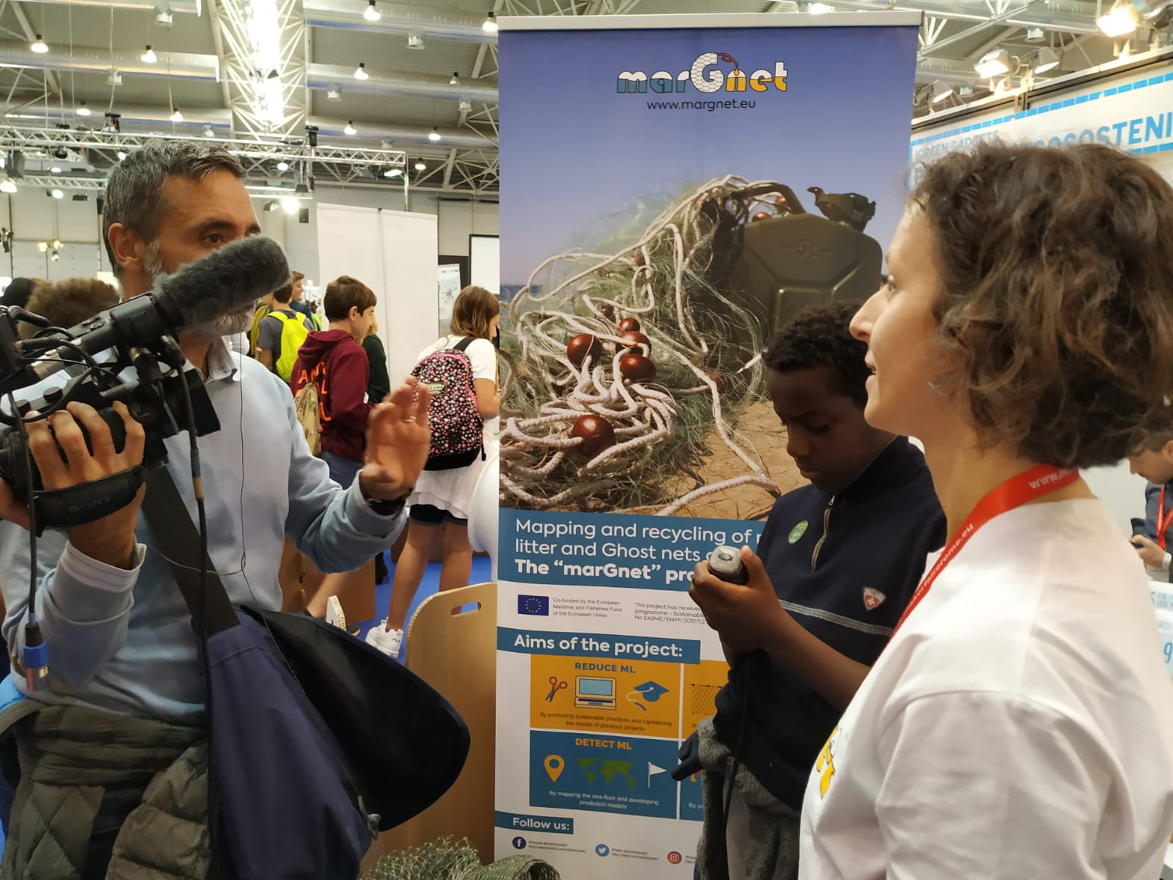
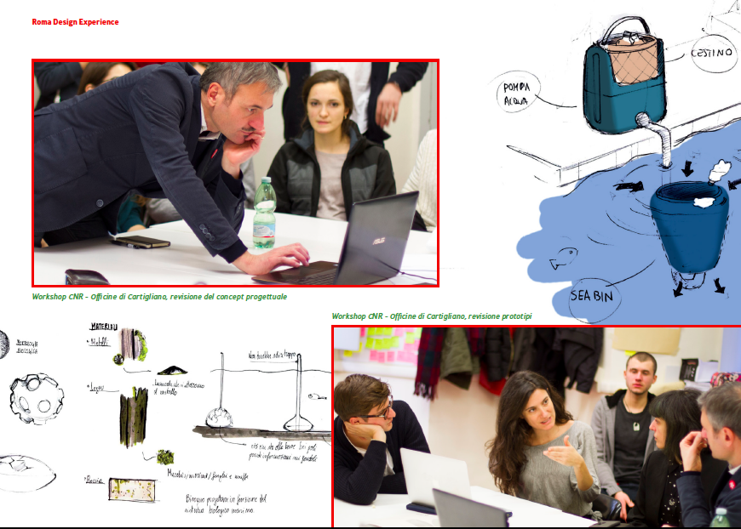
FATTI di plastica - Bioeconomy
Stakeholders engagement (3 exibition, 5 workshops)
Promote sustainable solutions through innovativation (1 business competition)
Stimulate collaborative projects and business ideas (public-private partnership)
Education
Notes:
All’anno?

Slide 15
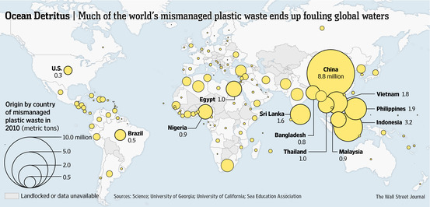
90% of plastics comes from 10 main rivers

Slide 16
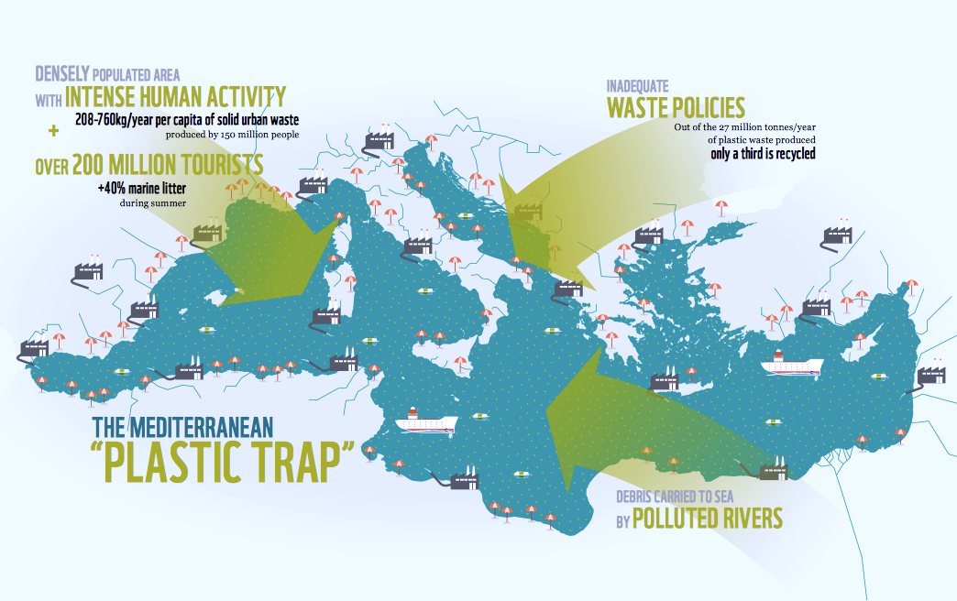
The marine litter occurrence in the MED
Notes:
the strategy refers to policy coming from multiple sectors like supply, biomass use, ecosystem protection, regional policies and smart specialization
. Bioeconomy is key for moving towards a circular, low-carbon economy in the contest of the renewed Industrial Policy Strategy (34), the Circular Economy Action Plan (35) and Accelerating Clean Energy Innovation (36). From the first release in 2012 (3) the strategy proposed a comprehensive approach to address the ecological, environmental, energy, food supply and natural resource challenges that our planet is facing. The updated European Bioeconomy Strategy (better focused the actions to accelerate the deployment of a sustainable European bioeconomy and to maximise bioeconomy impact on the 2030 Agenda its Sustainable Development Goals (SDGs), and the Paris Agreement (33). The strategy looks at circularity as an economy process that provides multiple value-creation while decoupling from the consumption of finite resources (37). Collectively, the strategy refers to policy coming from multiple sectors like supply, biomass use, ecosystem protection, regional policies and smart specialization as reported

Slide 17
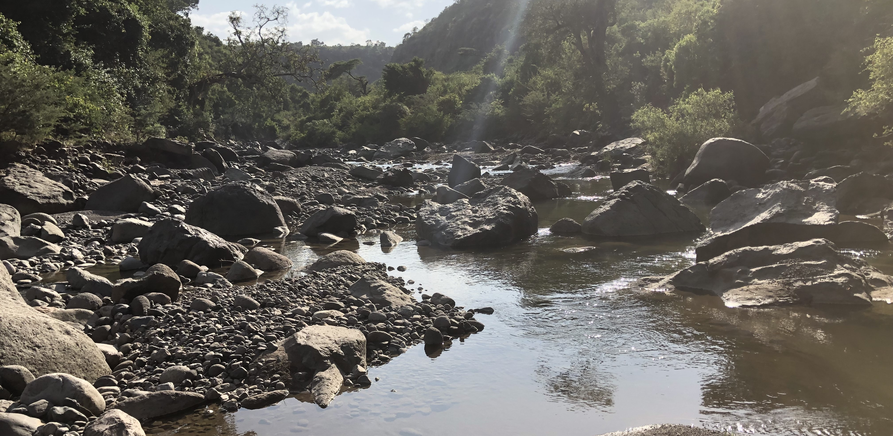
Rivers Contract
Innovative models of local governance for integrated basin / sub-basin management
RC are a form of negotiated planning that:
helps to involve social actors
improve people’s knowledge of current territorial conditions and the effects of human activities;
increase social awareness;
include society in the identification and implementation of solutions;
encourage innovative changes in planning objectives and urban and architectural design, starting with the legal and planning framework of an Action Plan.
Starting from the ‘80 s, RA were experimentally tested in Belgium and France and currently widespread also in Italy.

Slide 18
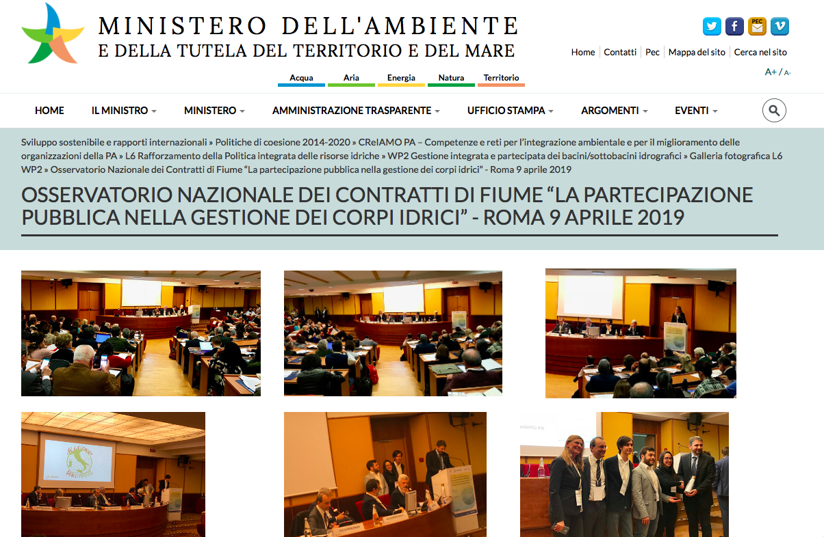

Slide 19
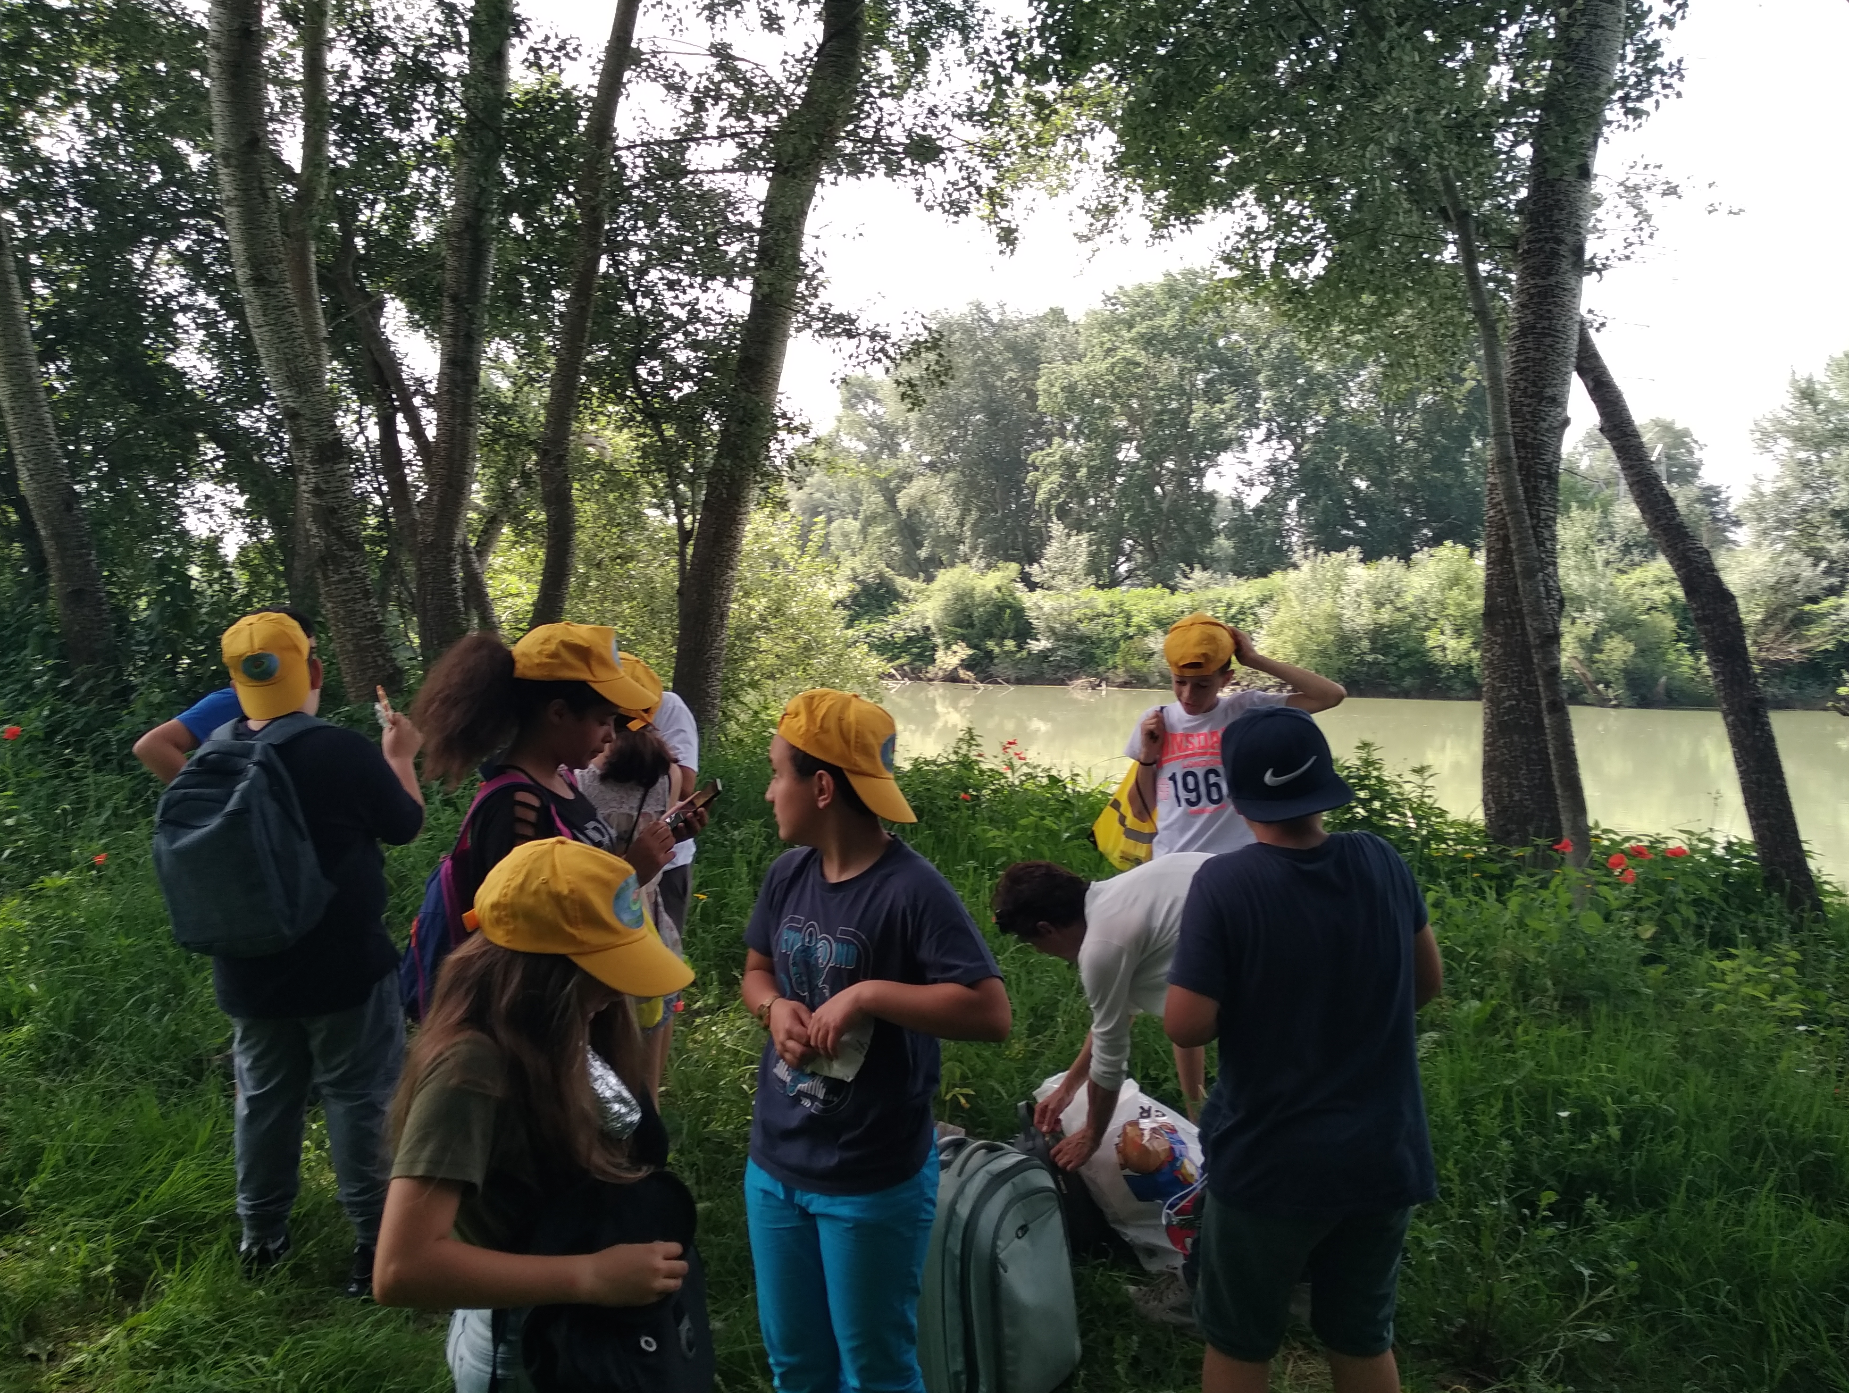
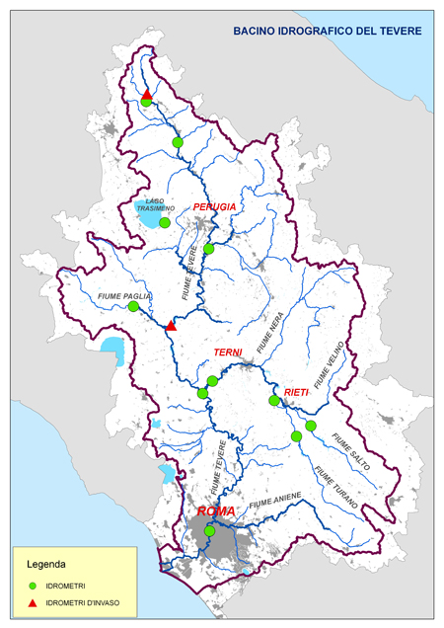
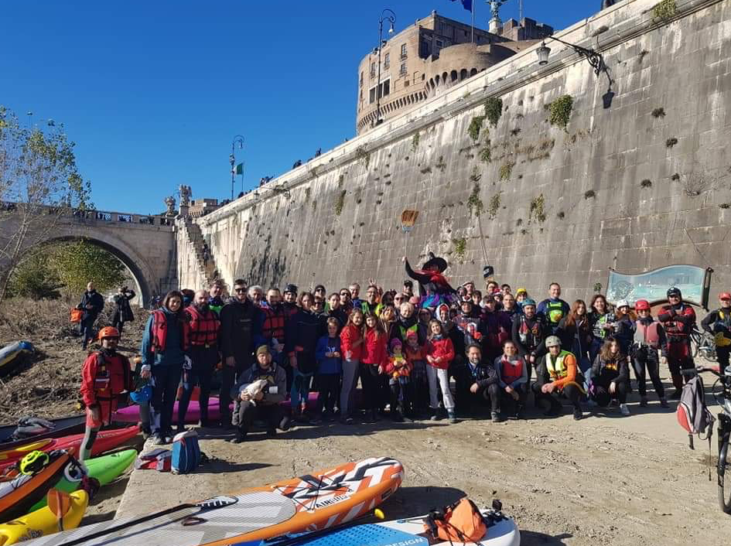
ACTIVITIES:
Education
Tiber - basin
Civil society

Slide 20
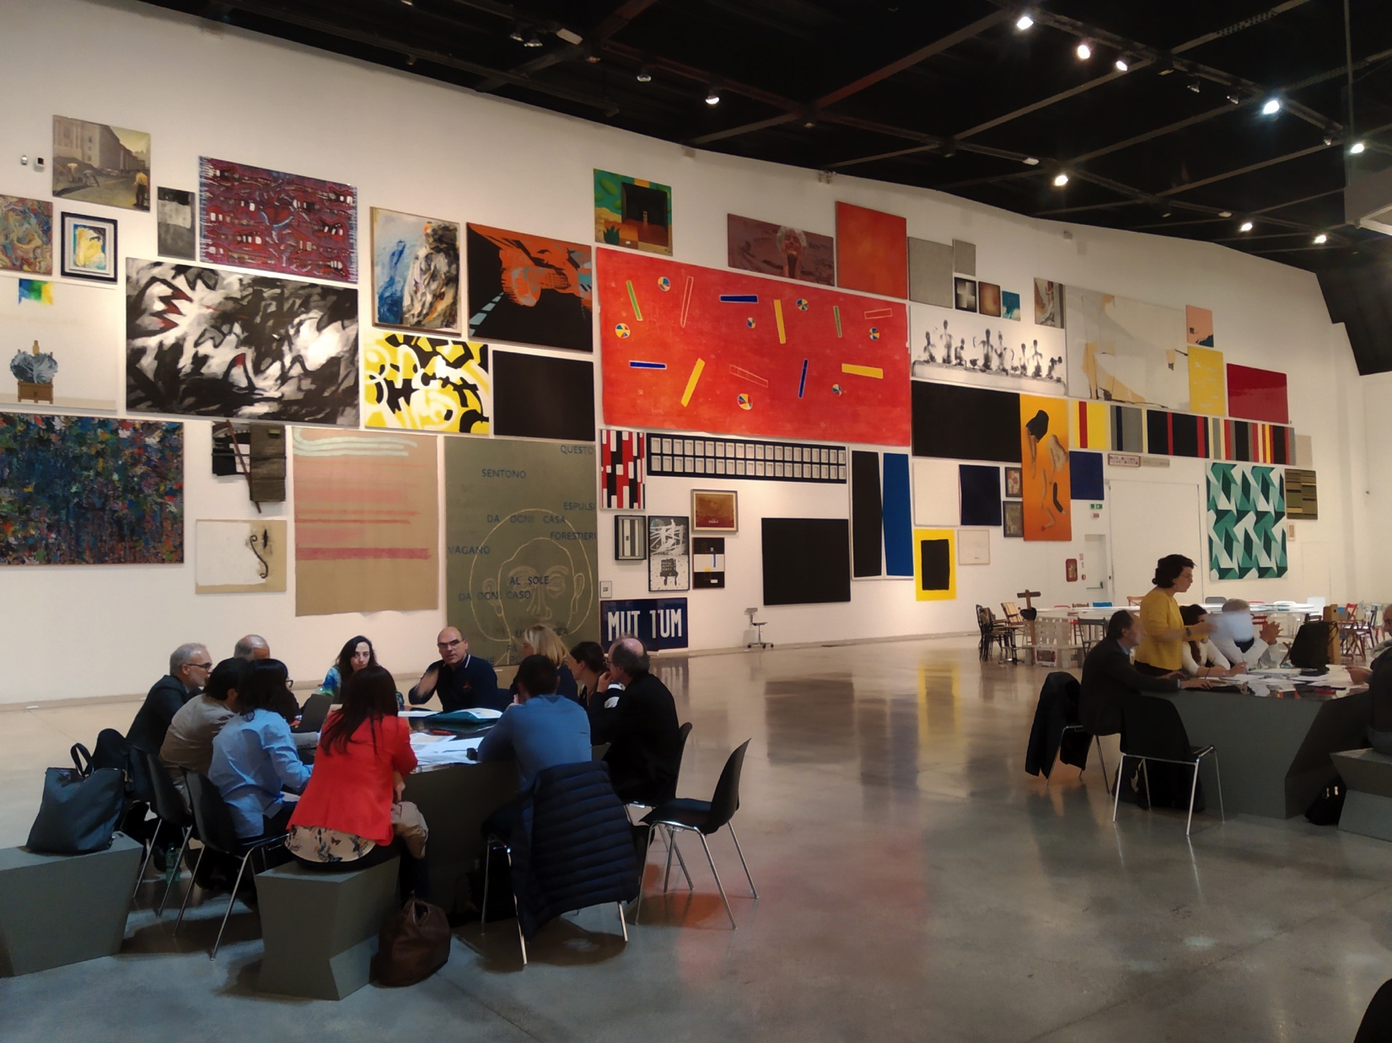
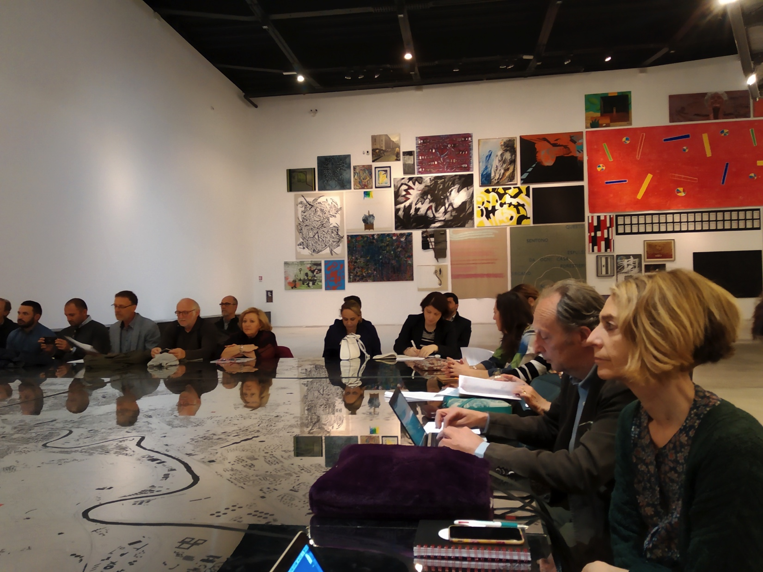
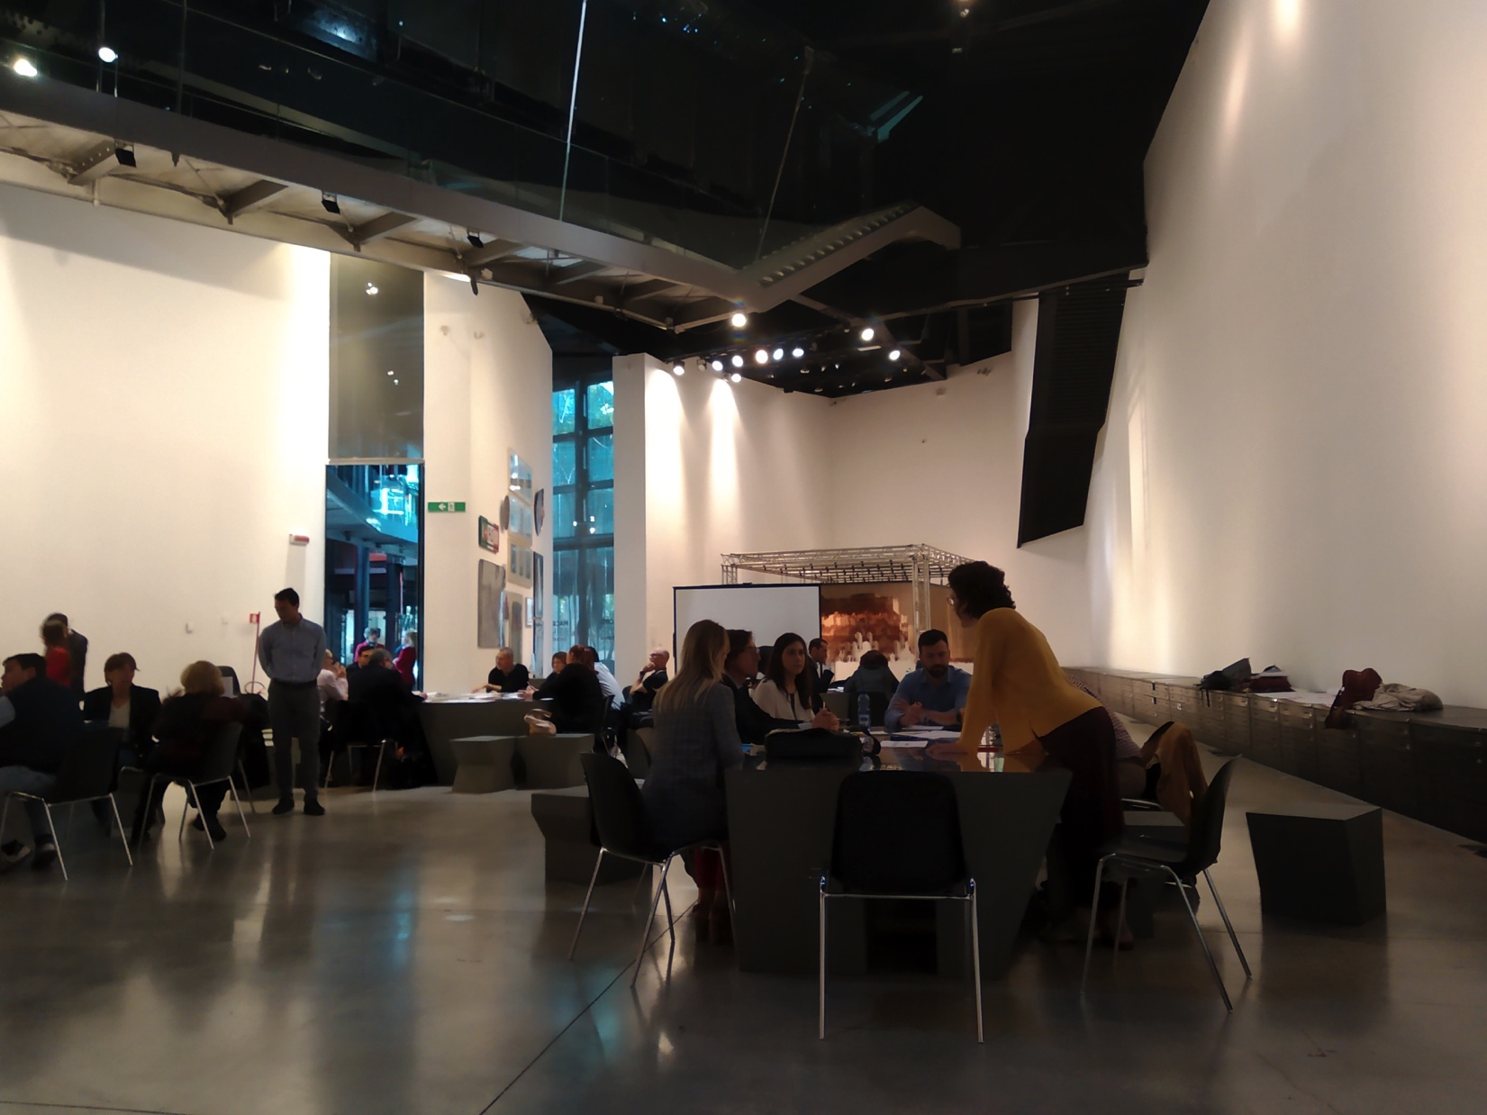
Workshop
“building the 3 years action plan for Tiber”
Participants: Municipalities/Region
Research, associations, private (?)
PLASTIC monitoring and collection
in THE ACTION PLAN with dedicated project/finding etc

Slide 21
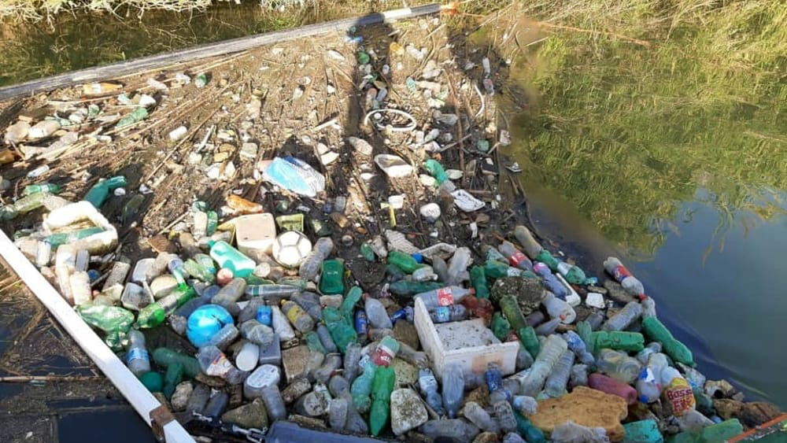
River TIBER
1 Month
500kg of litter
Regione Lazio
COREPLA
CASTALIA

